Slide 1


25+ Easy Ways to Boost Student Engagement
Presentation by:
Tammy Meyers

Slide 2
Take Control of your Learning Experience
ON24 Learning Platform:
All windows are resizable and moveable
Use the Related Content box to access slides and resources
Submit your questions using the Q&A
PGP certificates are available for download
Use the toolbar to access other features and bring back minimized tools.
Notes:
Hello and welcome to our session, 25 easy ways to boost student engagement. I am Tammy Meyers, a special education teacher from Montgomery County, Indiana. Thank you for joining me at Keep Indiana Learning.
Before we get started, a few quick notes about this ON24 platform. You can resize, move, and minimize all the windows on the screen to best suit your learning style.
When I share my screen to demonstrate a tool or resource, you may want to maximize this video window. Click the four arrows at the top of this window to go to full screen, and click the escape button on your keyboard to exit full screen. If you are watching this on a mobile device or tablet, you can pinch and zoom to increase the size.
The slides and resources mentioned in the session can be accessed in the Related Content box. If you do not see the Related Content box, you can click on the checklist icon from the toolbar. Feel free to pause the video as needed.
You can ask questions throughout the session using the Q&A tool from the toolbar. If this is an On Demand session, those questions will be sent to me via email and I will respond back to you at the email you used for registration.
If you would like to share this session with a colleague, please click the share button in the toolbar. At the end of this session you will be prompted to complete a short survey. You can also access the survey at anytime by clicking on the hand/survey icon in the toolbar.
PGPS are available after you have watched 85% of this session. Click on the certificate icon in the toolbar to download your PGPs.
Let’s get started!

Slide 3
Today’s Objective:
We will discover
__ __ __ __ __ __
ways to __ __ __ __ __ student
excitement!
Notes:
Simple / spark

Slide 4

Goals for today:
One idea you will use tomorrow.
One idea you will try next month.
One idea you will use next year.
Notes:
Simple / spark

Slide 5
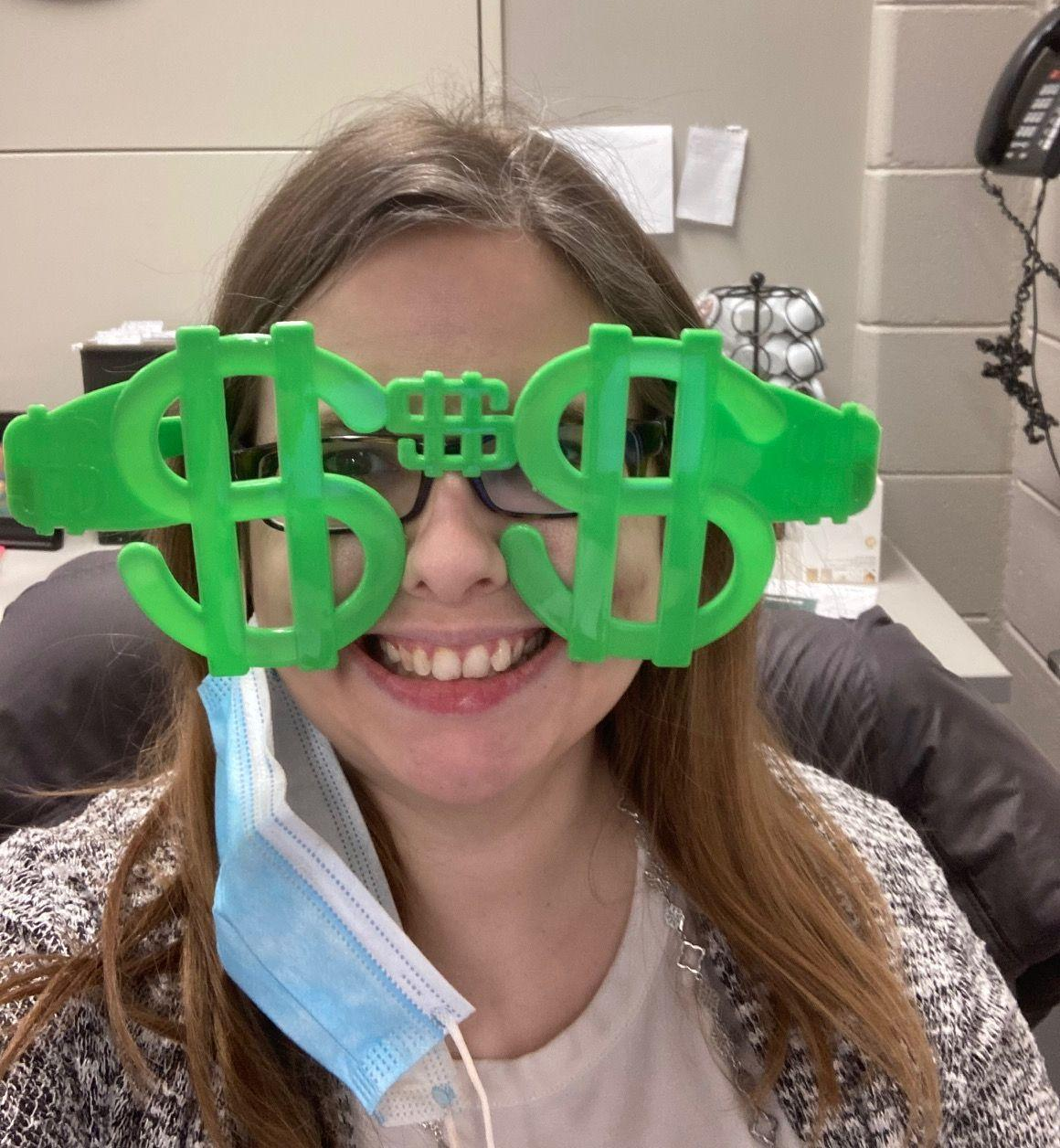
#1-3 Fun Lesson Introductions
Props: Blender, money glasses, Dude
Perfect bubble gum video, and more!
Minute Madness:
Social Studies: How many states can you list?
Math: How many prime numbers?
Reading: Words with the “br” blend, synonyms
for “said”, etc.
“Balloon Man”: to state today’s objective

Slide 6
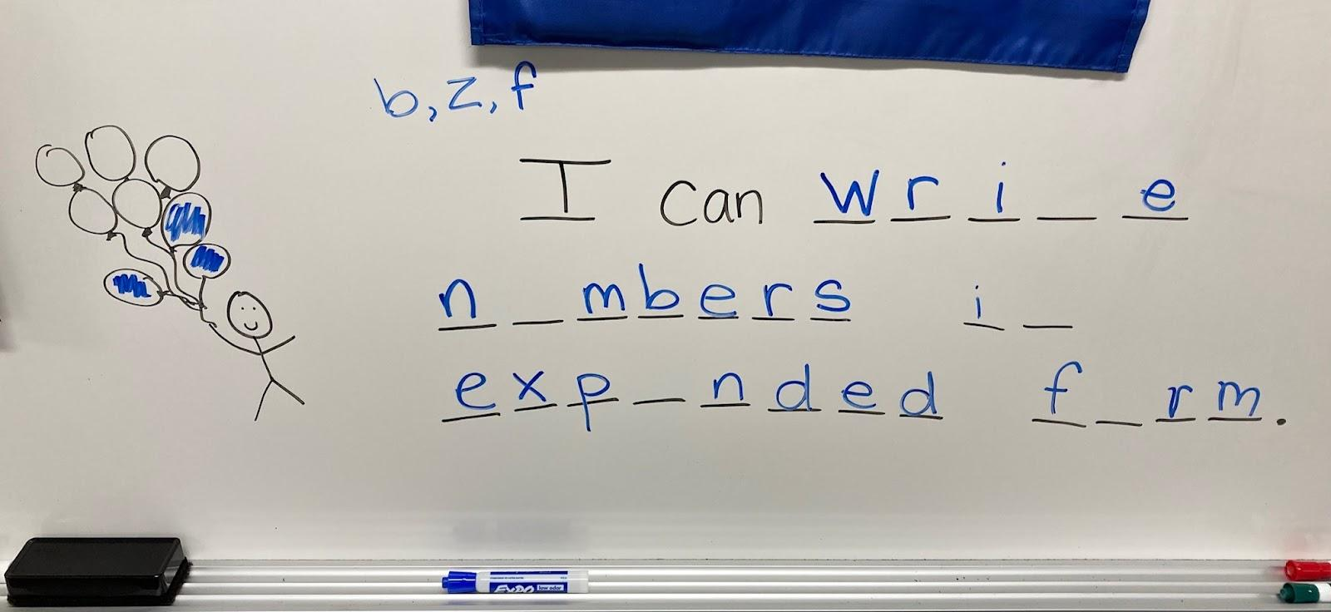

Slide 7
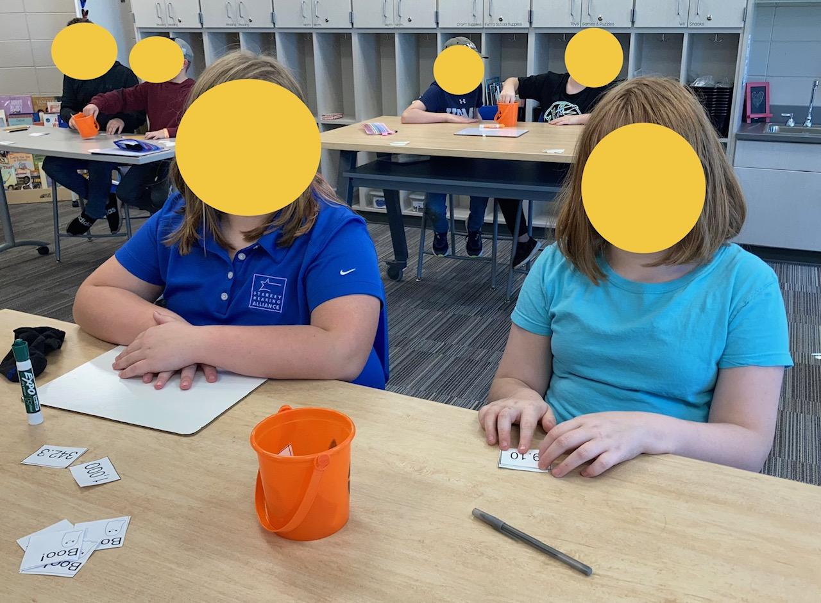

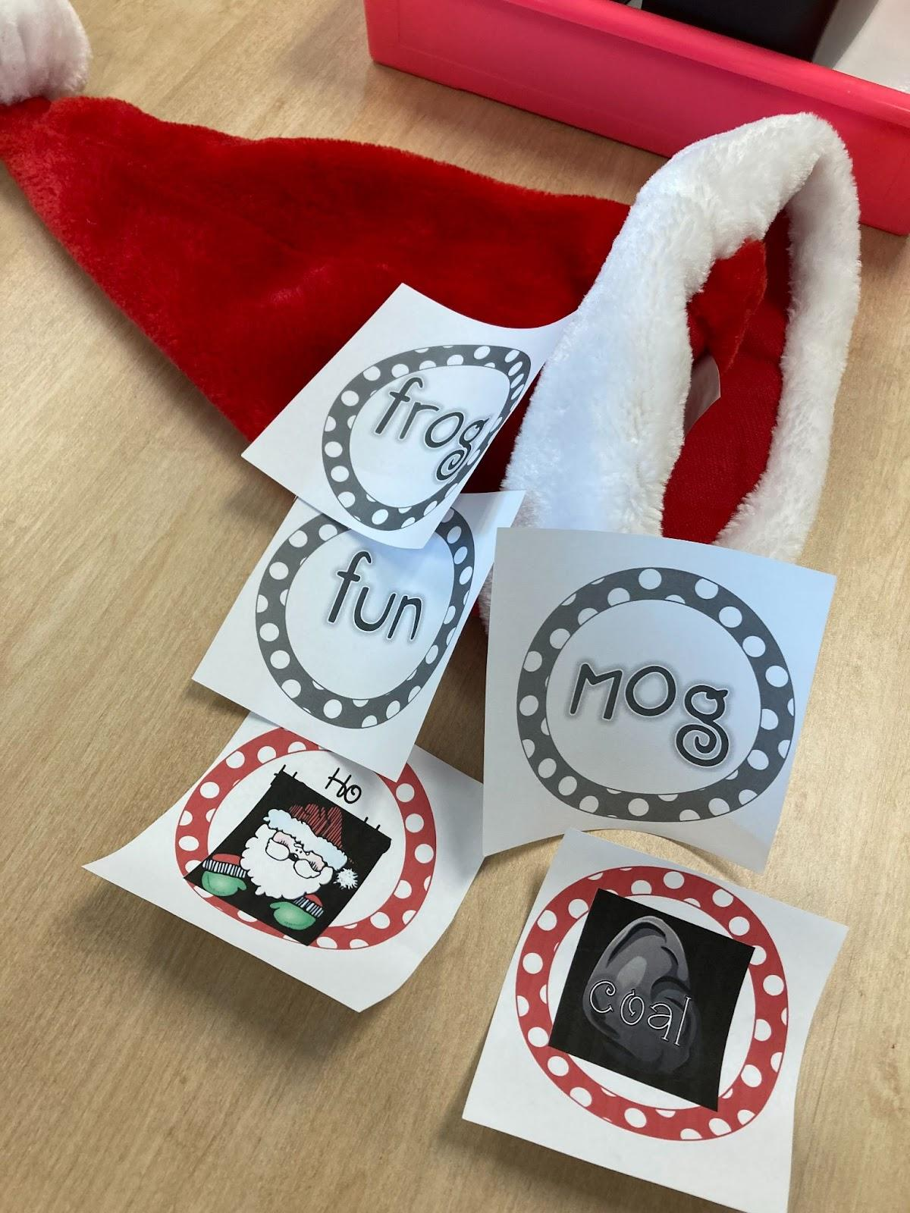
#4 Draw/Solve/Uh-Oh Games
Variations:
Sight words, states/capitals, parts of speech, foreign language, multiplication facts, spelling words, abc’s…

Slide 8
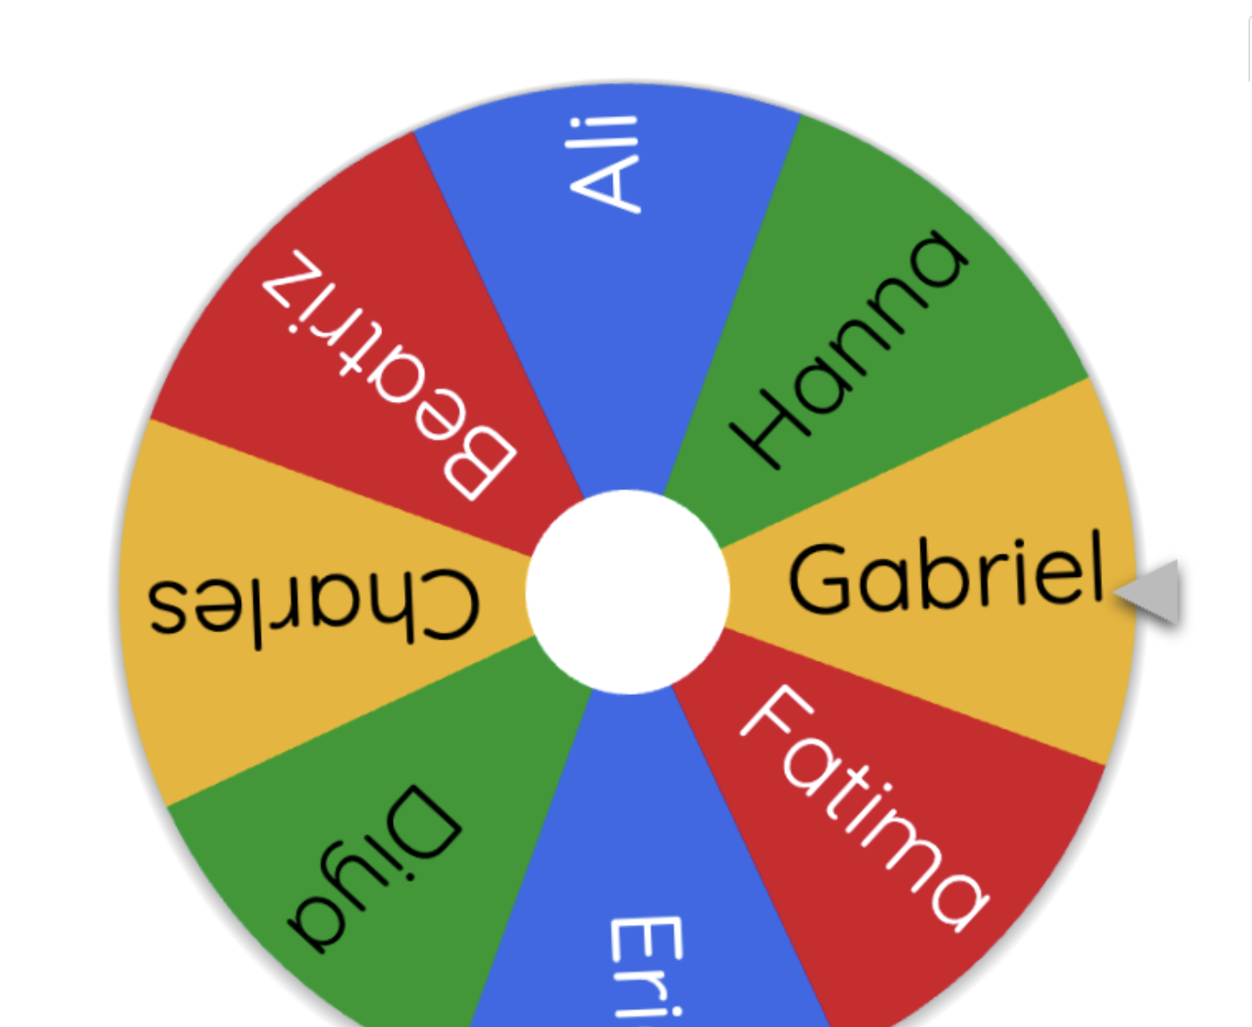
#5-9 Everyone Participates
Squat, stand, one hand
Vote at your heart (1, 2, 3, fingers)
4 Corners
Turn & Talk (w/ accountability)
Wheel of Names.com
Notes:
https://wheelofnames.com/

Slide 9
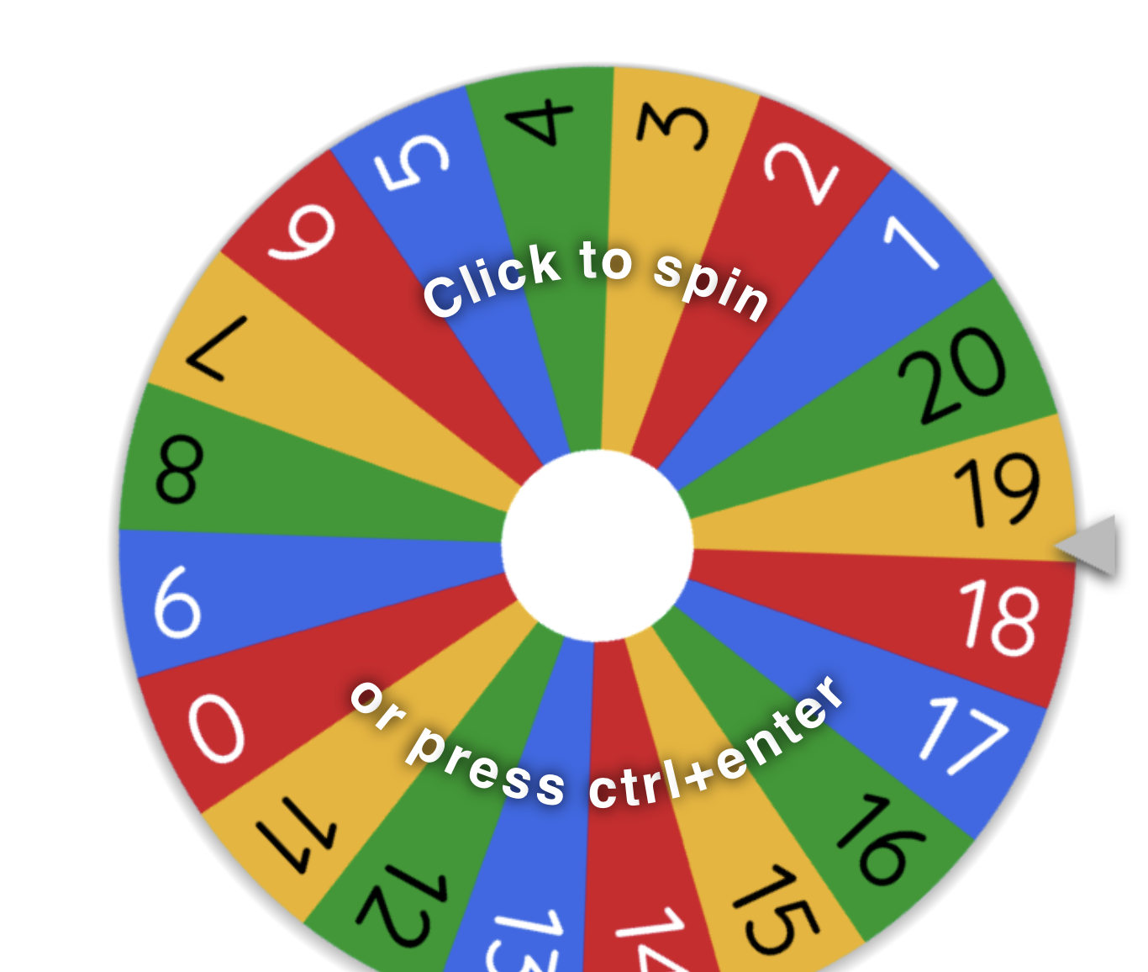
#10-12 Wheel of Names…without names
-Math problems: solve the problem you land on
4y+2=34
5x4
7+__=10
#s 1-20. Spin to choose which
worksheet number to do
Words: identify the suffix, say the
word in German, identify the part of speech

Slide 10

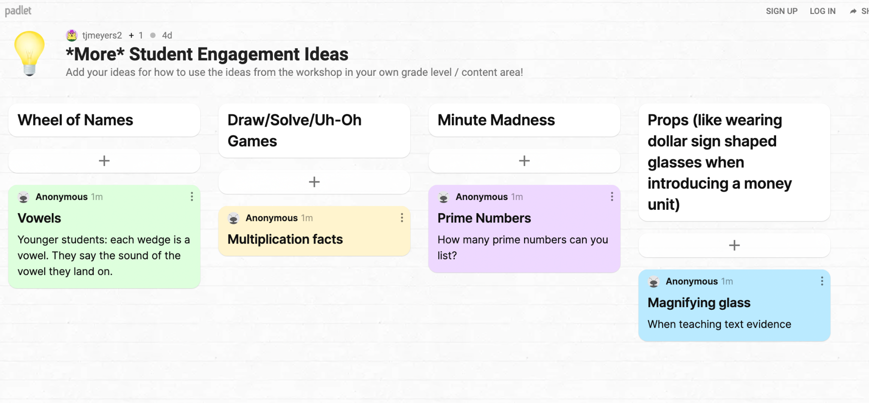
Padlet Pause!
Have you thought of additional ways to use the ideas in your grade level / content area? Add them to our padlet!
Notes:
https://padlet.com/tjmeyers2/9k528228jue9bxsa

Slide 11

#13-15 Sticky Notes
Lesson Intro: “As you come in, find
two sticky notes…” Sight words,
math problems, fact/opinion, vocabulary
words, …
Young learners: “Drive to the word ‘and’.”
“Park on the sum of 3 plus 1.”
Exit tickets!

Slide 12
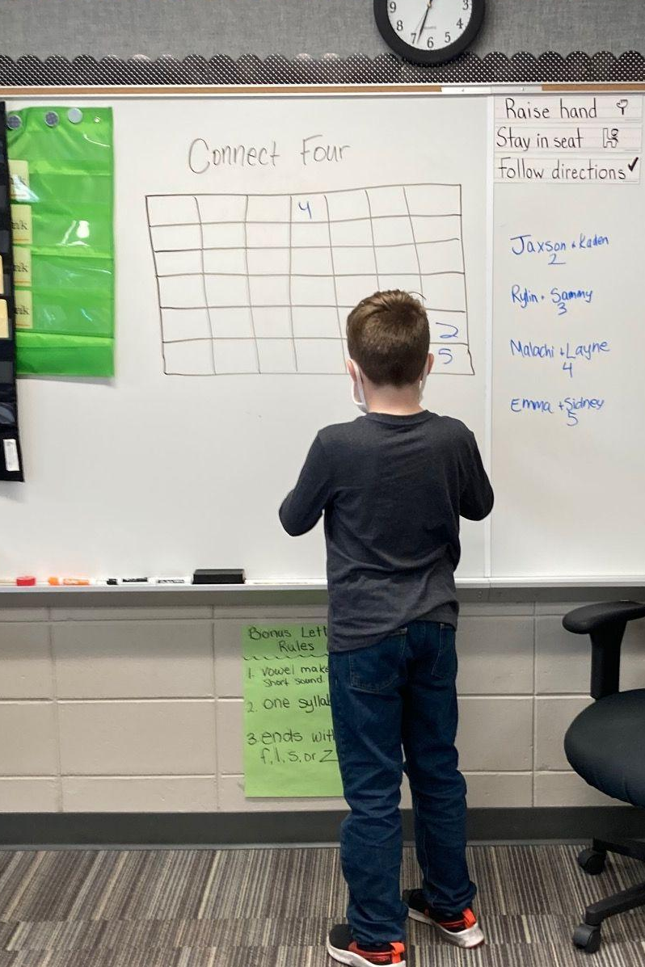
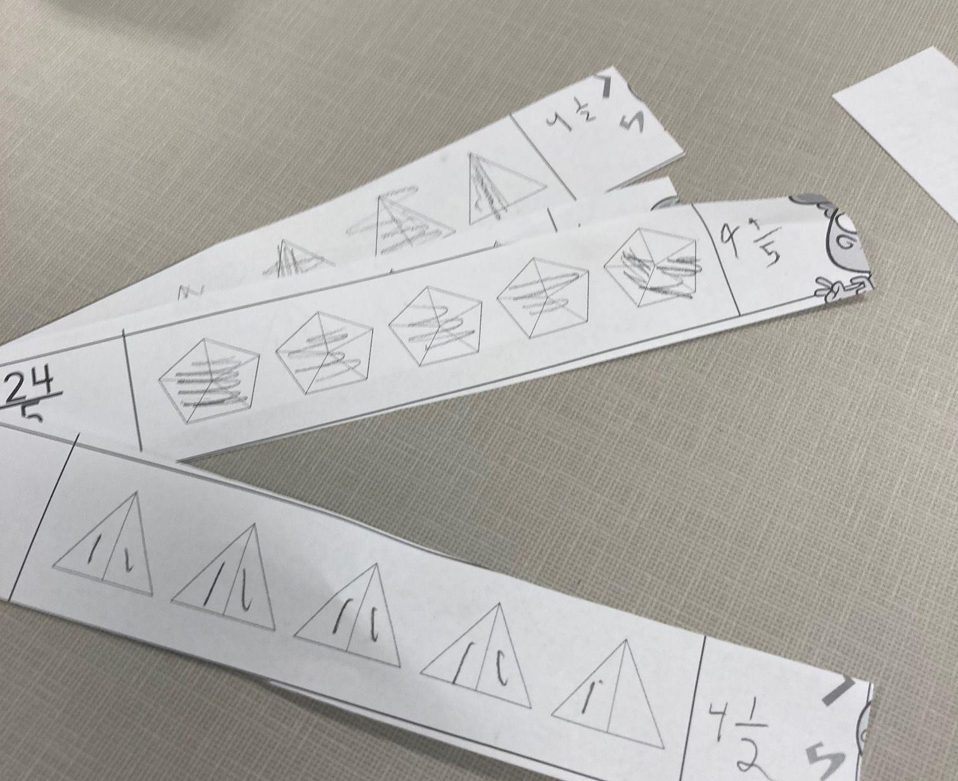
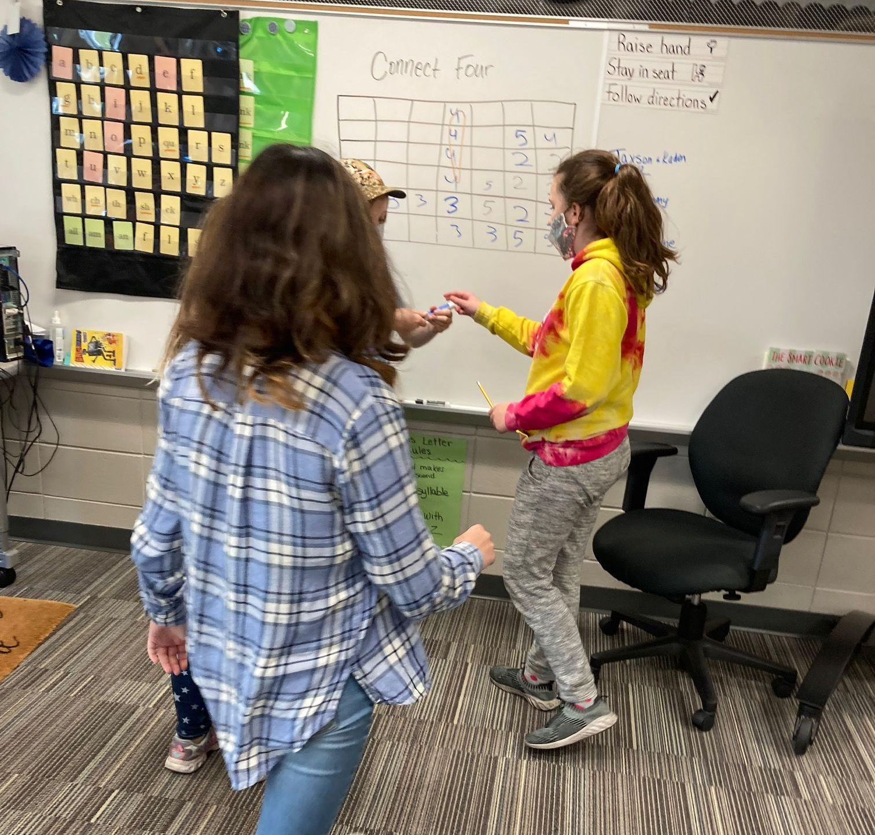
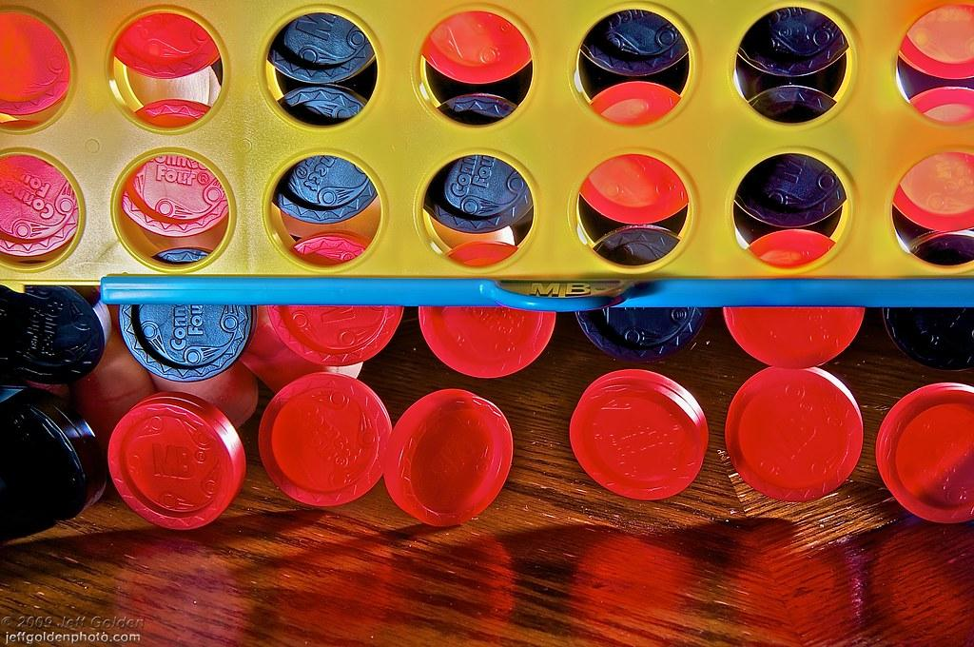
#16 Connect 4
Notes:
This was during intervention time for 5th grade working on mixed numbers and improper fractions. I cut up a worksheet. EASY, virtually no prep involved, and they were highly engaged. Way more fun than sitting with a worksheet. Yuck!

Slide 13
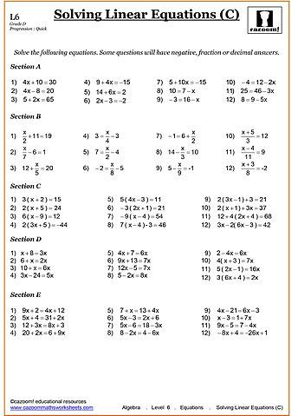

#17-20 Worksheet? Schmorksheet.
Paper Airplanes (From Katie Powell, @teachbeyondthedesk
Solve 1, scoot.
Solve 1, musical chairs, solve the next one.
½ class solves some, the other ½ solves different
problems. Mix & Mingle. Explain how you solved your
problem. Check the other person’s work. Are they correct?
Notes:
Katie’s Twitter: https://twitter.com/Beyond_the_Desk
Katie’s Website: https://www.teachbeyondthedesk.com/
Katie’s Book: https://www.amazon.com/gp/product/B07X2YYD94/ref=dbs_a_def_rwt_bibl_vppi_i0

Slide 14

#21 Trashketball
Works for a group or a 1:1 with oppositional student
Notes:
Tell how to play as a group (two teams, solve problem earns 2 pts and can shoot basket for bonus point) and how to play 1:1, my math student.

Slide 15
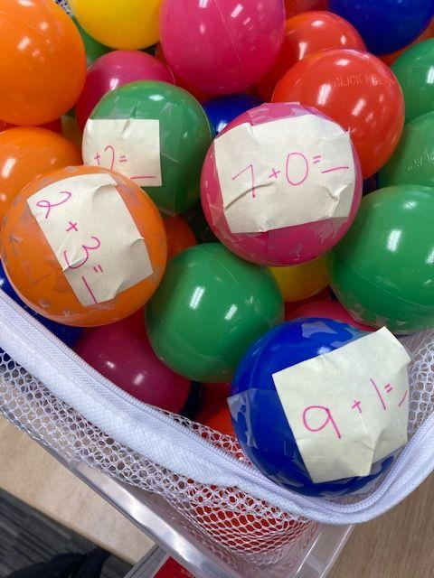
#22-29 Ball Pit Balls
Addition facts
Fractions to simplify
Presidents (put in order)
Capitals/States
Vocabulary words
Dots (1:1 counting)
Solve for x
Long division problem (grab 3 balls, do those problems)

Slide 16
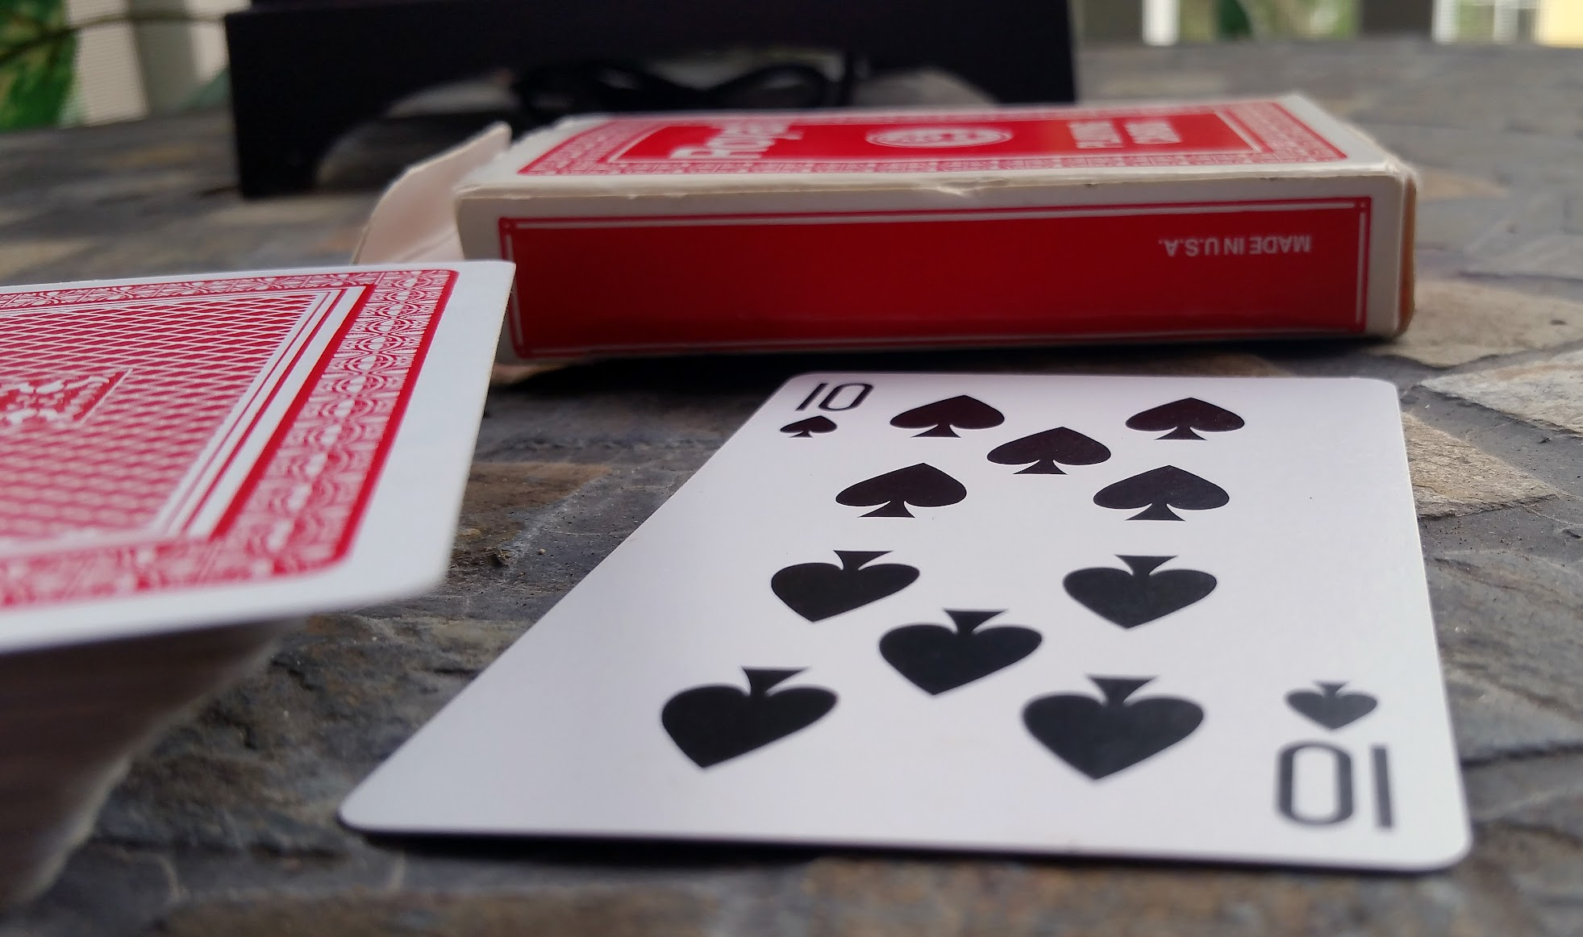
#30-36 Deck of Cards
How many more to make 10?
Add the cards together.
Compare the numbers / Top It
Make 2- or 3- digit numbers
Decimals
Fractions
Place value
Notes:
Tell how to play as a group (two teams, solve problem earns 2 pts and can shoot basket for bonus point) and how to play 1:1, my math student.

Slide 17
Tammy Meyers
@MrsMeyersSMWC
tjmeyers@gmail.com

Slide 18

Thank you for attending!
Please complete the short feedback survey on the screen.
Don’t forget to download your PGP Certificate from the webcast toolbar.
Notes:
Make this the last slide in your presentation

