Slide 1


The Road to STEM Certification: Announcing & Using Your Status
Notes:
SS is the STEM leg of KInL. SS is a STEM-centric community of practice committed to fostering the delivery of data-informed services, including high-quality professional development, resources, and support for STEM-focused districts, programs, and organizations in an endeavor to produce a combined impact greater than the sum of separate STEM efforts.
STEM Synergy is a result of numerous partnerships over the years and is the latest iteration of the Indiana STEM Ecosystem.

Slide 2
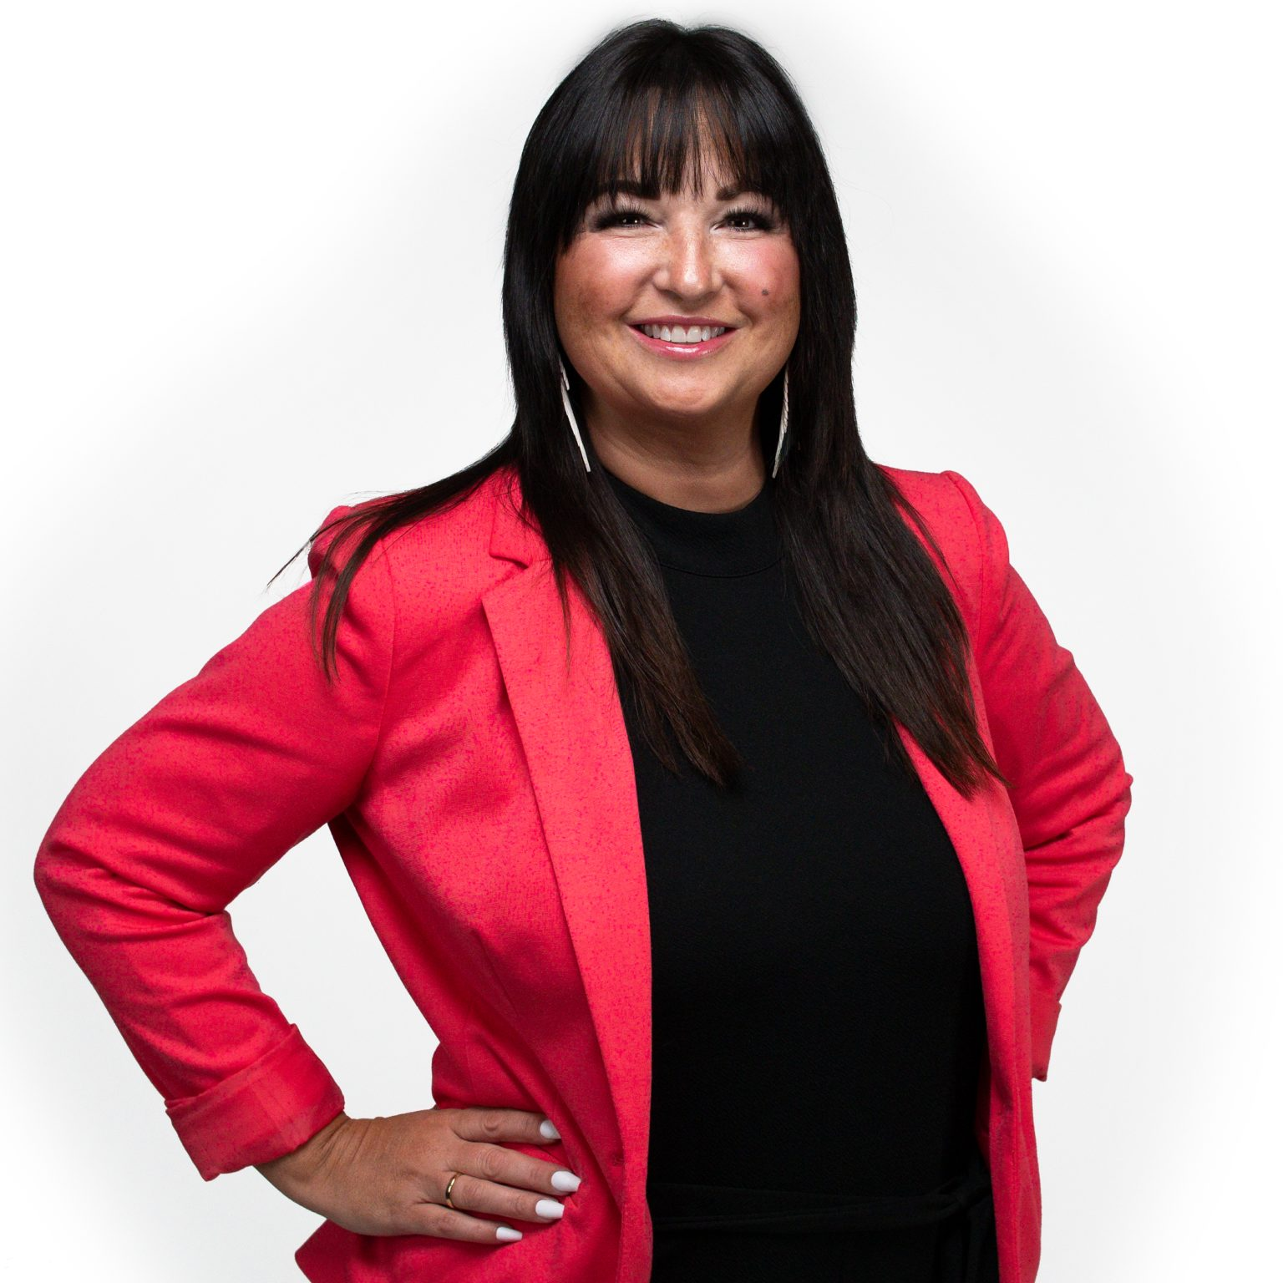
Who I Am…
17 Years in Indiana Public Education
Former Teacher, Building Administrator, CTE Director, Student Services Coordinator, and Assistant Superintendent
Former IDOE Chief of Workforce & STEM Alliance
Current KInL STEM Synergy Coordinator & Indiana STEM Ecosystem Lead
Notes:
Over a 17 yrs serving at all levels in Indiana education
Technology education and PLTW teacher, building administrator, CTE Director, Student Services Director, and Assistant Superintendent.
Two years at the State level as the Chief of Workforce & STEM Alliances.
Led the charge from the General Assembly in 2017 to develop a 6 year Statewide STEM strategic plan outlining Indiana's objectives for STEM education.
Served across the nation as an educational consultant working toward equitable, high quality STEM for all. Amanda also serves as the Indiana STEM Ecosystem Lead and STEM Synergy Coordinator for CIESC/Keep Indiana Learning.

Slide 3
Today’s Learning Outcomes
By the end of the session I will better understand …
…how to leverage our new “STEM certified school” status, and
…next steps to consider to continue to move forward in our STEM journey.
Notes:
Congratulations! You were just awarded Indiana STEM school certification status by the Indiana Department of Education! After the glow of success fades, you may be wondering, now what? How do we use our new status to our advantage? How can we leverage this accomplishment within our school community and elsewhere? This session will provide participants with ideas on ways to use their new status to impact morale, enrollment and engagement within your schools, district, community, and across the state!

Slide 4
The Series…
Your Application Questions Answered by IDOE Finalizing and Submitting Your Application - Open Help Sessions Using the Feedback to Build Your Evidence Preparing for Your Site Visit Learning from Each Other Announcing & Using Your Status Getting Buy-In Ready for Recertification 2022-23 Application Review
Notes:
As a reminder…This session is one of many within the Road to STEM Certification Series and is intended to provide “just in time” support for schools that have recently applied to the IDOE for STEM Certification but will also provide future insight for those schools looking to apply in the future. Although you can view any of the sessions in the series in any order that suits you, there is a rhyme and reason for the established order, as it aligns to the steps in the process and the timeline set by IDOE.
Your Application Questions Answered by IDOE - was recorded live October 6, 2021 & Coming in August 2022 Live
Finalizing and Submitting Your Application - Open Help Sessions - October 2021 (Coming in September 2022)
Using the Feedback to Build Your Evidence - (Live) December 14, 2021,now on demand
Preparing for Your Site Visit (On Demand) - February 2022
Learning from Each Other Showcase of schools (On Demand) - Coming in March 2022
Announcing & Using Your Status (On Demand) - Coming in May 2022
Getting Buy-In (On Demand) - Coming in May 2022
2022-23 Application Review (On Demand) - Coming in June 2022

Slide 5


CONGRATULATIONS!....Now What?
Notes:
You have gone through the daunting task of earning certification, you have gotten your banner and visit by IDOE to snap the pic….but now what? Can you use that hard work for something other than wall decor and a photo opp? YES!

Slide 6
CONGRATULATIONS!....Now What?
Announce your status in your newsletter, auto calls, & on social media
Add to your hallway & building decor
Contact your local media
Jump on a local radio station
Offer a tour & interview for a PR piece
Send your local papers a press release
Add it to the next Board agenda
Open house for families & the community
Notes:
You have gone through the daunting task of earning certification, you have gotten your banner and visit by IDOE to snap the pic….but now what? Can you use that hard work for something other than wall decor and a photo opp? YES!

Slide 7
Understanding the Relevance
Talk about it to your staff
  Ensure they know their role in the bigger picture, even if they were not engaged much in the process
Talk about it to your students
  Get them involved
Talk to your business & industry partners
  How can they support and engage

Slide 8
Opportunity for Continuous Improvement
Improve your staff morale
Increase your student engagement
Increase your equitable access
Notes:
Use this status as an opportunity to continue to improve

Slide 9
Improve Morale
Leverage your school’s new status to celebrate your educators
  Give the glory to those in the trenches!
Let them run with it! Give them the flexibility to continue down this path of STEM focused instruction.
Provide educators with PLC/team time to discuss what’s next for them in STEM

Slide 10
Increase Engagement
Families & Guardians - Host STEM nights, special STEM events, etc.
Pull your community partners into the fun
Involve students in the planning of where to go next within STEM

Slide 11
Equitable Access
Focus on expanding equitable access
  ALL students should engage in high quality integrative STEM across curricular areas
  This does not mean a “STEM” course for every student.
    Consider how your teachers are using problem and project based learning, questioning techniques, and real world problem solving.
Notes:
When you were awarded, the rubric states that (in terms of equitable access) 100 percent of elementary students should be participating in integrated STEM instruction/programming, other than just a related arts classes; Middle School and High School should have STEM elective enrollment, including AP/dual credit; and HS STEM programs should include but not be limited to AP & dual credit offerings.

Slide 12
Stretch Your Thinking
Teacher evaluation
Grand challenges
Increase your equitable access
Notes:
Use this status as an opportunity to continue to improve

Slide 13
How are you evaluating STEM?
Consider your teacher evaluation rubric
Where can you expand opportunities for teachers to feel comfortable exploring new methods?
Do not make this a taboo subject!
Notes:
Are you dinging teachers for controlled chaos in their STEM classroom?

Slide 14
Solve BIG Problems
What problems can your students solve in your local community?
  Food desert?
  Public transportation issue?
  Need a new public space for events?

Slide 15
Leveraging Your Leadership Team
What ways can your STEM leadership team LEAD in this ongoing STEM movement in your building?
Notes:
Can they…
Lead PLC’s
Lead STEM discussions
Continue to revisit the plan and progress being made

Slide 16

Retaining & Increasing Enrollment
Notes:
Let’s face it, it is a jungle out there, and schools are competing every year for enrollment numbers. It is a taboo topic that no one likes to talk about, but it is true. There are many ways you can use your new status, but one of the more controversial ways is to use it to attract MORE students and keep the ones you have coming back. There are a lot of choices for educating our children today, so flaunting this status to increase interest in what your school has to offer simply makes sense. I know it is not a popular discussion, but it is a TRUE one! This matters…..and people need to know about it….and it will increase the interest in your school!

Slide 17
Keep it Going….
Real world problem solving
Leverage your PLCs - share out all the awesome integrated STEM lessons and units they are using
Are you mirroring this in your (admin) instruction during meetings?
Progress monitoring is key!
STEM Certification is not a “one and done” event!

Slide 18
THANK YOU!!
STEM Synergy Coordinator
Keep Indiana Learning
Amanda McCammon
amccammon@ciesc.org
www.KeepIndianaLearning.org
Twitter: @AMcCammon_
Notes:
As always, feel free to reach out with questions.
Need More Individualized Support? Reach out!

