Slide 1

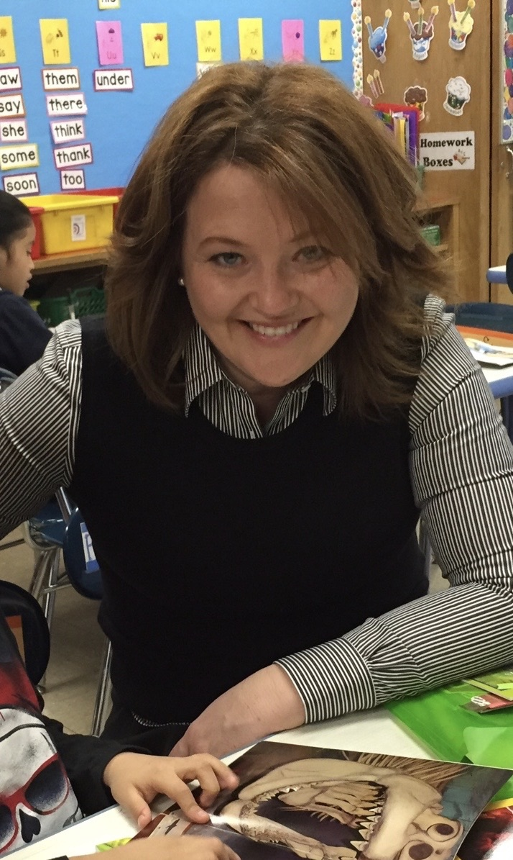
Balancing the Science & Art of Teaching Reading
Presentation by:
Celena Larkey

Slide 2
Balancing the Science and Art Of Teaching Reading
Celena Larkey
Founder, Crafted Literacy Collective LLC
craftedliteracycollective@gmail.com

Slide 3
Now Read This:
يَقْرَأُ
ler
阅读
čitati
číst
læse
Lezen
read

Slide 4
What Constitutes Reading?
A: Reading is decoding and understanding written text. Decoding requires translating the symbols of writing systems (including braille) into the spoken words they represent. Understanding is determined by the purposes for reading, the context, the nature of the text, and the readers’ strategies and knowledge.
B: Reading is decoding and understanding text for particular reader purposes. Readers decode written text by translating text to speech, and translating directly to meaning. To understand written text, readers engage in constructive processes to make text meaningful, which is the end goal or product.
C: Reading is the process of deriving meaning from text. For the majority of readers, this process involves decoding written text. Some individuals require adaptations such as braille or auditorization to support the decoding process. Understanding text is determined by the purposes for reading, the context, the nature of the text, and the readers’ strategies and knowledge.
Cline, F., Johnstone, C., & King, T. (2006). Focus group reactions to three definitions of reading (as originally developed in support of NARAP goal 1). Minneapolis, MN: National Accessible Reading Assessment Projects. Available on the World Wide Web at www.narap.info.

Slide 5
Four Approaches of Teaching Reading...
Phonics
Whole-word approach
Language Experience
Context Support

Slide 6
There is One Right Way? Is there One Right Way?
There is a system to how written English (and other) language is both decoded and encoded.
The science behind the learning of this system is largely unchanged since the inception of written language.
The art humans bring to this learning has shifted and changed over time.

Slide 7
The Science of Reading
Letters and sounds: Letter-sound knowledge is essential for both phonic decoding and sight-word learning.
Phonic decoding: Early phonological awareness skills enable the development of letter-sound knowledge and should be targeted for direct instruction through first grade. Advanced phonological awareness skills should continue to be assessed and practiced through third grade to ensure that a solid orthographic lexicon is established.
Orthographic mapping: Understanding orthographic mapping allows for teachers to support students who struggle to read. Orthographic mapping is the process that occurs when unfamiliar words become automatic sight words. The research on orthographic mapping explains how students develop this vast sight word bank for accurate and automatic word retrieval and also why students with reading problems struggle to develop this skill.

Slide 8
The Art of Teaching Reading
Whole Language Practices
Components of Literacy Instruction
Conditions of Learning

Slide 9
Finding Balance, Choosing Balance
Methods work best when employed by informed teacher decision makers
Children are at the center of our instructional practices - Systems and methods deserve to be studied so they can be arranged and taught by informed professionals – that means us.
Teaching children to read and growing readers are not opposite aims

Slide 10
Celena Larkey
Crafted Literacy Collective LLC

Slide 11

Thank you for attending!
Please complete the short feedback survey on the screen.
Don’t forget to download your PGP Certificate from the webcast toolbar.
Notes:
Make this the last slide in your presentation

