Slide 1


Comfort in Curriculum for Home-based Providers
Presentation by:
Angielena Williams

Slide 2
Hello and welcome to our session, Comfort in Curriculum Choices for Early Childhood Home-based Providers. I am Angielena Williams, Senior Project Manager of Early Care and Learning, with the OECOSL. Thank you for joining me/us at Keep Indiana Learning.
Before we get started, a few quick notes about this ON24 platform. You can resize, move, and minimize all the windows on the screen to best suit your learning style.
When I share my screen to demonstrate a tool or resource, you may want to maximize this video window. Click the four arrows at the top of this window to go to full screen, and click the escape button on your keyboard to exit full screen. If you are watching this on a mobile device or tablet, you can pinch and zoom to increase the size.
The slides and resources mentioned in the session can be accessed in the Related Content box. If you do not see the Related Content box, you can click on the checklist icon from the toolbar. Feel free to pause the video as needed.
You can ask questions throughout the session using the Q&A tool from the toolbar. If this is an On Demand session, those questions will be sent to me via email and I will respond back to you at the email you used for registration.
If you would like to share this session with a colleague, please click the share button in the toolbar. At the end of this session you will be prompted to complete a short survey. You can also access the survey at anytime by clicking on the hand/survey icon in the toolbar.
PGPS are available after you have watched 85% of this session. Click on the certificate icon in the toolbar to download your PGPs.
Let’s get started!

Slide 3
Objectives and Core Knowledge Competencies (CKC’s)
-Discuss what an early childhood home-based provider is
-Share the benefits of using a curriculum
-Identify a few curriculum models and learning theories
-Review a checklist for developing your own curriculum
CKC’s
1.1-The theories and concepts of infant/child/youth growth and development
4.1-How to use knowledge of content, concepts, and learning trajectories to design the curriculum and learning environments
6.2-How to build enriched learning environments based on the latest research on child development and expected learning trajectories
https://www.in.gov/fssa/carefinder/files/2016_INCKC-upd.pdf

Slide 4
Types of
Child Care Programs
Family Child Care Homes A.K.A. Early Childhood Home-based Providers
Care takes place in the Caregiver’s home
Must be licensed if caring for more than five (5) unrelated children
Mostly multi-aged
Class I or Class II
-Early Head Start/Head Start
-Child Care Centers
-Child Care Ministries
-Family Child Care Homes
*This list is not all inclusive

Slide 5

What is Early Childhood Curriculum?
“Simply stated, curriculum it is what you want children to learn and what you plan to teach. Curriculum should be based on what is known about child development and learning for any given age range. Developmentally Appropriate Practice (DAP) means “teaching children where they are (developmentally), as individuals and as a group, and helping each child reach challenging but achievable goals …” (Copple & Bredekamp, 2009) . Your curriculum guides you in determining these achievable goals; what knowledge, skills, and dispositions (attitudes) you want children to learn and develop. It is recommended that good curriculum be a written document that is used in planning experiences for children.”
*see reference slide

Slide 6

Developmental Research and Curriculum
Creating your teaching philosophy and developing your approach to learning should begin with knowing and understanding current developmental research:
-How to design your learning environments
-How you will provide opportunities for engagement
-How you will promote adult and peer interactions
-How you will plan for learning

Slide 7


This Photo by Unknown Author is licensed under CC BY-SA

Slide 8

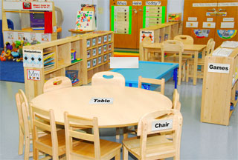

Where is curriculum delivered?
Curriculum is delivered anywhere children are engaged in learning and developing! ☺

Slide 9
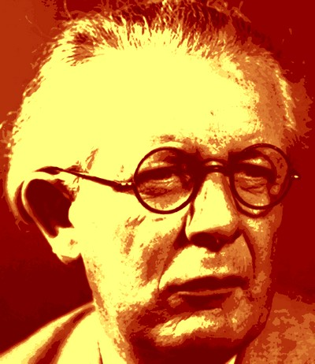

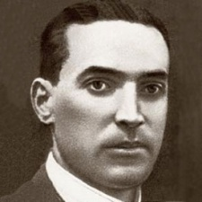
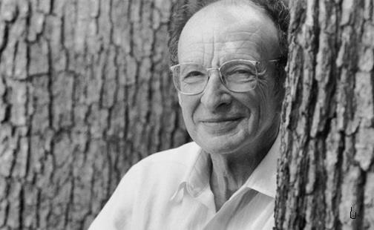
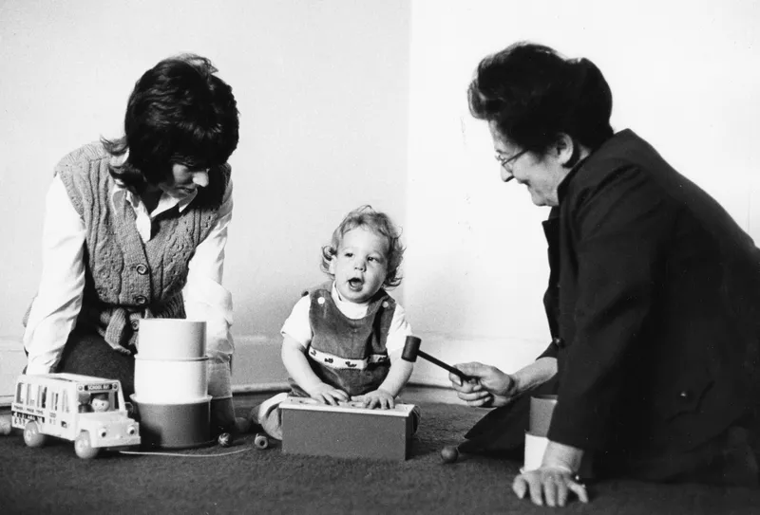
Learning Theories and Curriculum Models
Cognitive Theory (Piaget)
Social Learning Theory (Bandura)
Sociocultural Theory (Vygotsky)
Ecological Systems Theory (Bronfenbrenner)
Attachment Theory (Ainsworth)
*Simplypsychology.org
Reggio Emilia
Waldorf
Highscope
Project Based
Classical
Bankstreet

Slide 10
Curriculum Components
Components of Development
Concepts
Content
Activities
Accommodations
Areas of Development
Social
Emotional
Physical
Language
Cognitive

Slide 11

https://www.in.gov/doe/students/indiana-academic-standards/early-learning/

Slide 12

Checklist for Choosing/Developing a Curriculum
1. How does the curriculum define the roles of the teacher and the child in the learning
process?
2. What domains of learning are addressed? Are they integrated or treated separately?
Will the curriculum lead to achievement of state early learning standards?
3. Does the curriculum provide guidance for differentiating teaching for students with
special behavior? Linguistic or learning needs?
4. Do the curriculum’s developers provide an assessment system that is consistent with
the teaching philosophy and learning content?
5. What research evidence exists to support the value or effectiveness of the curriculum?
6. Is the curriculum appropriate for all teachers, regardless of the qualifications? What
kind of professional development is provided?
7. Are specific materials required to implement the curriculum?
8. Does the curriculum model provide guidance for such services as parent involvement
and the transition to kindergarten?
*See the complete document at: http://nieer.org/resources/policybriefs/12.pdf

Slide 13
What this means for you!
Purchased vs Creating Your Own
Materials and Trainings Available to Assist You
Ages and Stages/Milestone Charts
Be Intentional in Planning (Learning Objectives, Assessment, Teaching Strategies, Materials)
Breathe! You GOT THIS!!!

Slide 14


Slide 15



References
https://www.in.gov/fssa/carefinder/files/2016_INCKC-upd.pdf

Slide 16
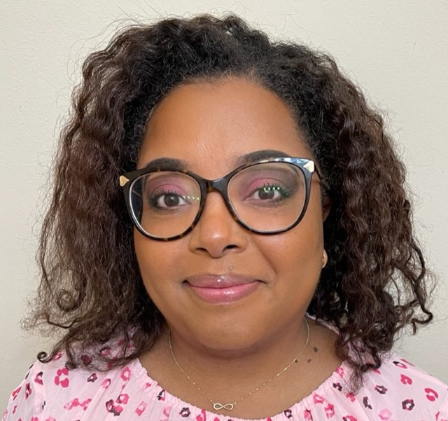
Angielena Williams M.S. ECS
@AngielenaW
Angielena.williams@fssa.in.gov

Slide 17

Thank you for attending!
Please complete the short feedback survey on the screen.
Don’t forget to download your PGP Certificate from the webcast toolbar.
Notes:
Make this the last slide in your presentation

