Slide 1


Creating Critical Thinkers with the SAT in Mind
Presentation by:
Duke Lines

Slide 2
Take Control of your Learning Experience
ON24 Learning Platform:
All windows are resizable and moveable
Use the Related Content box to access slides and resources
Submit your questions using the Q&A
PGP certificates are available for download
Use the toolbar to access other features and bring back minimized tools.

Slide 3
Language of Instruction
Critical Thinking = process of purposeful, self-regulatory judgement
Gives consideration to evidence, context, criteria
Literacy Classroom = intentional use of everyday reading, writing, and discussion in the classroom

Slide 4
Consider Your Staff & Students
Are they predominantly the consumers or producers of their teaching & learning?
Are they passively or actively engaged in their teaching & learning?

Slide 5
The Why for Critical Thinking
“Our job is not to prepare students for something. Our job is to help students prepare themselves for ANYTHING.”
A.J. Juliani

Slide 6
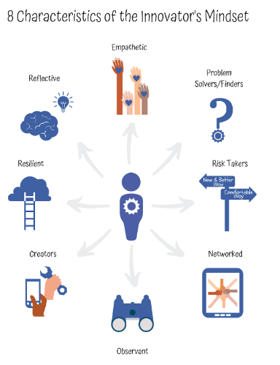
Graphic credit to George Couros
Notes:
https://georgecouros.ca/blog/archives/9233

Slide 7

The What of Critical Thinking
What comes to mind when you think of critical thinking?
Examine (Observe, Look & Listen)
Inquire (Ask lots of questions)
Understand & Interpret the problem (Analysis)
Propose & Navigate ideas with Peer Edit, Storming, and Norming (Collaboration & Communication)
Problem-Solve (Practice & Prototype)
Make Inferences (draw conclusions and report out based on evidence)

Slide 8
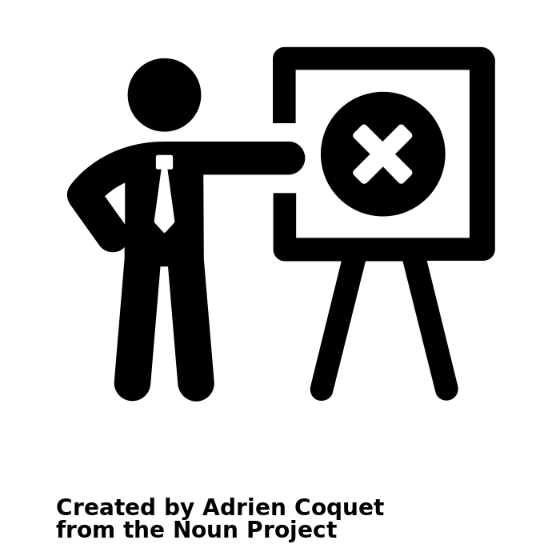
The Myths of Critical Thinking
Critical Thinking is just another subject
Critical Thinking is only for high achieving students
Critical Thinking is a quick-fix strategy or just a big abstraction or “buzzword” in education
Notes:
In Reality:
It’s not just an “extra.” Should be an integral skill set for teaching & learning all subject matter. Foundational for ALL Students.
Critical thinking is more of a process than a destination. All students, no matter their starting point, need tools to integrate new content, solve problems, analyze and evaluate information, and ultimately succeed in school. Create a thinking-centered classroom.
Critical thinking should be approachable. The what and the how: the what is what students should know and be able to do and the how is designing instruction that empowers students to think their way to that knowledge and ability.

Slide 9
With the SAT® in Mind
What do students need to know for post high school success?
Analyze Data (charts, tables, graphs)
Comprehend challenging literary and informational texts
Revise and edit extended texts
Use evidence in reading and writing
Use and Understand words in context
***From College Board

Slide 10
How might we be more selective and intentional in teaching and learning in order to engage and empower our students in literacy?

Slide 11
Effective Literacy Instruction
Effective teaching requires knowing which approaches/strategies work and when they work
Importance of Effective Strategies (effect size overview)
Surface - Deep - Transfer of Learning Strategies

Slide 12
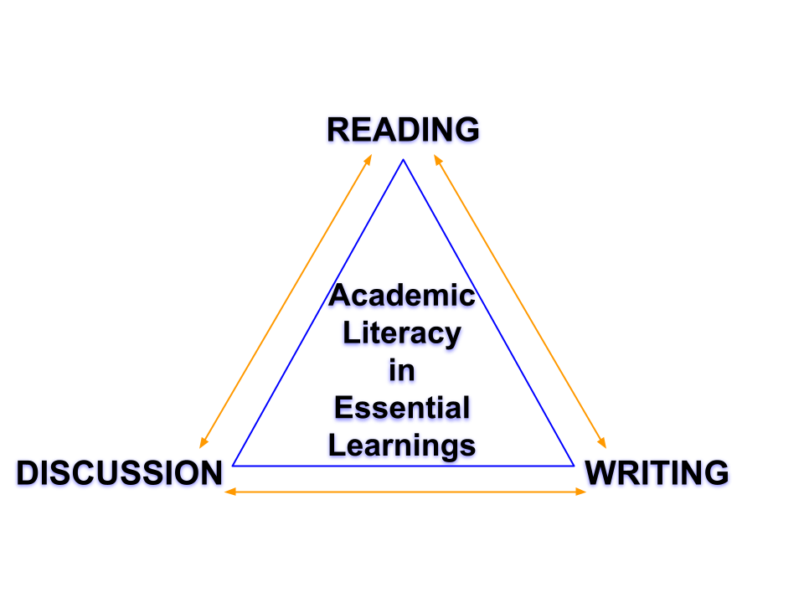

Slide 13
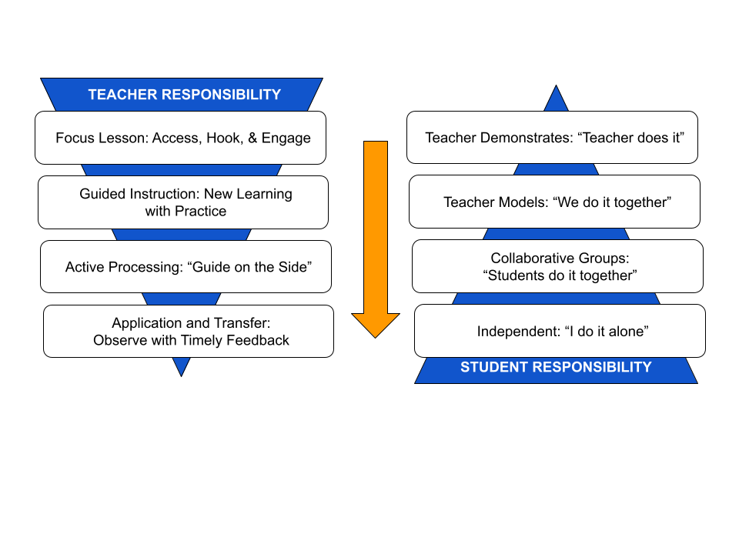
Adapted from “A structure for Instruction that Works” from Fisher & Frey, 2006

Slide 14
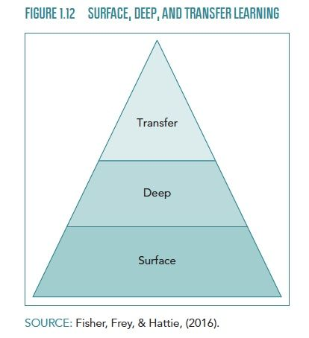

Slide 15
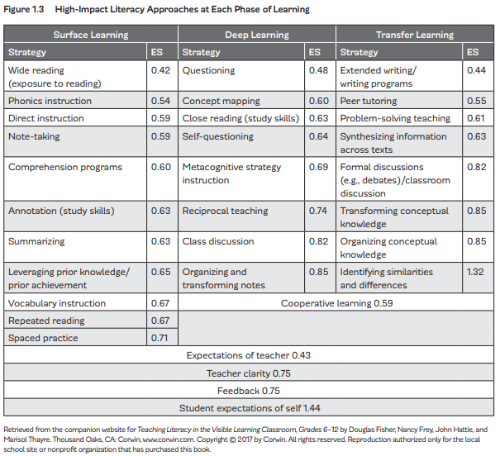
Copyright 2017 by Corwin. Reprinted from Teaching Literacy in the Visible Learning Classroom, Grades 6 - 12.

Slide 16
Importance of Teacher Clarity
Teachers know what students need to learn
Teachers communicate learning intentions to students
Teachers and students understand success criteria

Slide 17
What’s a Learning Intention?
Learning Intentions describe what it is that we want our students to LEARN
What makes a quality Learning Intention?
States the goal of learning
Provides the why
Stated in student-friendly language

Slide 18
What’s Success Criteria
Describes what we are doing to learn; necessary evidence students need to produce and teachers assess
What makes a quality Success Criteria?
Focused on the learning, not the tasks/activities
Aligned to exemplars
Commonly written in “I Can” statements

Slide 19
Critical Thinking with Literacy in Mind
Rigorous Instruction
Intentional use of reading, writing, and discussion
Exposure to variety of texts (narrative and informational)
High-Level Questioning
Relevant Engagement
Clarity with Learning Intentions & Success Criteria
Formative Checks for Understanding along the way
Authentic audience with peer feedback

Slide 20
R: Raise the level of content: Why do students need to learn this? What will successful learning look like? How will I teach this? What resources do I need?
I: Increase complexity in instruction: Engage students in cognitively complex tasks
G: Give appropriate support and guidance: Scaffolding, modeling, providing clear expectations, presenting multiple opportunities to learn, providing feedback,allowing productive struggle
O: Open your focus: Open-ended questioning, open-ended research, open-ended vocabulary instruction, open-ended choices for students
R: Raise expectations: Expecting the best, allowing student ownership, tracking progress, creating a culture

Slide 21
Difficulty vs Complexity
Difficulty:
A measure of effort required to complete a task
In assessment, a function of how many people can complete the task correctly
Complexity:
A measure of the thinking, action, or knowledge that is needed to complete the task
In assessment how many different ways can the task be accomplished

Slide 22
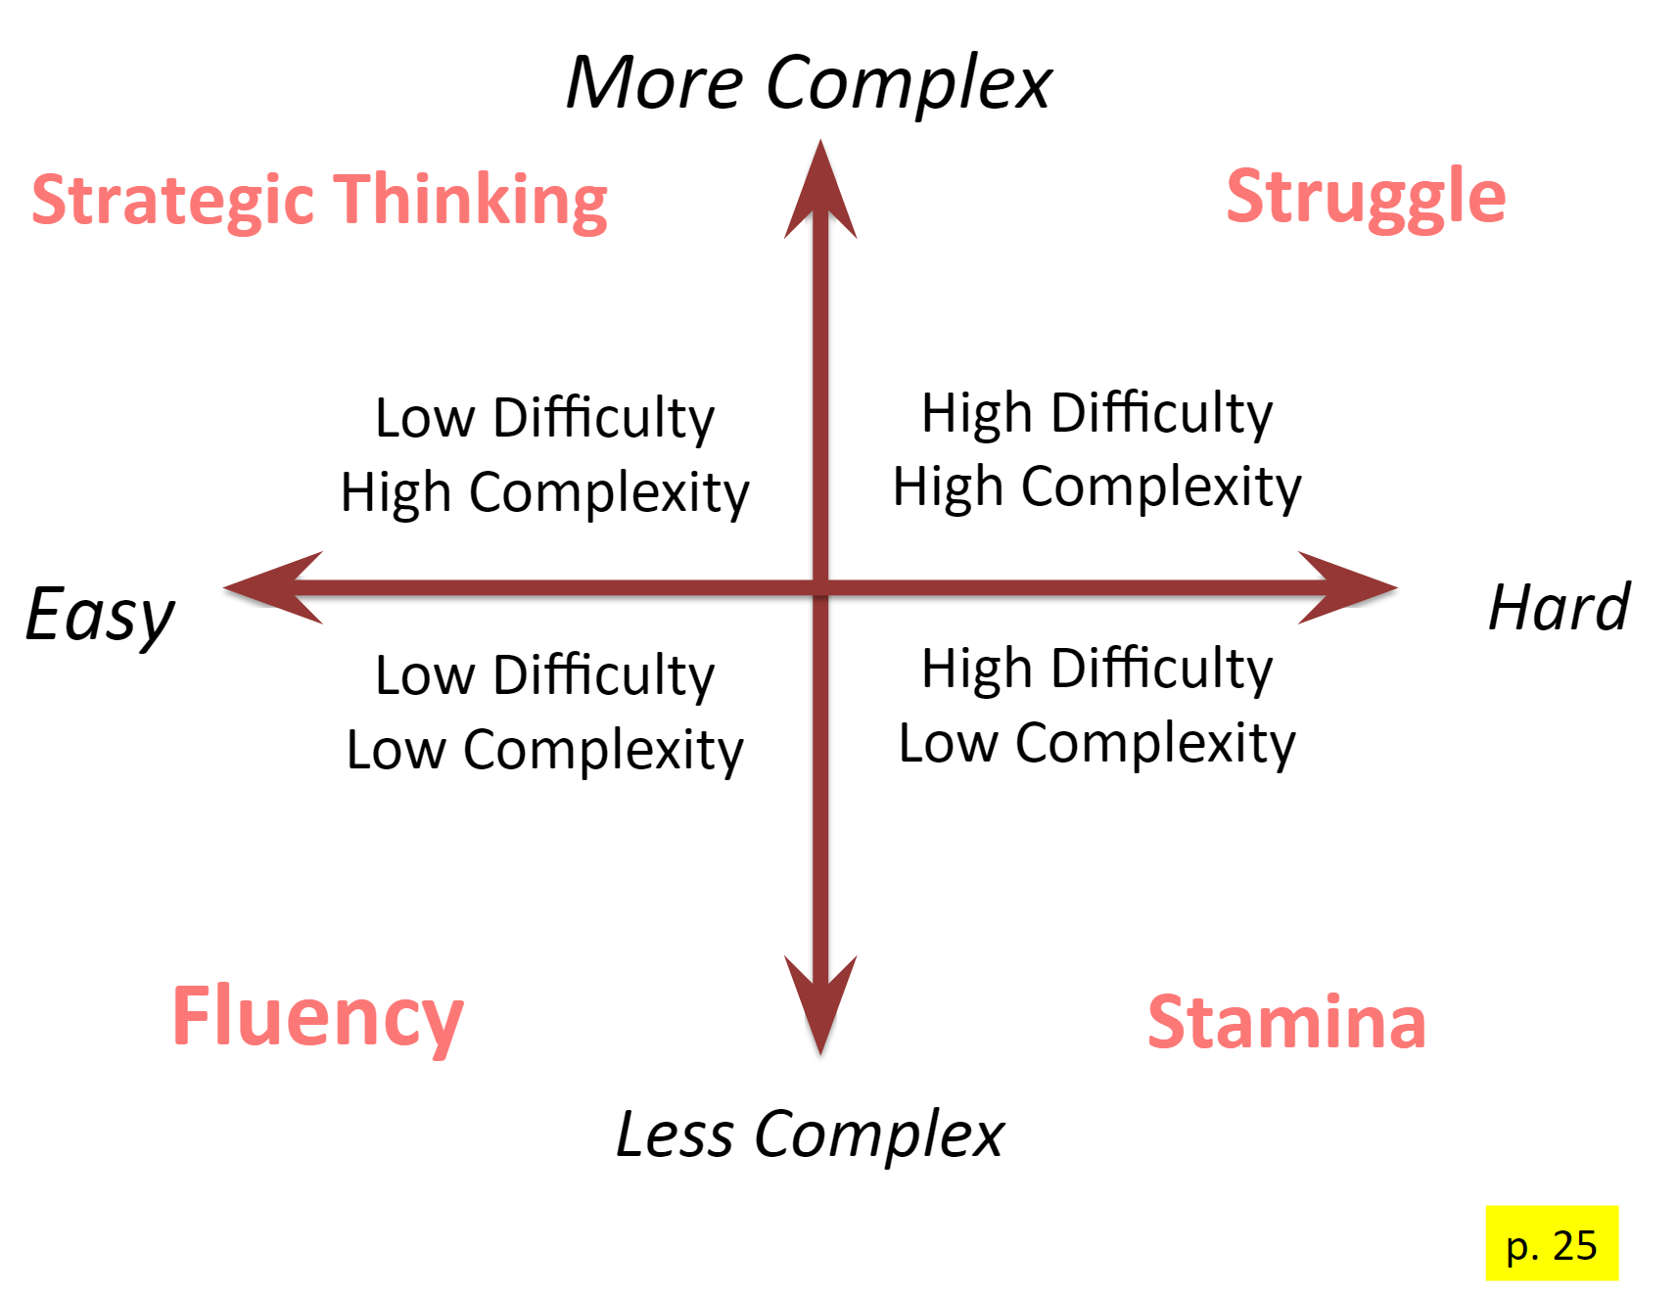
Visible Learning for Literacy Book

Slide 23
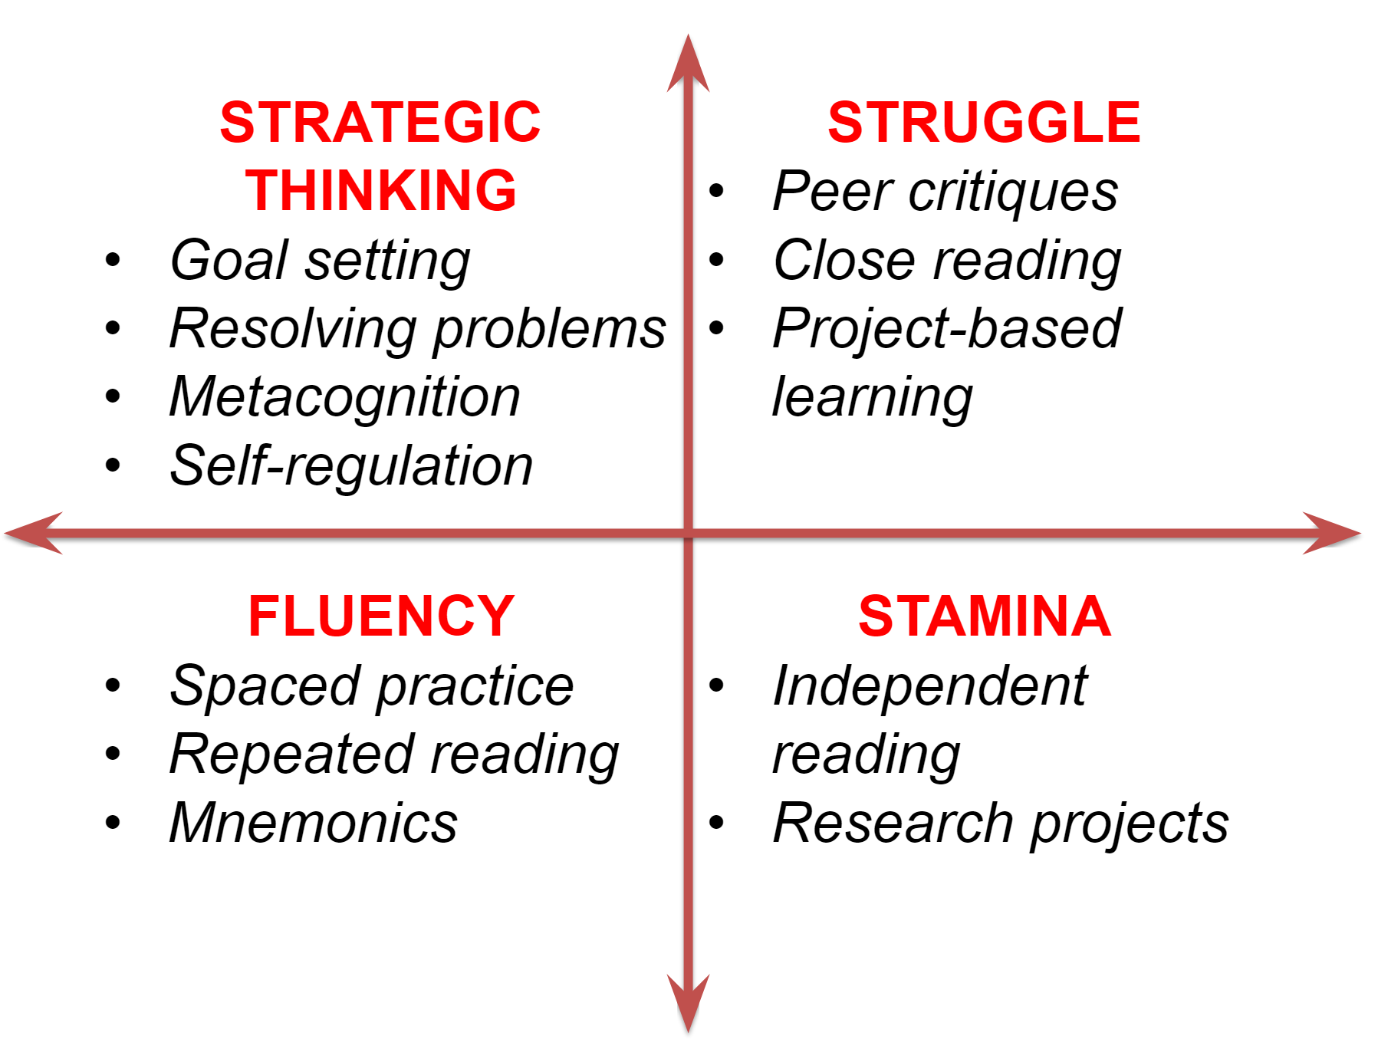
Expertise
Visible Learning for Literacy Book

Slide 24
Complexity = Depth of Knowledge
What is DOK?
Mechanism to ensure the intent of the standard and level of student performance matches
To provide cognitive-processing ceiling
(highest level students can be assessed) for
item development
To ensure that teachers are teaching to a level that will promote student achievement

Slide 25
DOK Levels
Level 1 - Recall & Reproduction (surface & rote)
Level 2 - Skills & Concepts (compare/contrast)
Level 3 - Strategic Thinking/Reasoning (complex and justify response w/ evidence)
Level 4 - Extended Thinking (very complex and relating ideas in context/among content areas)

Slide 26
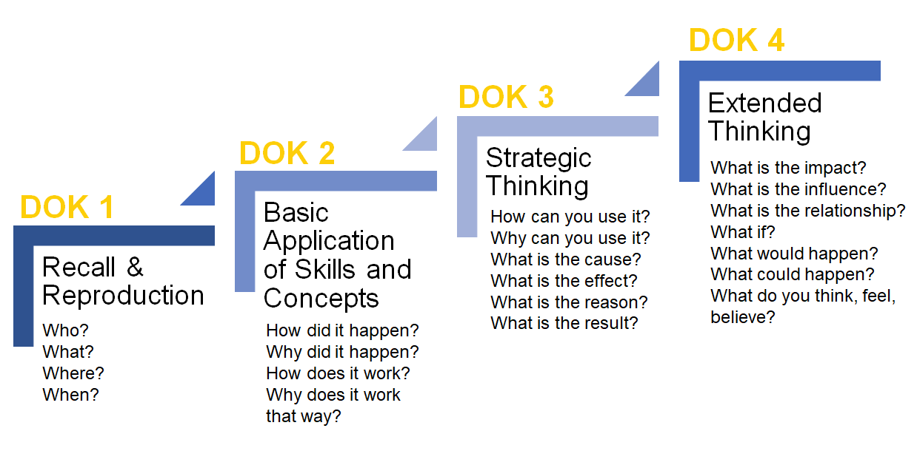
Source: IDOE

Slide 27
Task Activity for Difficulty & Complexity
In your PLC or Grade Level Team:
Use the Difficulty / Complexity Matrix and pick a grade level standard you will be teaching in the next month
Create a task from each of the 4 quadrants you will be able to implement and bring back to the PLC / Grade Level Team

Slide 28

So what?
Now What?
Notes:
Action by P Thanga Vignesh from NounProject.com

Slide 29
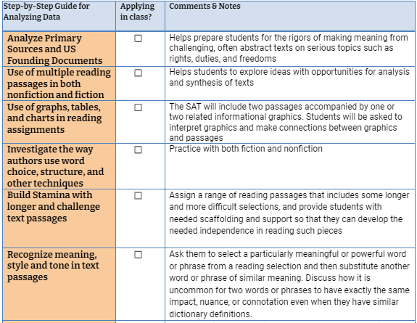
The How: Skill Building and Instructional Strategies for the SAT®
Instructional Strategies In Action Checklist

Slide 30
Next Steps: Tips for Student Success with SAT®
Register/Sign up for Khan Academy and practice!
Use evidence to support your arguments
Build up your reading stamina
Always analyze the informational graphics
Increase comfort reading and interpreting the U.S. founding documents and primary sources
Answer every question, guess if needed

Slide 31
Resource Slide
Doug Fisher, Nancy Frey, John Hattie - Visible Learning for Literacy
Doug Fisher, Nancy Frey, John Hattie, and Marisol Thayre - Teaching Literacy in the Visible Learning Classroom
Indiana Department of Education
College Board
The Noun Project for Icons
Notes:
Action by P Thanga Vignesh from NounProject.com

Slide 32

Duke Lines
@duke_lines
dlines@cpcsc.k12.in.us

Slide 33

Thank you for attending!
Please complete the short feedback survey on the screen.
Don’t forget to download your PGP Certificate from the webcast toolbar.
Notes:
Make this the last slide in your presentation

