Slide 1

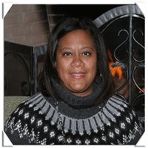
Culturally Responsive SEL Series: The Power & Purpose of Culturally Responsive SEL
Presentation by:
Stephanie Steward-Bridges

Slide 2

Culturally Responsive Social Emotional Learning (SEL) Series
Session 1: The Power & Purpose of Culturally Responsive SEL
January 19, 2022
Notes:
Amanda

Slide 3

Meet Our Presenter!
Stephanie Steward-Bridges
Director of African American Student & Parent Services
South Bend Community School Corporation
ssteward-bridges@sbcsc.k12.in.us
Notes:
Amanda

Slide 4
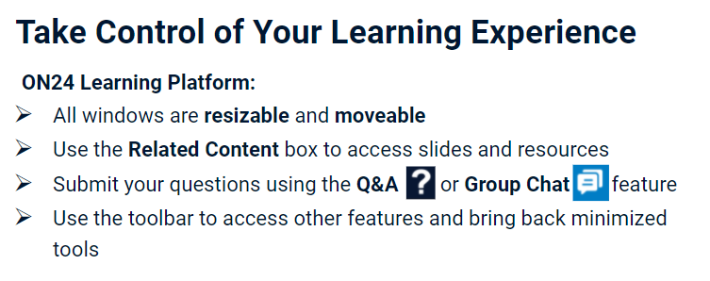
Notes:
Amanda

Slide 5
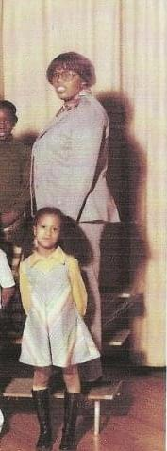

My
Journey

Slide 6
Culturally Responsive Social Emotional Learning
The Power and Purpose of Culturally Responsive SEL
Cultural/Global Responsive SEL with GC Scored and Dr. Yvonne Larrier
Culturally Responsive Modifications
The Power and Purpose of Reflection

Slide 7
The Power and Purpose of Social and Emotional Learning
Benefit of Social Emotional Learning
Intersection of SEL and Culture
Danger of Micro-Exclusions
SEL & Trauma
The Importance of Thriving Learning Environments; Culturally Responsive and Sustaining SEL

Slide 8
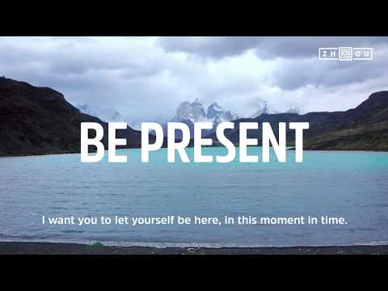
Before
We
Begin

Slide 9

Collaborative for Academic, Social, and Emotional Learning; CASEL
SEL Definition
We define social and emotional learning (SEL) as an integral part of education and human development. SEL is the process through which all young people and adults acquire and apply the knowledge, skills, and attitudes to develop healthy identities, manage emotions and achieve personal and collective goals, feel and show empathy for others, establish and maintain supportive relationships, and make responsible and caring decisions.

Slide 10

CULTURE
The customary beliefs, social forms, and material traits of a racial, religious, or social group
Also : the characteristic features of everyday existence (such as diversions or a way of life) shared by people in a place or time
The set of shared attitudes, values, goals, and practices that characterizes an institution or organization

Slide 11
How Does One Impact the Other?
The customary beliefs, social forms, and material traits of a racial, religious, or social group
Also : the characteristic features of everyday existence (such as diversions or a way of life) shared by people in a place or time
The set of shared attitudes, values, goals, and practices that characterizes an institution or organization
We define social and emotional learning (SEL) as an integral part of education and human development. SEL is the process through which all young people and adults acquire and apply the knowledge, skills, and attitudes to develop healthy identities, manage emotions and achieve personal and collective goals, feel and show empathy for others, establish and maintain supportive relationships, and make responsible and caring decisions.

Slide 12
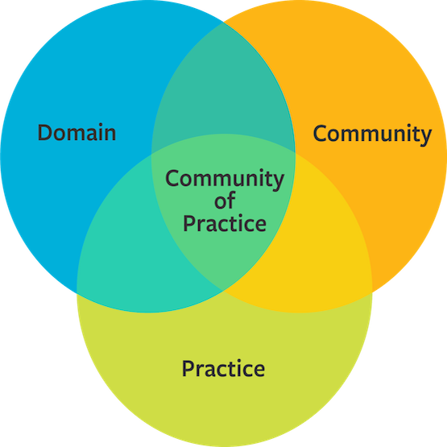
Communities of Practice (COP)are groups of people who share a concern or a passion for something they do and learn how to do it better as they interact regularly ~ Etienne Wenger
(Concern)
(Interaction)
Communities of Practice impact how we think and perceive difference ~ Cris Cullinan
(Doing)

Slide 13
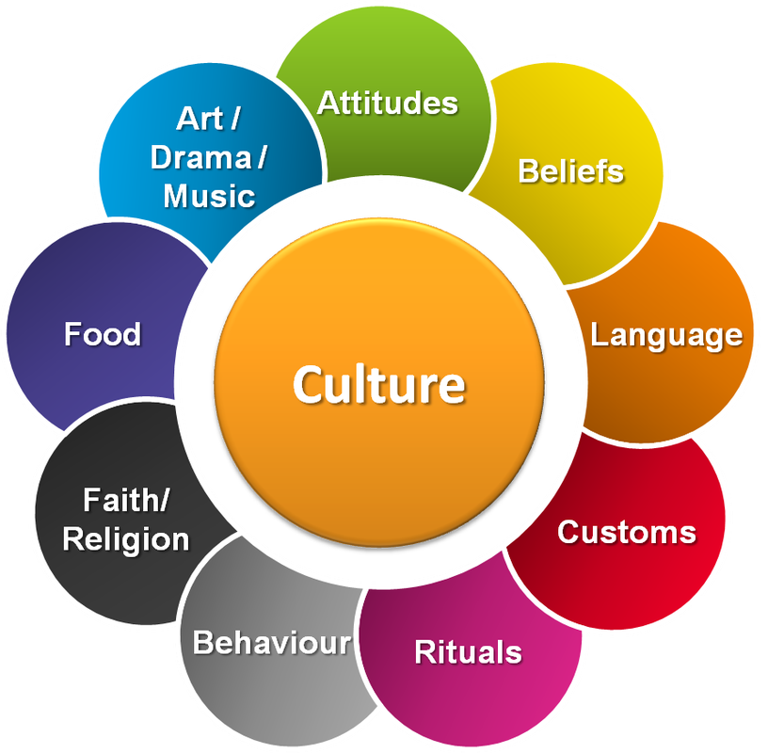
Values and Beliefs
Experiences
Attitudes and Behavior

Slide 14
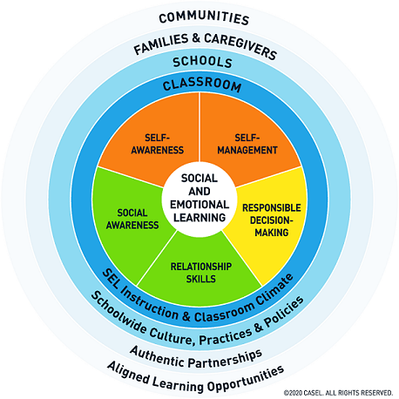
Regulation
Perceptions
Community
Self Efficacy
Take Action

Slide 15
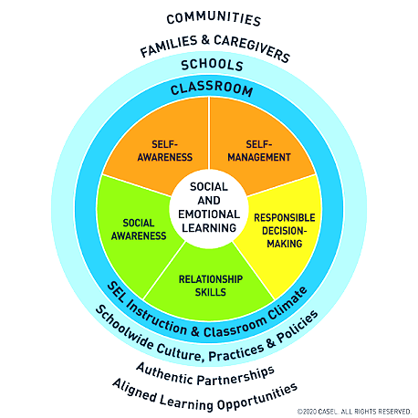

Slide 16
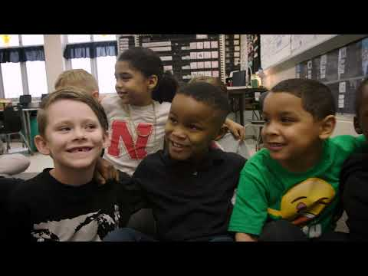

Slide 17

Micro-Exclusion
Equality of Access
Good Intentions
SEL Competency Norms

Slide 18

Trauma,
SEL,
& Literacy
SEL is intended to create the space and bring explicit awareness to our emotional and regulatory systems,so that we can build the skills necessary for regulating the stress response. We need SEL to be able to "sit and focus" in the classroom. ~ Dr. Nancy Michael

Slide 19
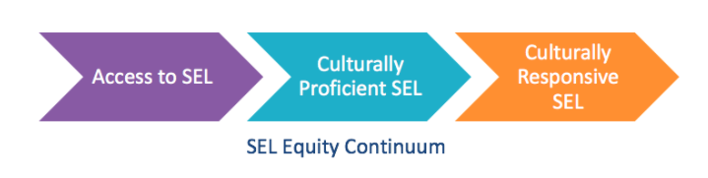

Slide 20
ACCESS
Building Behavior Expectations
SEL Building Wide
Curriculum or Team Approaches
All students have opportunities for SEL experience and skill development

Slide 21
Culturally Proficient
Instructor Proficiency
Safe and Collaborative Learning Environments
Learning experiences that are bias free and respectful of ALL students

Slide 22
Culturally Responsive & Sustainable SEL
Intentionality with SEL
Representation of a Range of Identities
Engage the Student Experience
Asset Based Practices
Build Relationships and Community
Practices that actively draw upon and support students’ diverse backgrounds, identities, strengths and challenges as a strategy to create agency

Slide 23
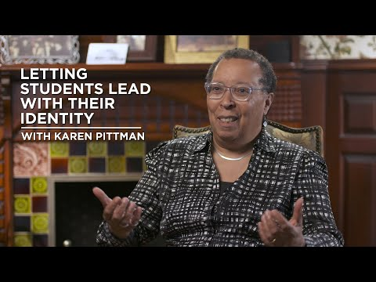
All
Experiences
Matter

Slide 24
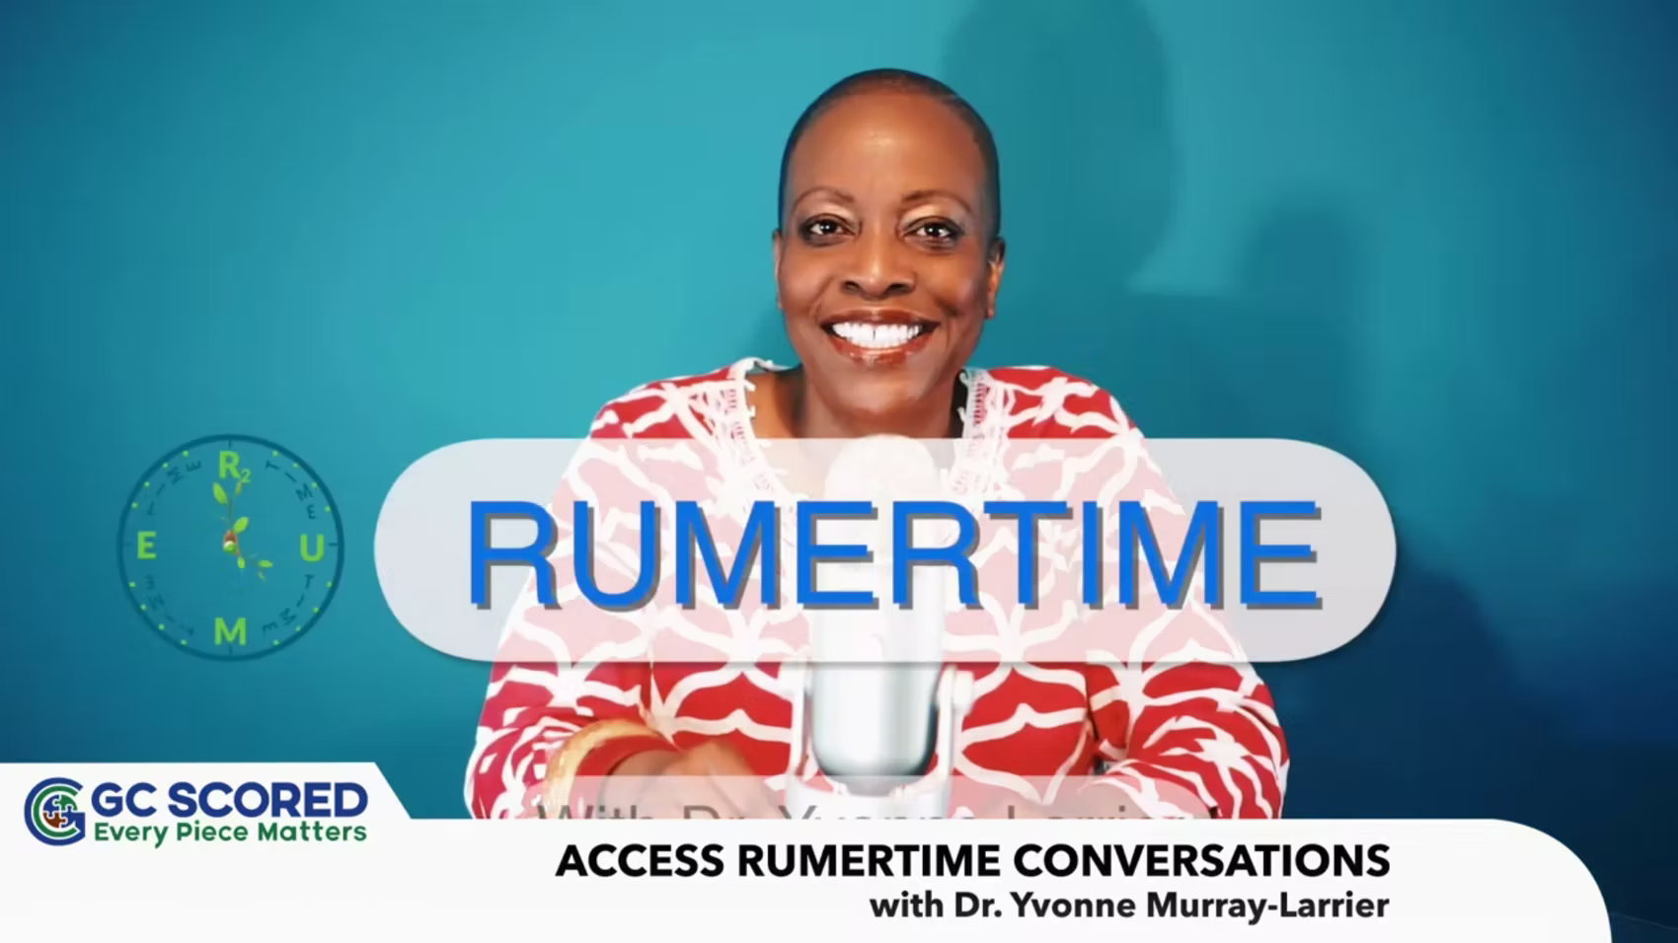

What’s Next

Slide 25
Resources
Collaborative For Academic Social and Emotional Learning (CASEL): Fundamentals of SEL: https://casel.org/fundamentals-of-sel/
Culturally Responsive Social Emotional Competency Development: https://www.doe.mass.edu/sfs/sel/sel-all.docx
Vision, Privilege and the Limits of Tolerance; C. Cullinan: https://vetvoicenational.files.wordpress.com/2018/10/cris-cullinan-visions-privilege-and-the-limits-of-tolerance.pdf
Harvard Center for the Developing Child Links:
https://46y5eh11fhgw3ve3ytpwxt9r-wpengine.netdna-ssl.com/wp-content/uploads/2010/05/Persistent-Fear-and-Anxiety-Can-Affect-Young-Childrens-Learning-and-Development.pdf
https://developingchild.harvard.edu/guide/introducing-ecd-2-0/
https://developingchild.harvard.edu/resources/how-early-childhood-experiences-affect-lifelong-health-and-learning/

Slide 26
Thank You
Session Evaluation: Please complete by selecting “Evaluation” in the Resources box.
We appreciate honest feedback to assist us in supporting and serving you!
OnDemand: Participants will receive a link to the recorded session via email, within a week of the live session
PGP certificates will be e-mailed upon completion of the session
(Live and OnDemand)
CEUs will be emailed to active INSSWA members within one month of session and evaluation completion
Notes:
Amanda CEUs will be emailed by INSSWA President

Slide 27
Upcoming Events
Events Calendar https://keepindianalearning.org/events/
Celebrating National School Counseling Week, February 7 - 11, 2022
  Coffee Talk with Indiana’s Exemplary School Counselor Award Recipients
Comprehensive School Counseling Series, Session 2, February 7, 2022
Winter Book Study - Connections Over Compliance: Rewiring Our Perceptions of Discipline by Dr. Lori Desautels
Culturally Responsive SEL Series, session 2, February 23, 2022
Portrait of a Graduate - Save the Date:, March 10, 2022
Register at https://keepindianalearning.org/free-events/
Notes:
Amanda

Slide 28


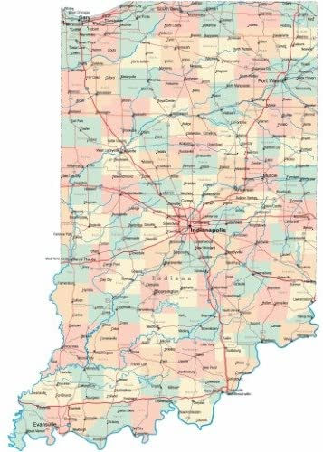

We appreciate our partners!
Representatives from over 30 school districts in the state
Notes:
Amanda

Slide 29


CONTACT US!
Amanda Culhan: amanda@culhanconsulting.com
Dr. Andrew Melin: amelin@ciesc.org
Rachel Bauer: rbauer@indianaonline.org
Dawn Meadows: dmeadows@indianaonline.org
STAY CONNECTED
Counselor Connect
Keep Indiana Learning
Newsletter
KInL YouTube Channel
Subscribe to our newsletter at keepindianalearning.org/subscribe/
Notes:
Amanda

