Slide 1

Culturally Responsive Social Emotional Learning (SEL) Series
Session 2: Cultural/Global Responsive SEL
February 23, 2022
Notes:
Amanda

Slide 2
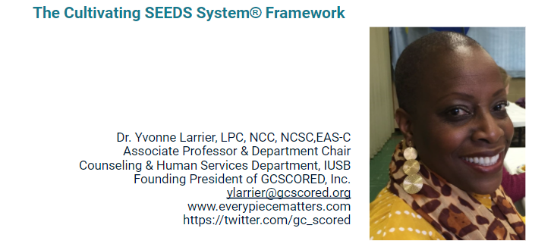
Meet Our Presenter!
Notes:
Amanda

Slide 3
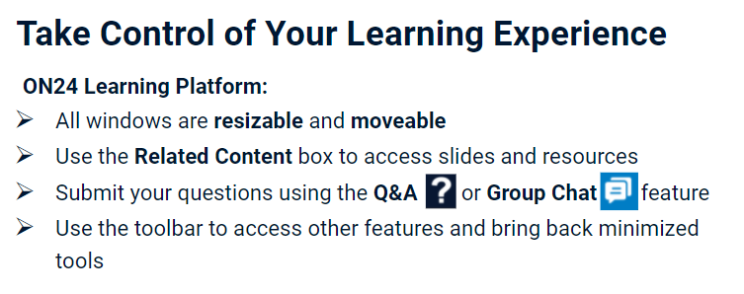
Notes:
Amanda

Slide 4
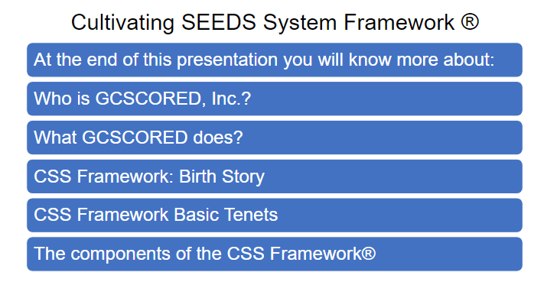
Notes:
Amanda

Slide 5


Slide 6


Slide 7
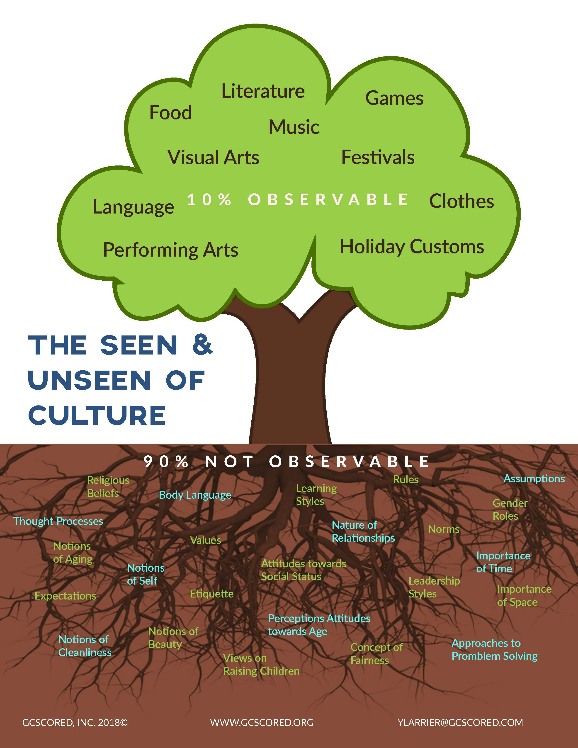
Cultural Competence & Responsiveness
CULTURAL COMPETENCE, “ is the awareness, knowledge, and skills needed to function effectively with culturally diverse populations.” Sue & Sue, 2016
CULTURAL RESPONSIVENESS, “is a person’s ability to first and foremost be aware of and understand what it means to be responsive and then follow that awareness up with action that leads them to respond empathically, compassionately, justly, sensitively, kindheartedly with goodwill toward individuals who are culturally diverse of space and place.”

Slide 8
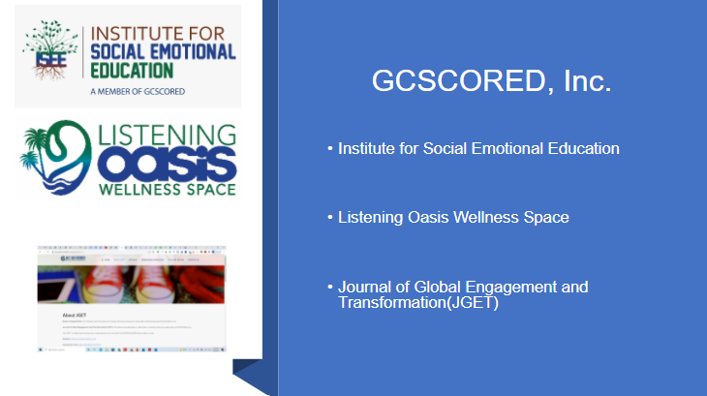

Slide 9


Slide 10

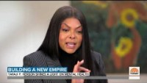
“Behind Every Behavior is a Belief” Larrier

Slide 11


Slide 12
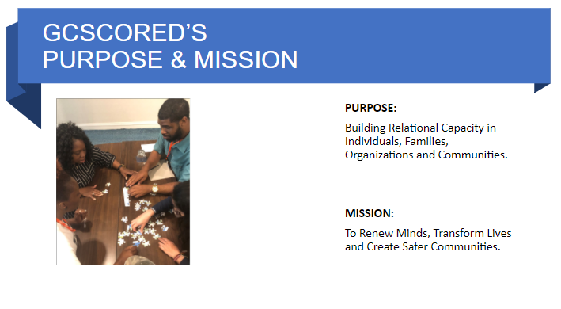

Slide 13
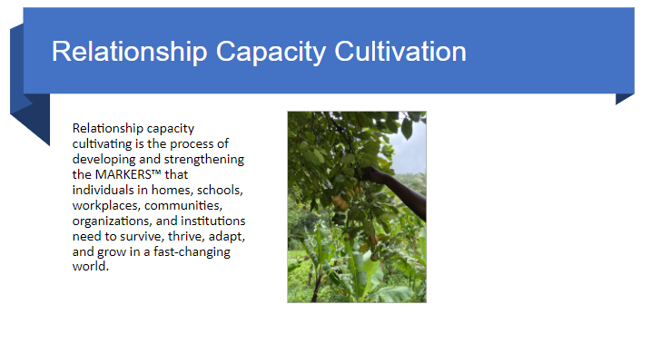

Slide 14
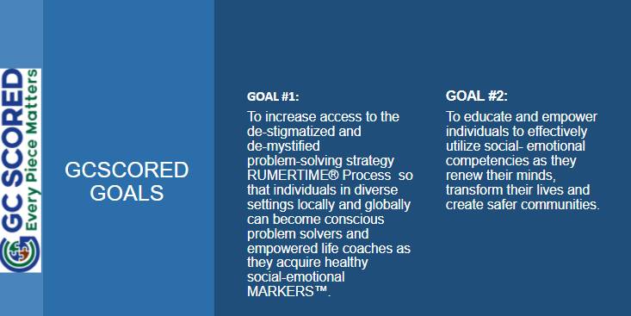

Slide 15
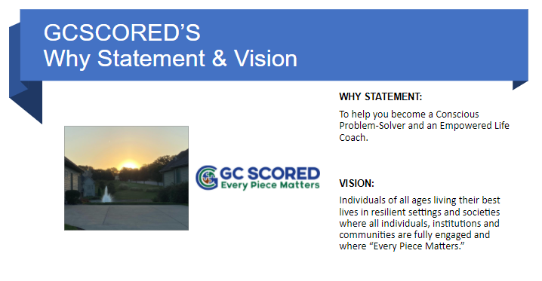

Slide 16


Slide 17


Slide 18


Slide 19


Slide 20
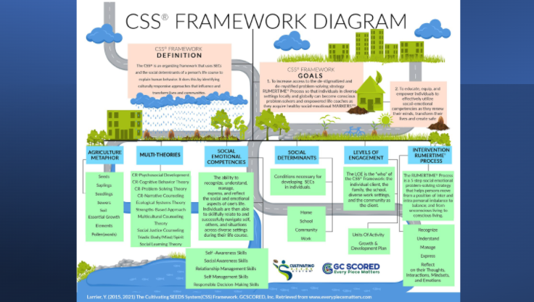

Slide 21


Slide 22
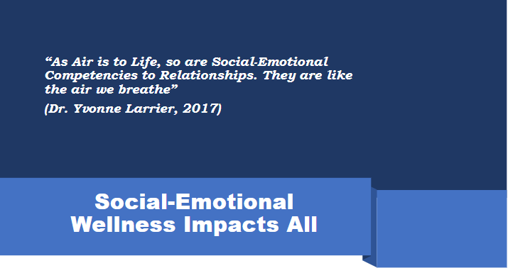

Slide 23
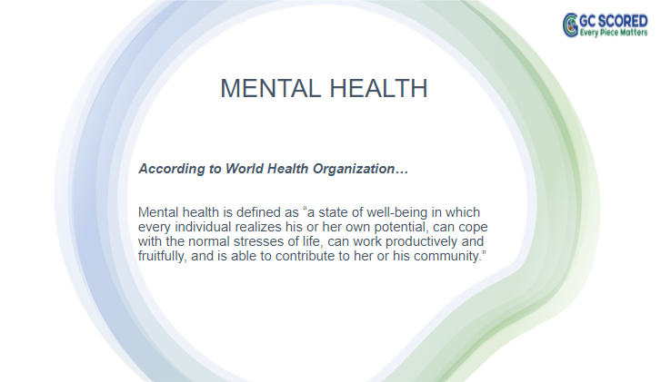

Slide 24


Slide 25
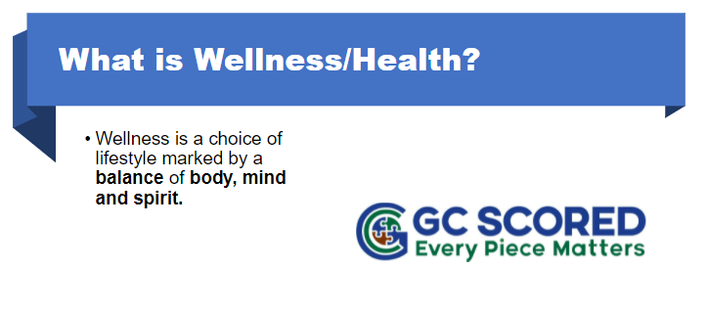

Slide 26


Slide 27


Slide 28
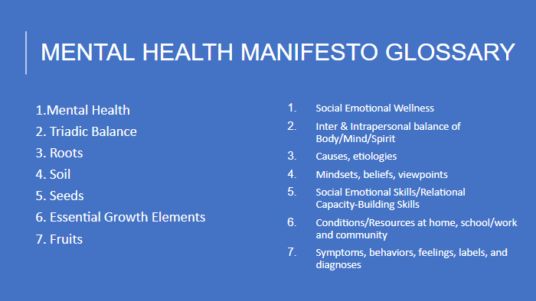

Slide 29
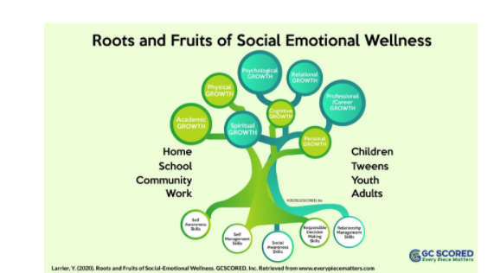

Slide 30


Slide 31
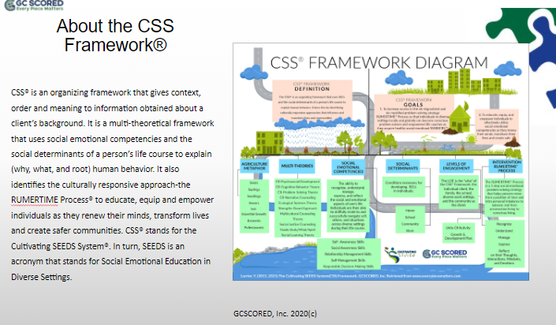

Slide 32
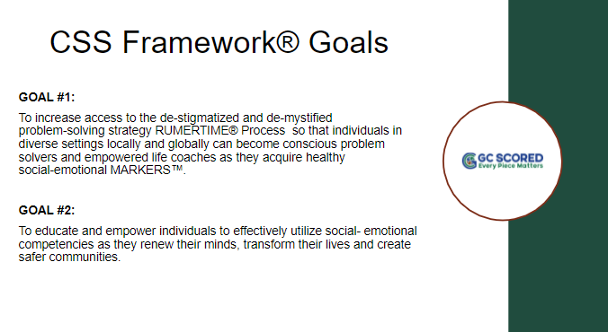

Slide 33
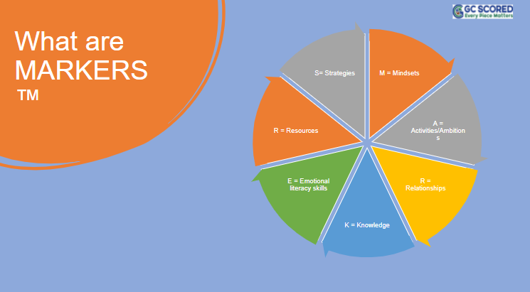

Slide 34
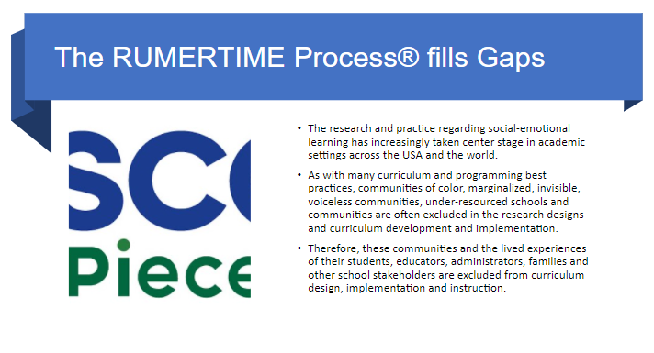

Slide 35
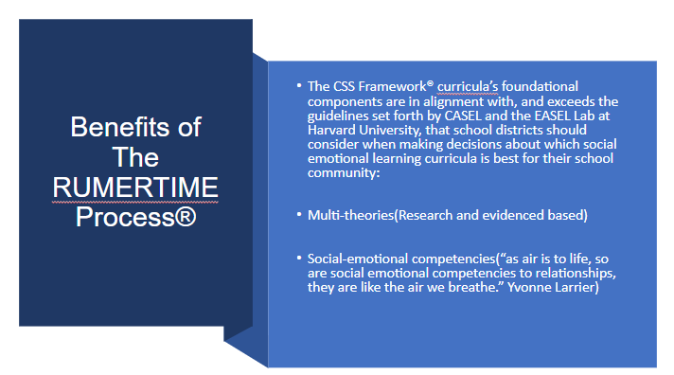

Slide 36
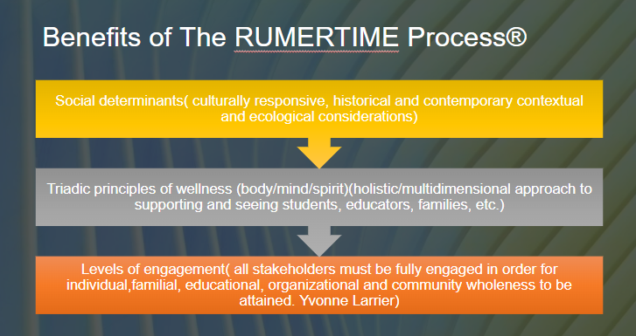

Slide 37
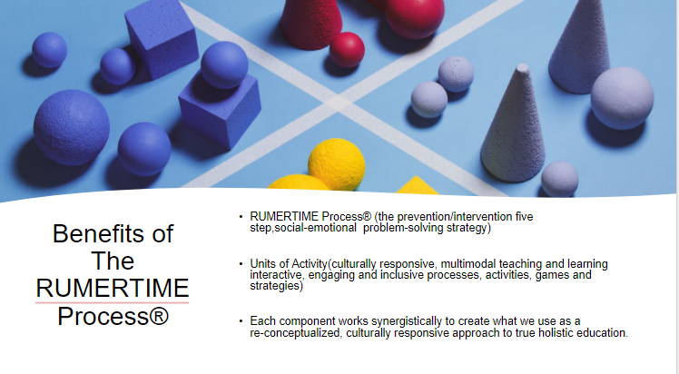

Slide 38
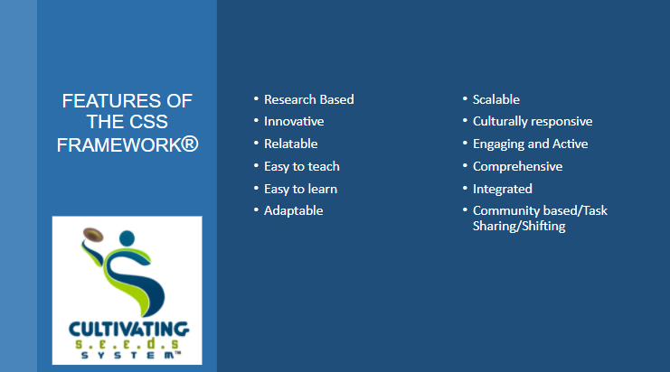

Slide 39
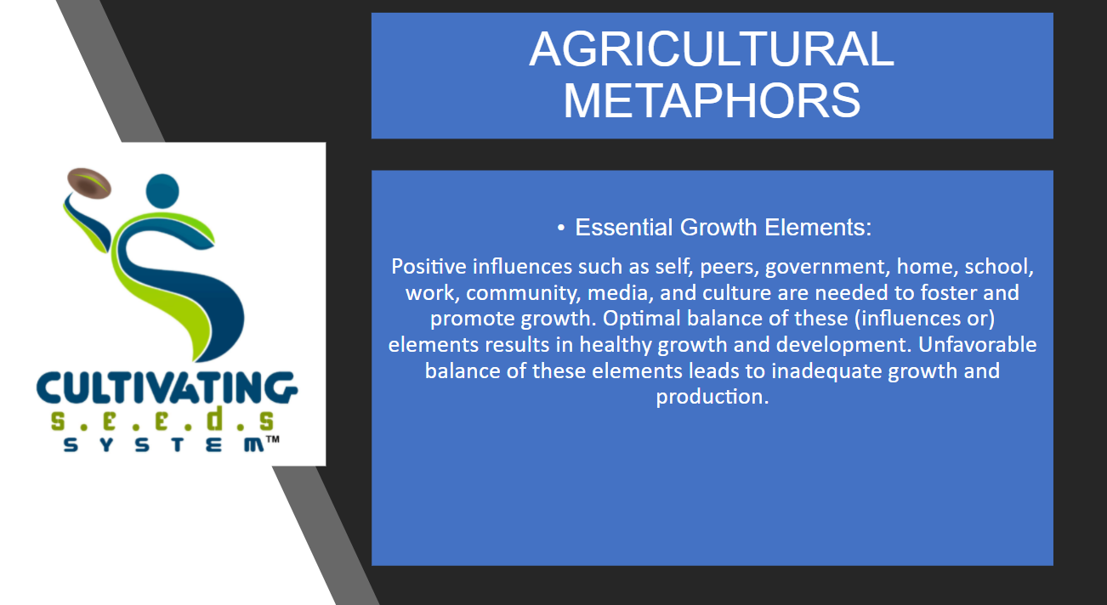

Slide 40
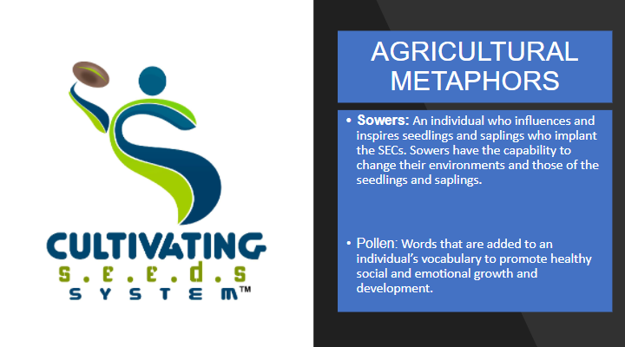

Slide 41
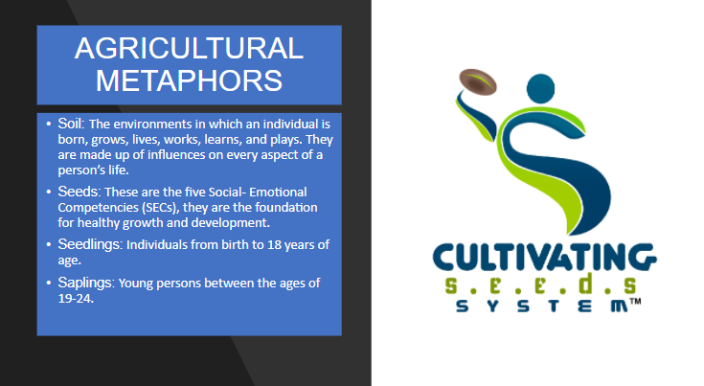

Slide 42


Slide 43


Slide 44
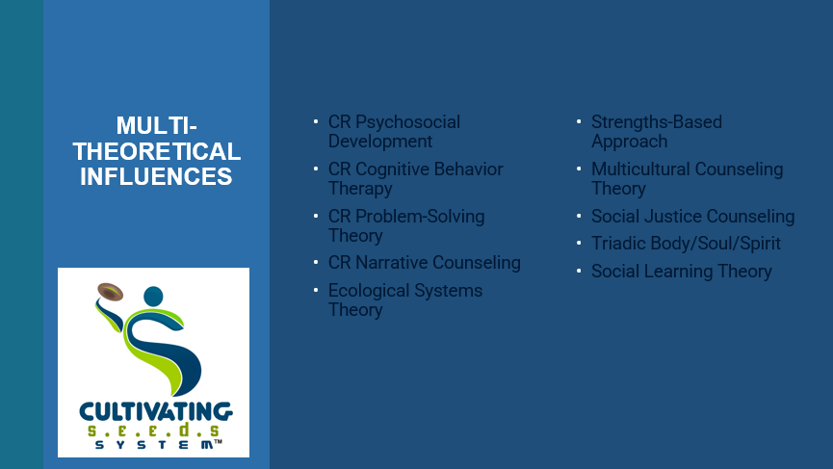

Slide 45
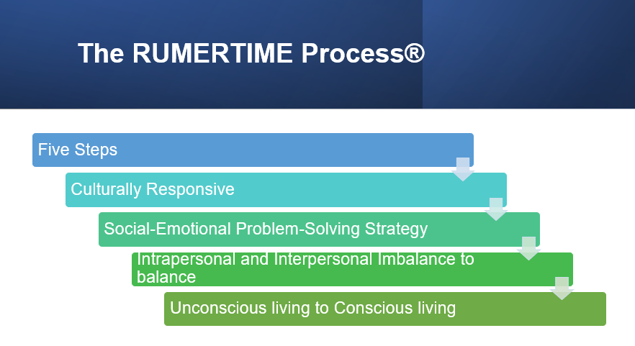

Slide 46


Slide 47
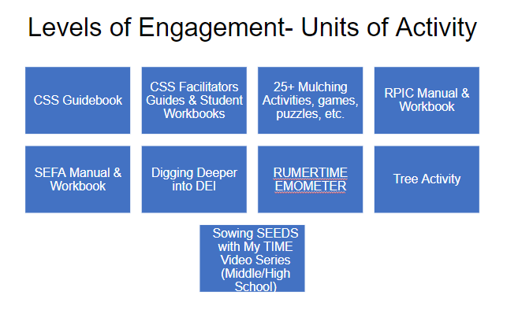

Slide 48
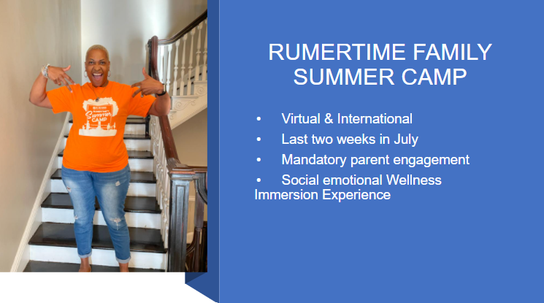

Slide 49
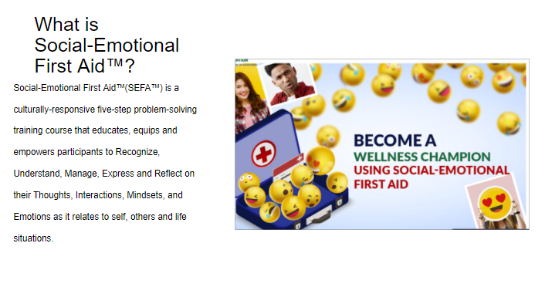

Slide 50
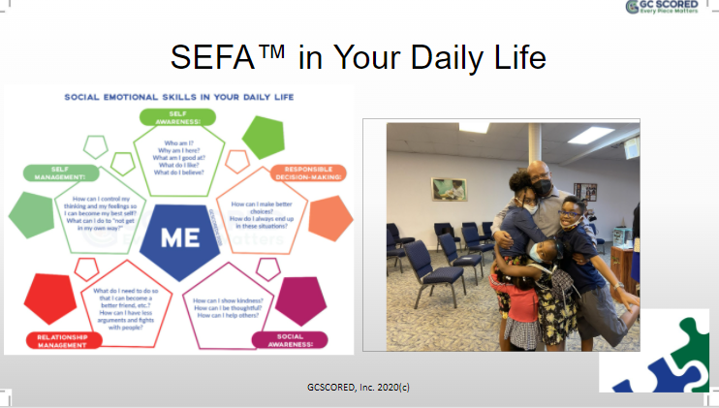

Slide 51
Resources
All infographics, pictures and graphics are the property of Dr. Yvonne Larrier of GCSCORED, Inc.
WWW. Everypiecematters.com
info@gcscored.org

Slide 52

Thank You
Session Evaluation: Please complete the feedback survey on the screen.
We appreciate honest feedback to assist us in supporting and serving you!
PGP certificates can be downloaded from the webcast toolbar.
CEUs will be emailed to active INSSWA members within one month of session and evaluation completion
Notes:
Amanda CEUs will be emailed by INSSWA President

Slide 53
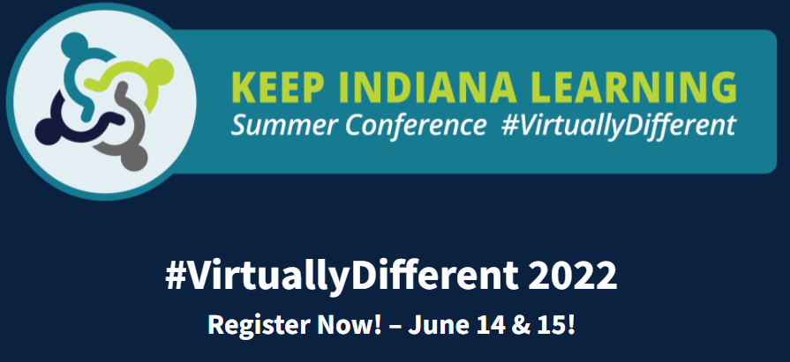
Upcoming Events
Events Calendar https://keepindianalearning.org/events/
Portrait of a Graduate Livestream, March 10, 2022
Culturally Responsive SEL Series, session 3, March 16, 2022 via zoom
Keep Indiana Learning Virtual Conference, June 14-15, 2022
Register at https://keepindianalearning.org/free-events/
Notes:
Amanda

Slide 54


CONTACT US!
Amanda Culhan: amanda@culhanconsulting.com
Dr. Andrew Melin: amelin@ciesc.org
Rachel Bauer: rbauer@indianaonline.org
Dawn Meadows: dmeadows@indianaonline.org
STAY CONNECTED
Counselor Connect
Keep Indiana Learning
Newsletter
KInL YouTube Channel
Subscribe to our newsletter at keepindianalearning.org/subscribe/
Notes:
Amanda

