Slide 2
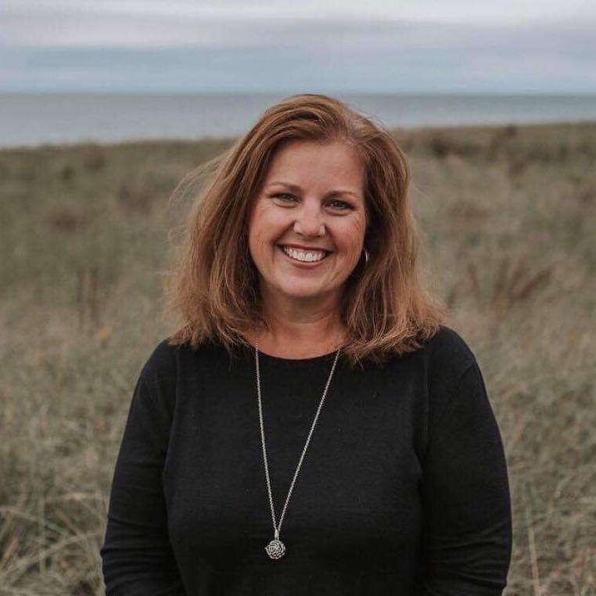

Curriculum Mapping in the Early Childhood Classroom
Kristin Parisi
Director, Clark-Pleasant Early Learning Center
kparisi@cpcsc.k12.in.us
@KristinParisi
@YOUR_CPELC

Slide 3
Hello and welcome to our session, Comfort in Curriculum Choices for Early Childhood Home-based Providers. I am Kristin Parisi, Director of Clark-Pleasant Early Learning Center. Thank you for joining me/us at Keep Indiana Learning.
Before we get started, a few quick notes about this ON24 platform. You can resize, move, and minimize all the windows on the screen to best suit your learning style.
When I share my screen to demonstrate a tool or resource, you may want to maximize this video window. Click the four arrows at the top of this window to go to full screen, and click the escape button on your keyboard to exit full screen. If you are watching this on a mobile device or tablet, you can pinch and zoom to increase the size.
The slides and resources mentioned in the session can be accessed in the Related Content box. If you do not see the Related Content box, you can click on the checklist icon from the toolbar. Feel free to pause the video as needed.
You can ask questions throughout the session using the Q&A tool from the toolbar. If this is an On Demand session, those questions will be sent to me via email and I will respond back to you at the email you used for registration.
If you would like to share this session with a colleague, please click the share button in the toolbar. At the end of this session you will be prompted to complete a short survey. You can also access the survey at anytime by clicking on the hand/survey icon in the toolbar.
PGPS are available after you have watched 85% of this session. Click on the certificate icon in the toolbar to download your PGPs.
Let’s get started!

Slide 4
Objectives for Tonight
Discuss what curriculum mapping is and why it is important
Share examples of what Clark-Pleasant Early Learning Center is doing
Discuss examples of pacing guides for ISPROUT SKBs and Early Learning Foundations

Slide 5

What is Early Childhood Curriculum?
“Simply stated, curriculum it is what you want children to learn and what you plan to teach. Curriculum should be based on what is known about child development and learning for any given age range. Developmentally Appropriate Practice (DAP) means “teaching children where they are (developmentally), as individuals and as a group, and helping each child reach challenging but achievable goals …” (Copple & Bredekamp, 2009) . Your curriculum guides you in determining these achievable goals; what knowledge, skills, and dispositions (attitudes) you want children to learn and develop. It is recommended that good curriculum be a written document that is used in planning experiences for children.”
*see reference slide
Notes:
From Angeliena’s presentation.

Slide 6
Begin With The End In Mind
Why - The process of intentional planning is huge. Knowing where you want to go and how you will get there allows for all students to have a guaranteed and viable curriculum.
What - Aligning the standards and how you will teach

Slide 7
What is Curriculum Mapping?
Curriculum Mapping Is…. | Curriculum Mapping Is NOT….
Reflective process for planning | Lesson plans
Understanding of objectives | Rigid instruction
Intentional assessments | One size fits all
Collaborative | Singular in nature

Slide 8
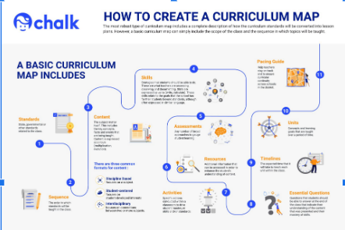
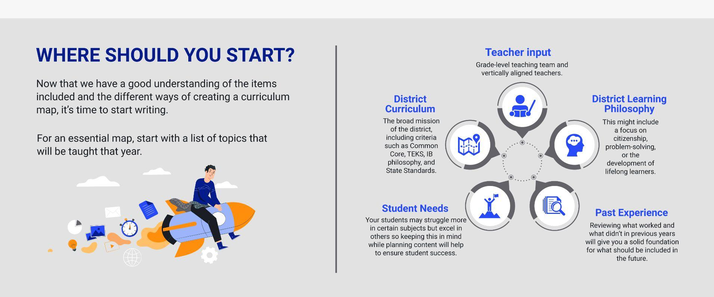
What is Curriculum Mapping?
https://www.chalk.com/curriculum-mapping-guide/

Slide 9



Resources
Pulling it all together
Curriculum
Foundations
SKBs
https://www.in.gov/doe/students/indiana-academic-standards/early-learning/

Slide 10
SKBs…Assessments…and Essential Learnings…Oh My!
28 SKBs
Authentic and Useable Assessments
How do we get it all in?

Slide 11
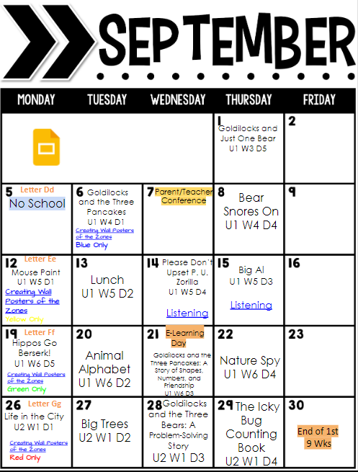
Mapping it all out

Slide 12
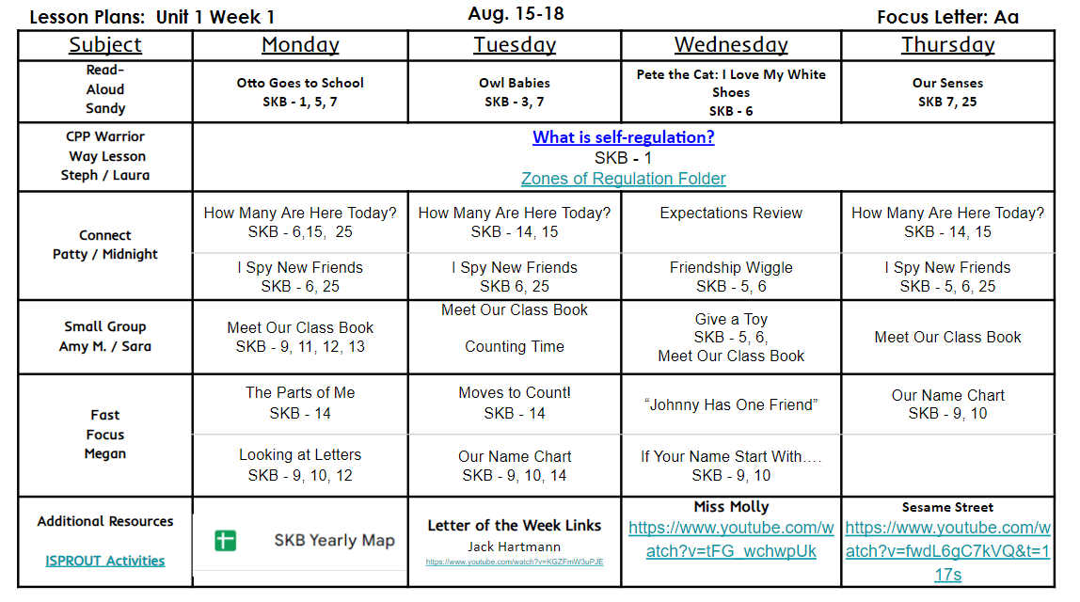
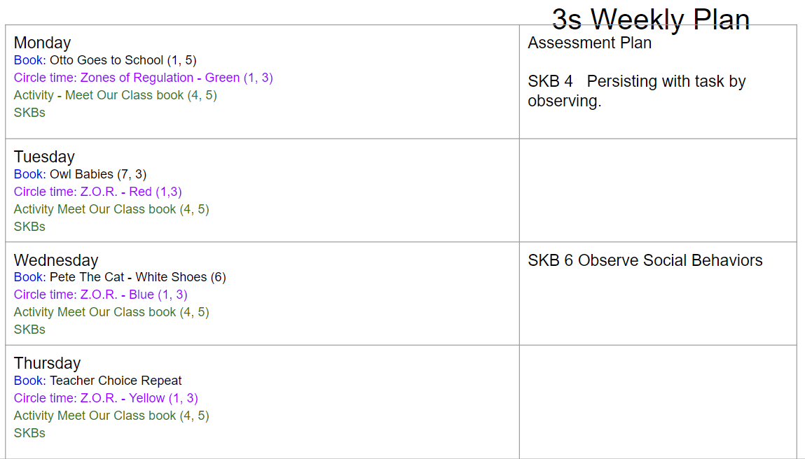

Slide 13
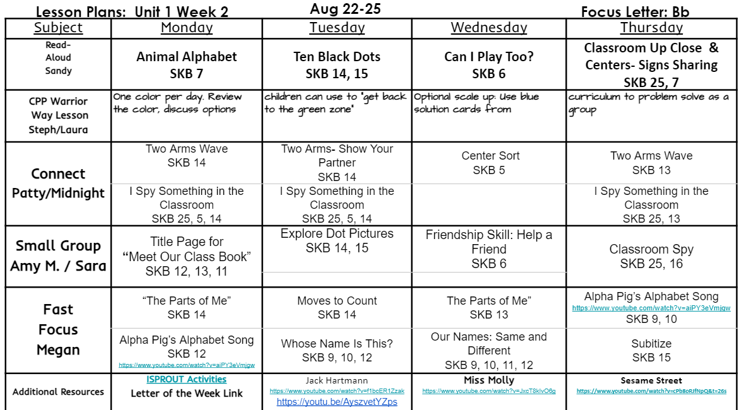
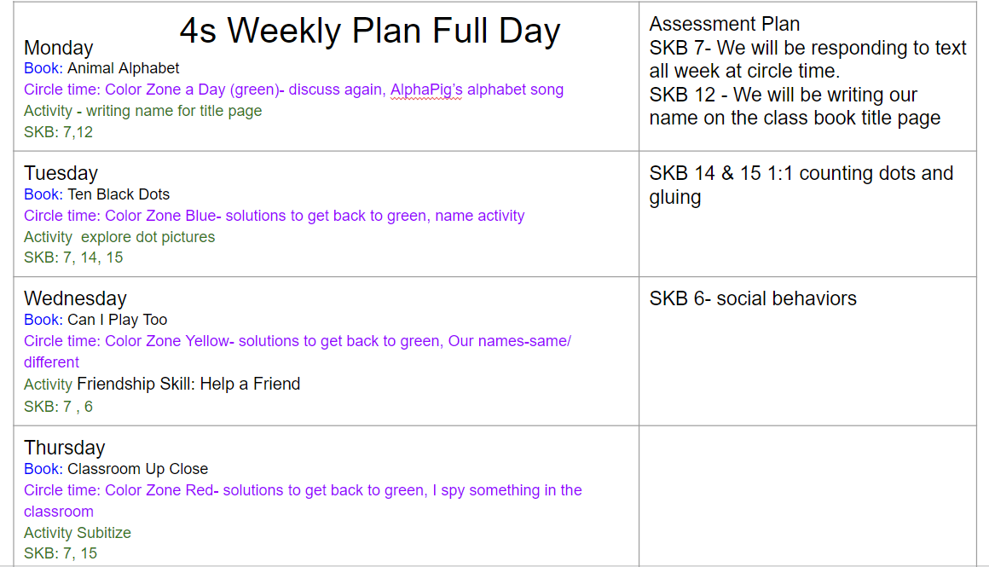

Slide 14
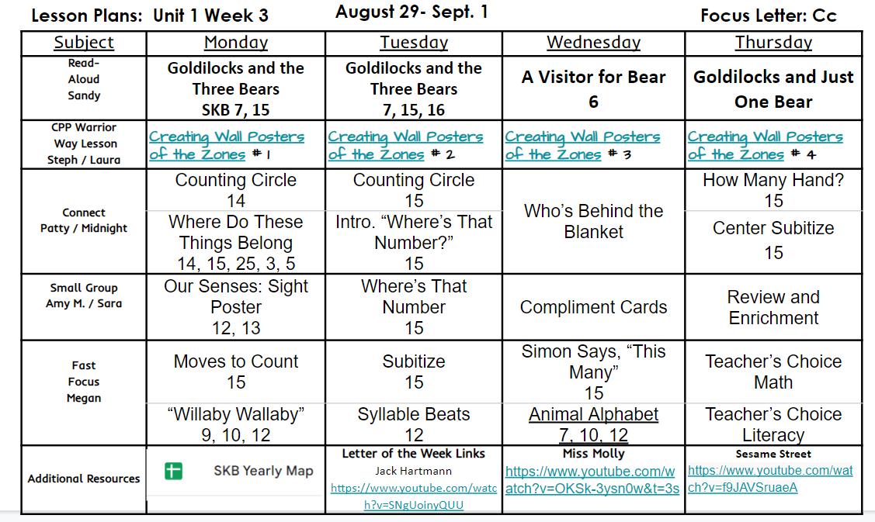
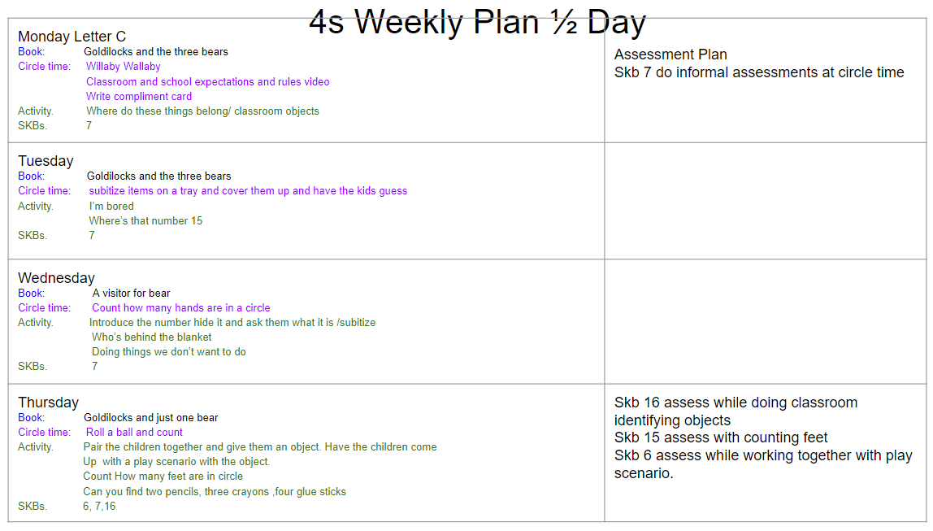

Slide 15
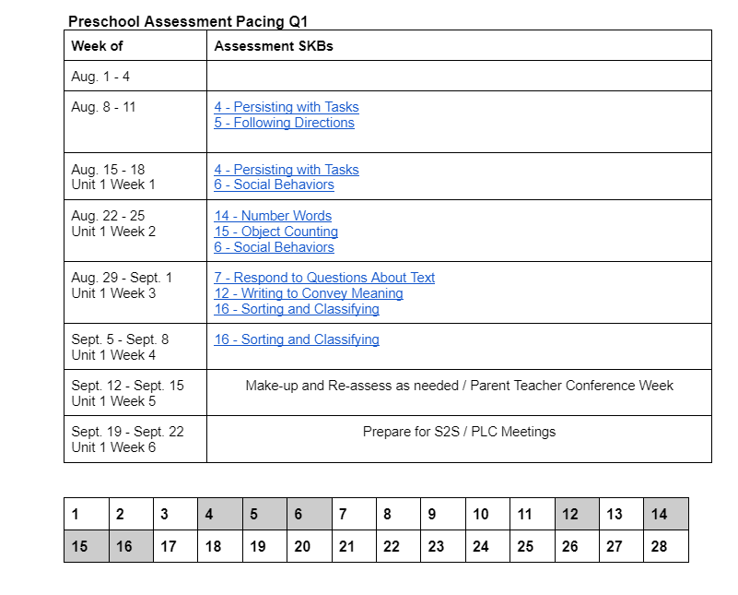
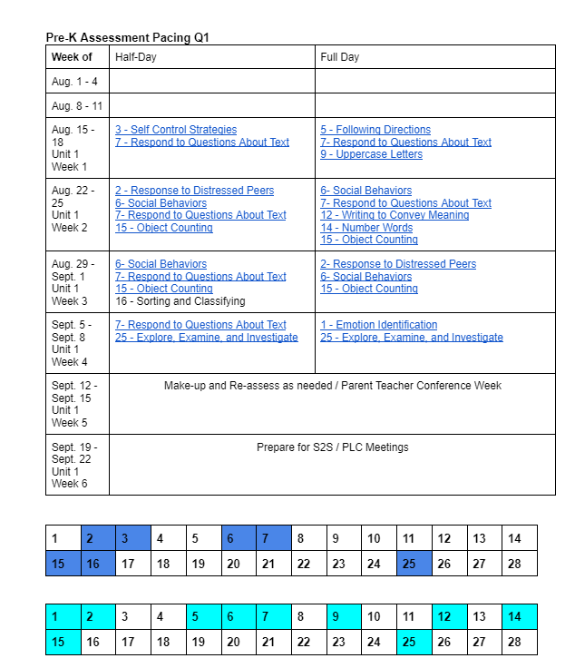

Slide 16
DAP: Planning and Implementing an Engaging Curriculum to Achieve Meaningful Goals …NAEYC Position Statement.
Educators use the curriculum framework in their planning to make sure there is ample attention to important learning goals and to enhance the coherence of the overall experience for children.
Educators are familiar with the understandings and skills in each domain (physical, social, emotional, linguistic, and cognitive) that are key for the children in their group. They know how development and learning in one domain impacts the other domains and crosses subject areas. They recognize that making sure the curriculum is culturally and linguistically relevant for each child is essential for supporting all development and learning across all domains and subject areas.
In their planning and follow-through, educators use the curriculum framework along with what they know (from their observation, documentation, and other assessment) about the children’s knowledge, interests, progress, languages, and learning needs. They carefully shape and adapt the experiences to be responsive to each child and to enable each child to reach the goals outlined in the curriculum.

Slide 17
In determining the sequence and pace of learning experiences, educators consider the learning progressions that children typically follow, including the typical sequences in which skills and concepts develop. To maximize language development, educators recognize differences in developmental progressions for monolingual, bilingual, and multilingual children and support the development of multilingualism. Educators use these progressions with an eye toward helping each child progress in all areas, and they make adaptations as needed for individual children. When children’s experiences have not matched the expectations for schooling, educators can both work to change inappropriate expectations and adapt the curriculum to build on children’s strengths and help them gain skills and knowledge. Such adaptations should maintain children’s agency; children can be partners with educators in guiding their learning, which reinforces high expectations and beliefs (on the part of both the child and the educator) in that child’s potential.
https://www.naeyc.org/resources/position-statements/dap/planning-curriculum

Slide 18
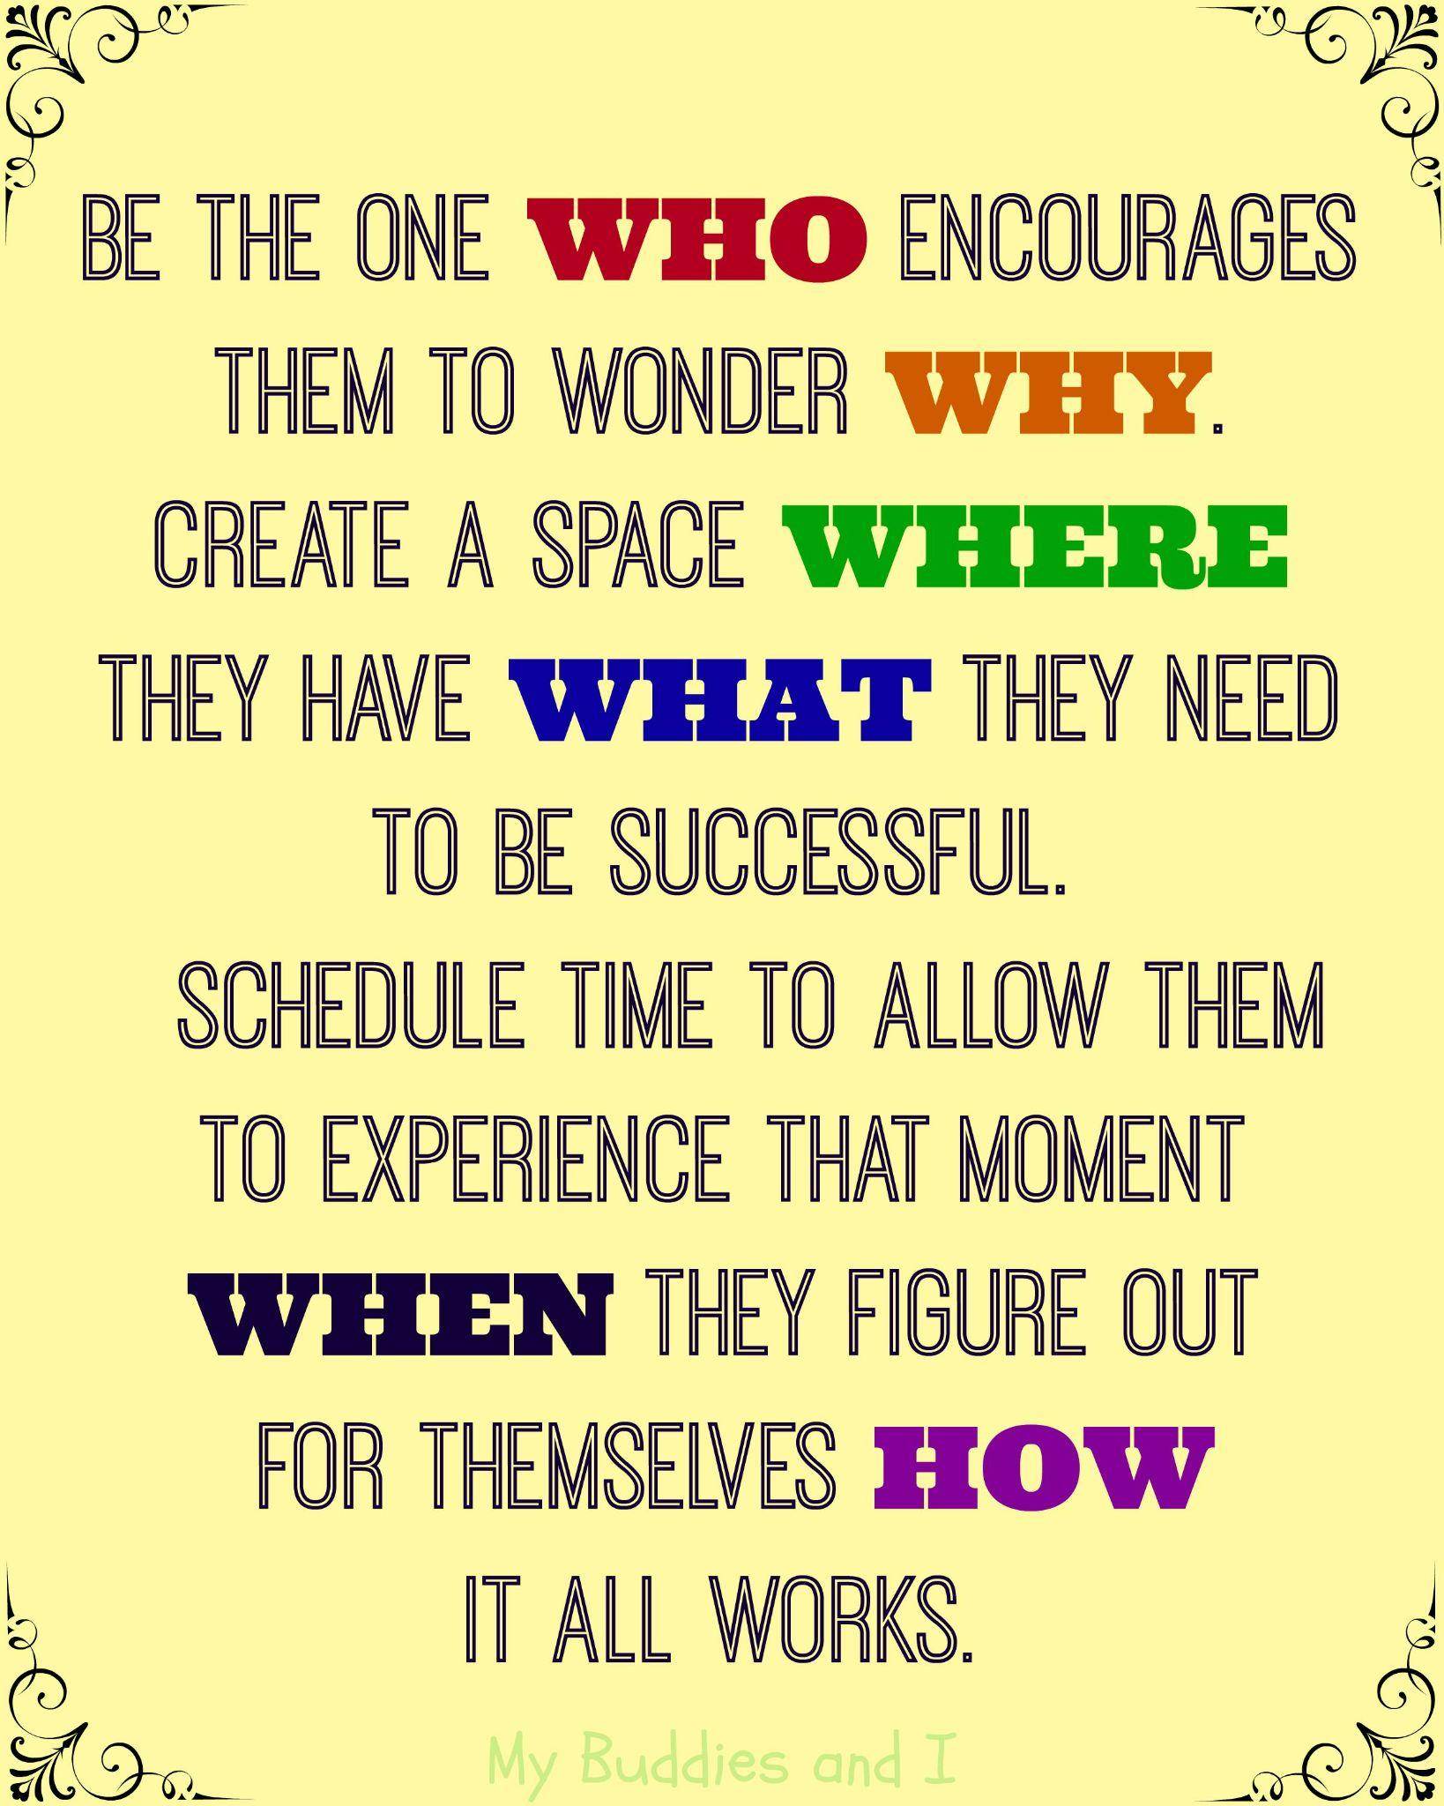

Slide 19
References
https://www.in.gov/doe/students/indiana-academic-standards/early-learning/
https://www.naeyc.org/resources/position-statements/dap/planning-curriculum
Clark-Pleasant Early Learning Center Documents

Slide 20
Kristin Parisi
@kristinparisi
kparisi@cpcsc.k12.in.us

Slide 21

Thank you for attending!
Please complete the short feedback survey on the screen.
Don’t forget to download your PGP Certificate from the webcast toolbar.
Notes:
Make this the last slide in your presentation

