Slide 1

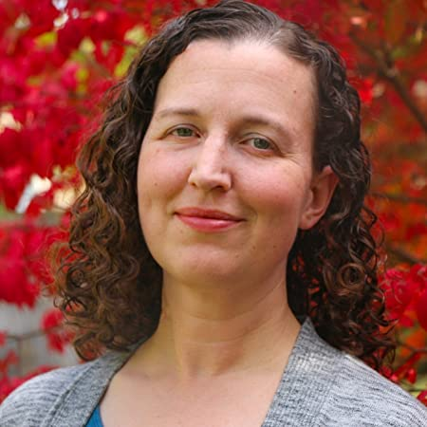
Grant Writing 101 –
Part 1
Presentation by:
Dr. Krista Smith

Slide 2

Take Control of your Learning Experience
ON24 Learning Platform:
All windows are resizable and moveable
Use the Related Content box to access slides and resources
Submit your questions using the Q&A
PGP certificates are available for download
Use the toolbar to access other features and bring back minimized tools.
Notes:
Hello and welcome to our session, Grant Writing 101: Part 1. I am Krista Stith, cofounder of Ben + STEM. Thank you for joining me at Keep Indiana Learning.
Before we get started, a few quick notes about this ON24 platform. You can resize, move, and minimize all the windows on the screen to best suit your learning style.
When I share my screen to demonstrate a tool or resource, you may want to maximize this video window. Click the four arrows at the top of this window to go to full screen, and click the escape button on your keyboard to exit full screen. If you are watching this on a mobile device or tablet, you can pinch and zoom to increase the size.
The slides and resources mentioned in the session can be accessed in the Related Content box. If you do not see the Related Content box, you can click on the checklist icon from the toolbar. Feel free to pause the video as needed.
You can ask questions throughout the session using the Q&A tool from the toolbar. If this is an On Demand session, those questions will be sent to me via email and I will respond back to you at the email you used for registration.
If you would like to share this session with a colleague, please click the share button in the toolbar. At the end of this session you will be prompted to complete a short survey. You can also access the survey at anytime by clicking on the hand/survey icon in the toolbar.
PGPS are available after you have watched 85% of this session. Click on the certificate icon in the toolbar to download your PGPs.
Let’s get started!

Slide 3

Program Agenda
My own grant writing journey
Why do we need funding?
What are grants
How is grant writing approached
Important points to get started
Photo by Brooke Cagle on Unsplash

Slide 4
Defining the Problem
Dynamics of state spending
Traditional approaches to raise funds (pledge fundraisers, bake sales, auctions, campaigns, donations, competitions, and crowdfunding)
Not a lot of professional development opportunities in grant writing

Slide 5
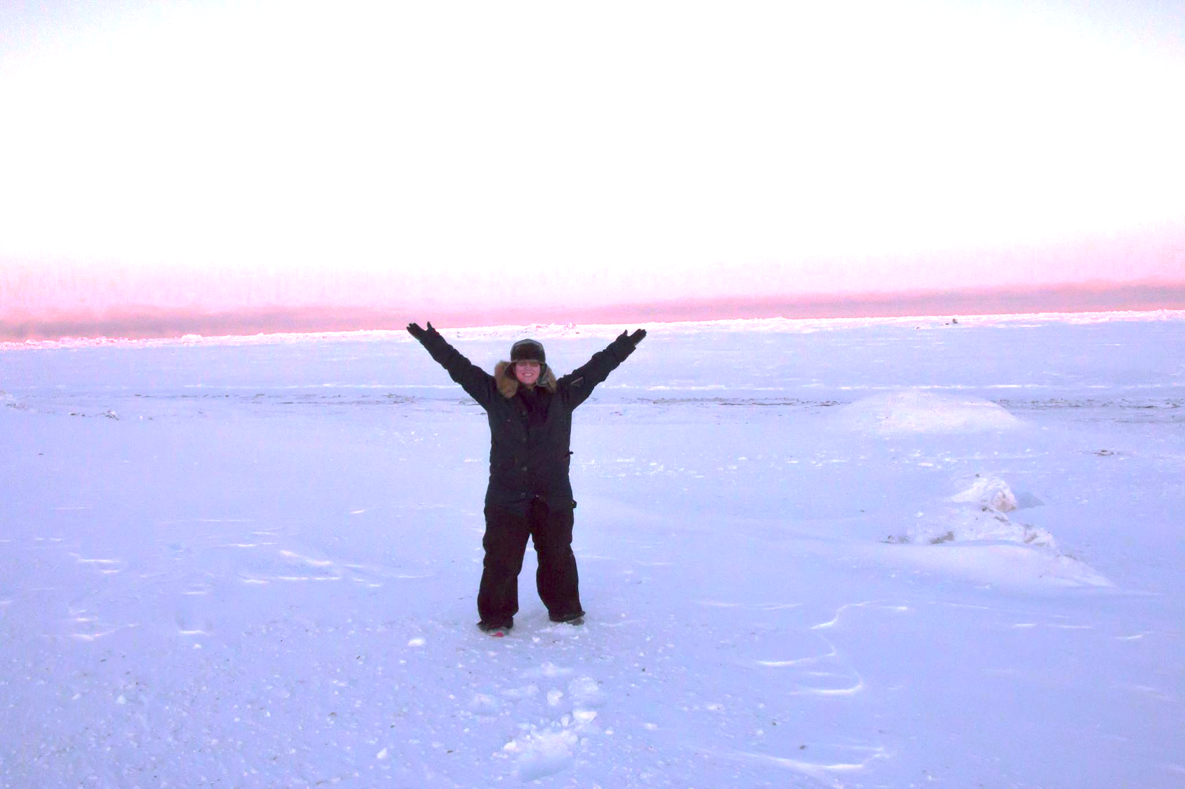
My own grant writing journey
Arctic Circle with my high school students!

Slide 6
What is a grant
“A grant is an award of money that allows you to do specific things that usually meet very specific guidelines
that are spelled out in detail and to which you must respond clearly in your grant proposal.”
  -Ellen Karsh and Arlen Sue Fox, The Only Grant-Writing Book You Will Ever Need (2014)

Slide 7

Approaches By Schools and Districts
Individual writer (e.g., teacher or school leader)
School or District Writer
Collaborative team/Grant Committee
Hire an external grant writer
Potential benefits and drawbacks?
Photo by Surface on Unsplash

Slide 8

Important Points to Get Started
501c (specifically a 501c3) status is usually a necessity
  Governmental or tribal organization (state, city, etc.)
  Public or private academic institution
  Researcher within an academic institution
  Businesses under very specific circumstances

Slide 9

Important Points to Get Started
Grants are generally competitive
  Multiple 501c(3)-designated organizations may be requesting from the same pool of funds
  A strong grant proposal shines
  Perseverance is key
Photo by Erda Estremera on Unsplash

Slide 10

Important Points to Get Started
Follow the grant-making organization's rules
  Rules for grant proposal
  Rules for managing the grant
  Always keep communication open

Slide 11

Important Points to Get Started
Be realistic
  Do not immediately go after huge grants worth tens of thousands and millions of dollars (unless you are partnering with others)
  Align your proposal with the mission, vision, and goals for the school/ educational program and not your own interests
Photo by Steven Lelham on Unsplash

Slide 12
In Conclusion
Grants are a great approach for raising funding
Learnable skill set to benefit students and the community
501c3 designation usually a necessity
Be prepared for competition
Follow the rules!
Be realistic in initial goals

Slide 13

Moving Forward
Definitions and initial preparation
Where and How to find grants
Drafting proposal components
If awarded, what is next?
Evaluation and Sustainability
Photo by Frederick Lower on Unsplash

Slide 14
Presenter Name
@Plus_STEM
Ben+STEM
KristaS@infinitecapacity.com

Slide 15
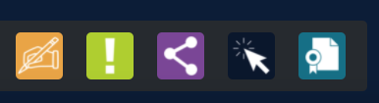
Thank you for attending!
Please complete the short feedback survey on the screen.
Don’t forget to download your PGP Certificate from the webcast toolbar.
Notes:
Make this the last slide in your presentation

