Slide 1



An Intimate Dialogue with Indiana STEM Certified Schools
Place Title Here
Presentation by:
Your Name Here
Hosted by:
Amanda McCammon
Notes:
SS is the STEM leg of KInL. SS is a STEM-centric community of practice committed to fostering the delivery of data-informed services, including high-quality professional development, resources, and support for STEM-focused districts, programs, and organizations in an endeavor to produce a combined impact greater than the sum of separate STEM efforts.
STEM Synergy is a result of numerous partnerships over the years and is the latest iteration of the Indiana STEM Ecosystem.
Today we will be having a casual conversation with a few representatives from schools that have gone through this process and been successfully awarded.

Slide 2
Who I Am…
17 Years in Indiana Public Education
Former Teacher, Building Administrator, CTE Director, Student Services Coordinator, and Assistant Superintendent
Former IDOE Chief of Workforce & STEM Alliance
Current KInL STEM Synergy Coordinator & Indiana STEM Ecosystem Lead
Notes:
Over a 17 yrs serving at all levels in Indiana education
Technology education and PLTW teacher, building administrator, CTE Director, Student Services Director, and Assistant Superintendent.
Two years at the State level as the Chief of Workforce & STEM Alliances.
Led the charge from the General Assembly in 2017 to develop a 6 year Statewide STEM strategic plan outlining Indiana's objectives for STEM education.
Served across the nation as an educational consultant working toward equitable, high quality STEM for all. Amanda also serves as the Indiana STEM Ecosystem Lead and STEM Synergy Coordinator for CIESC/Keep Indiana Learning.

Slide 3
The STEM Certification Support Series…
Your Application Questions Answered by IDOE Finalizing and Submitting Your Application Using the Feedback to Build Your Evidence Preparing for Your Site Visit Learning from Each Other (Various Podcasts & Panels) Announcing & Using Your Status Getting Buy-In Ready for Recertification 2022-23 Application Review
Notes:
As a reminder…This session is one of many within the Road to STEM Certification Series and is intended to provide “just in time” support for schools that have recently applied to the IDOE for STEM Certification but will also provide future insight for those schools looking to apply in the future.

Slide 4
Expert Panel
Pat Jarboe, William Tell Elementary, Teacher
https://sites.google.com/tellcity.k12.in.us/idoestemcertifiedschoolsdigita/evidence/partnerships
Notes:
Ask each to give a little bio/background of their role in STEM cert.
https://sites.google.com/tellcity.k12.in.us/idoestemcertifiedschoolsdigita/evidence/partnerships

Slide 5
Expert Panel
Mr. Chris Gibson, Principal, EVSC New Tech Institute HS
https://sites.google.com/evsck12.com/idoestemcertifiedschoolsdigita
Notes:
Ask each to give a little bio/background of their role in STEM cert.
https://sites.google.com/evsck12.com/idoestemcertifiedschoolsdigita

Slide 6
Expert Panel
Nancy Campbell, Principal, Prosser Career Education Center
Notes:
Ask each to give a little bio/background of their role in STEM cert.

Slide 7
Q & A Time
Please put any questions you have in the chat!
Notes:
SAMPLE Questions:
Tell me a little about the school and community where you serve.
School name, location, size, make up
What role did you play on the team during the certification process?
When did your school get certified? How long did they work to prepare?
How did you engage the Board, community, students, guardians and other stakeholders in the process?
Why was that important?
How did you get buy in?
What were some things you did to involve them?
Who was on the STEM leadership team?
What recommendations would you make to other schools in regard to who they should get on this team and why?
How was the entire school staff involved in the process?
What changes, if any, did you have to make in order to be ready to apply?
What area of the rubric was the biggest struggle to meet?
What did you find most difficult about the evidence collection?
What was the site visit like?
How did you prepare?
What would you recommend from that day to others to help them prep?
What has changed in your school since being certified?
Has it helped your school and community? How?
What are your schools next step to continue driving STEM forward in your school and community?

Slide 8
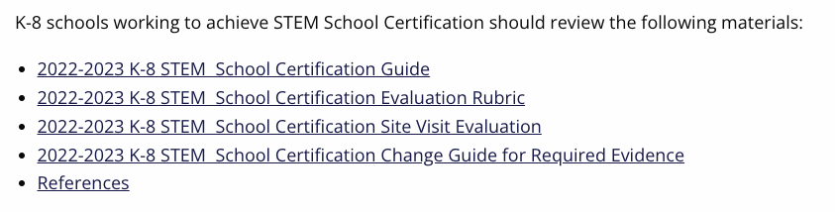
IDOE Resources for STEM School Certification
https://www.in.gov/doe/students/stem-school-certification/
Notes:
https://www.in.gov/doe/students/stem-school-certification/
https://www.in.gov/doe/files/STEM-Certified-Schools-List-for-website.pdf

Slide 9
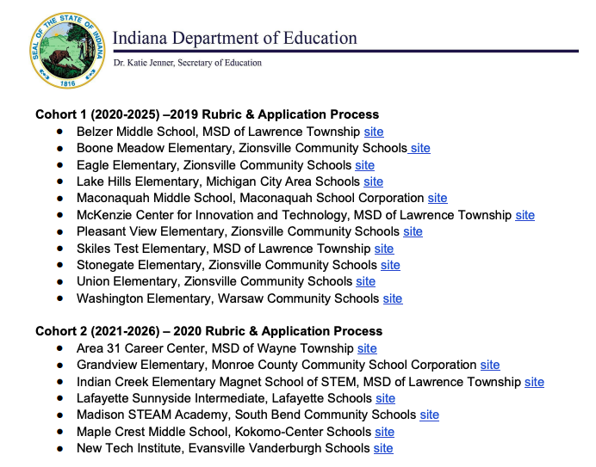
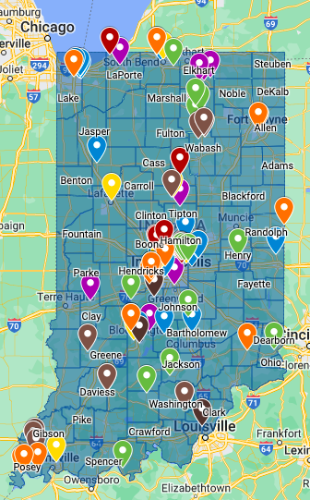
IDOE Resources for STEM School Certification
https://www.in.gov/doe/files/STEM-Certified-Schools-List-for-website.pdf
Notes:
https://www.in.gov/doe/students/stem-school-certification/
https://www.in.gov/doe/files/STEM-Certified-Schools-List-for-website.pdf

Slide 10
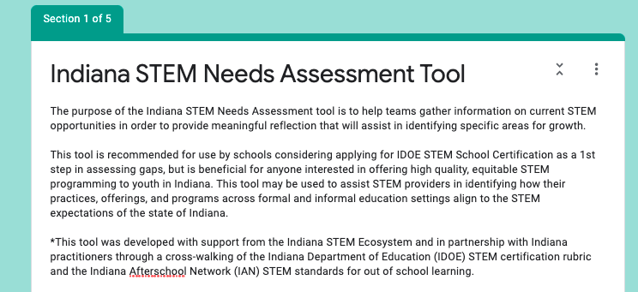
Notes:
Short form needs assessment - https://forms.gle/h1rHumi7FdGsuhc2A

Slide 11

Notes:
Ready to dive in and prep for application? Join us for the Bootcamp!
Learn from schools that are certified! Assess your needs and gaps, create a plan of action to get you to the finish line!
https://keepindianalearning.org/conferences-summits/stem-synergy-summer-bootcamp/

Slide 12

THANK YOU!!
STEM Synergy Coordinator
Keep Indiana Learning
Amanda McCammon
amccammon@ciesc.org
www.KeepIndianaLearning.org
Twitter: @AMcCammon_
Notes:
As always, feel free to reach out with questions.
Need More Individualized Support? Reach out!

Slide 13
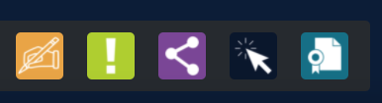
Thank you for attending!
Please complete the short feedback survey on the screen.
Don’t forget to download your PGP Certificate from the webcast toolbar.
Notes:
Make this the last slide in your presentation

