Slide 2
Take Control of your Learning Experience
ON24 Learning Platform:
All windows are resizable and moveable
Use the Related Content box to access slides and resources
Submit your questions using the Q&A
PGP certificates are available for download
Use the toolbar to access other features and bring back minimized tools.
Notes:
Hello and welcome to our session, When overwhelmed with digital citizenship, find your digital chill. . I am NAME, TITLE, ORG. Thank you for joining me/us at Keep Indiana Learning.
Before we get started, a few quick notes about this ON24 platform. You can resize, move, and minimize all the windows on the screen to best suit your learning style.
When I share my screen to demonstrate a tool or resource, you may want to maximize this video window. Click the four arrows at the top of this window to go to full screen, and click the escape button on your keyboard to exit full screen. If you are watching this on a mobile device or tablet, you can pinch and zoom to increase the size.
The slides and resources mentioned in the session can be accessed in the Related Content box. If you do not see the Related Content box, you can click on the checklist icon from the toolbar. Feel free to pause the video as needed.
You can ask questions throughout the session using the Q&A tool from the toolbar. If this is an On Demand session, those questions will be sent to me via email and I will respond back to you at the email you used for registration.
If you would like to share this session with a colleague, please click the share button in the toolbar. At the end of this session you will be prompted to complete a short survey. You can also access the survey at anytime by clicking on the hand/survey icon in the toolbar.
PGPS are available after you have watched 85% of this session. Click on the certificate icon in the toolbar to download your PGPs.
Let’s get started!

Slide 3


When overwhelmed with digital citizenship, find your digital chill.
Notes:
Icons from Noun project

Slide 4
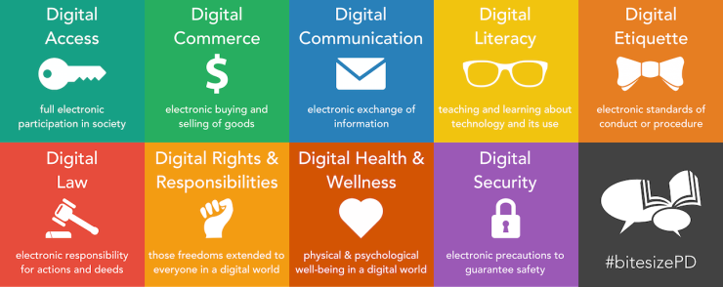
What is digital citizenship?
Graphic by Fractus Learning
Notes:
https://www.fractuslearning.com/digital-citizenship-poster/

Slide 5






What is digital citizenship?
RESPECT
EDUCATE
PROTECT
Etiquette
Access
Law
Communication
Literacy
Commerce
Rights and Responsibility
Safety (Security)
Health and Welfare

Slide 6

Digital Detectives
STOP! Too dangerous to proceed.
Slow down, be cautious - and be prepared to stop.
Coast is clear - but look both ways.
Notes:
Icons from Noun project

Slide 7


Implement in Your Classroom
During Class Implement one whole lesson every other week
Throughout Activities Include short lessons at the beginning of subject specific content
When Life Happens Make use of moments that allow for lessons to be taught with authentic scenarios
Notes:
Icons from Noun project

Slide 8
Supporting Positive Digital Behavior
Student of the Month Design a student of the month award to highlight good choices
Model Model positive digital citizenship in your own life for students
Digital Citizenship Week Highlight & participate in the national week in October
Notes:
Icons from Noun project

Slide 9


Incentives for Digital Citizenship
Digital Citizenship Student of the Week!
Sit in a rolling chair
Best of Wall
Dj for the day
Music/Headphones pass
Print color photos/artwork

Slide 10
RUPs: Students Take Ownership
Level 1 Lunch detention & letter writing | Unintentional minor offenses - only hurts the student (device use without teacher approval, etc.)
Level 2 After-school detention & letter writing | Intentional minor offenses - hurts the student and/or others (logged into another student’s account, etc.)
Level 3 Discipline committee decides | Intentional major offenses - hurts the student, others, and/or school property (changing PWs on computer)

Slide 11
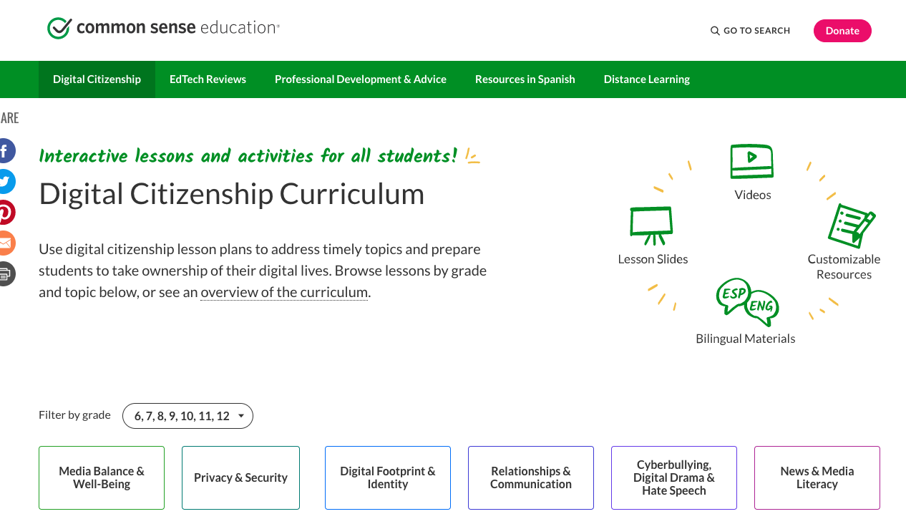
Use Common Sense
Screenshot from CommonSense Media
Notes:
https://www.commonsense.org/education/recognition-educators

Slide 12
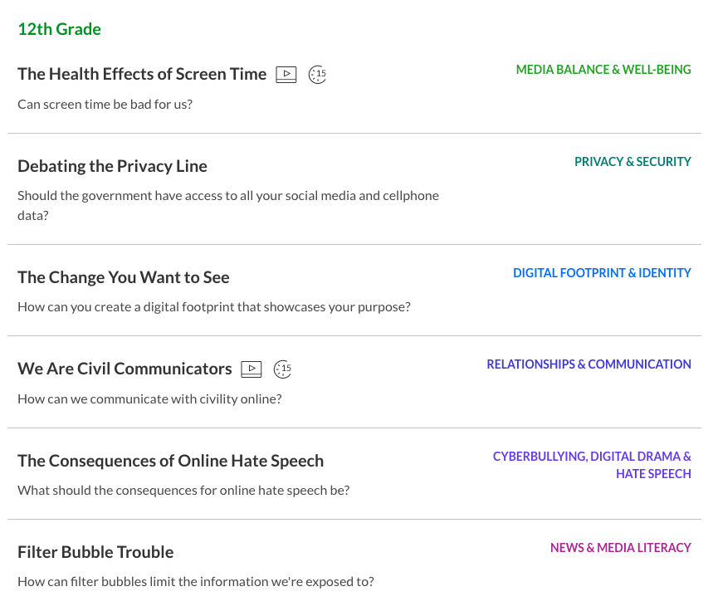
Use Common Sense
Screenshot from CommonSense Media
Notes:
https://www.commonsense.org/education/recognition-educators

Slide 13
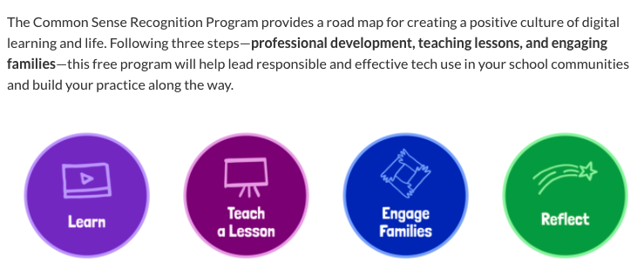
Use Common Sense
Screenshot from CommonSense Media
Notes:
https://www.commonsense.org/education/recognition-educators

Slide 14
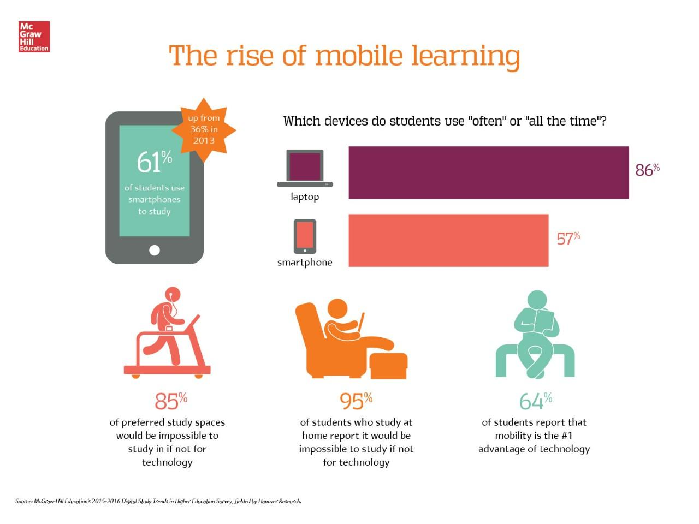
Media Habits
Graphic by McGraw Hill

Slide 15
Digital Chill
Technology steers what 2 billion people are thinking and believing every day. It’s possibly the largest source of influence over 2 billion people’s thoughts that has ever been created.
Tristan Harris, Wired Magazine
Notes:
Icons from Noun project
https://www.wired.com/story/our-minds-have-been-hijacked-by-our-phones-tristan-harris-wants-to-rescue-them/

Slide 16






Digital Chill
PURPOSE
CONNECTION
VALUE
Notes:
Icons from Noun project

Slide 17
Digital Chill
Instead of _______________,
I will ____________________.
Instead of showing notifications, I will check my accounts twice a day.
Instead of mindlessly scrolling, I will purposefully engage.
Instead of isolating myself, I will seek genuine connection.
Instead of connecting with people not present, I will engage with those in the room.
Notes:
Icons from Noun project

Slide 18


Kat Crawford and Kaylah Holland
@dramatickat and @HollandKaylah
kat@schlechty.org kholland@breakfree-ed.org

Slide 19
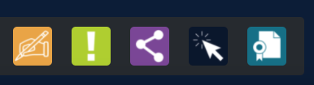
Thank you for attending!
Please complete the short feedback survey on the screen.
Don’t forget to download your PGP Certificate from the webcast toolbar.
Notes:
Make this the last slide in your presentation

