Slide 1
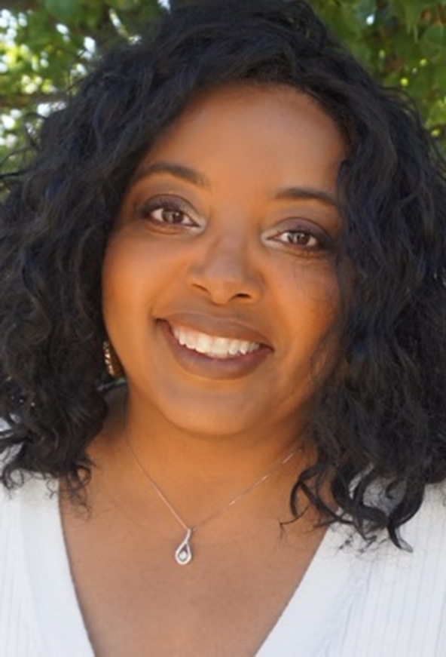
Practices to Prevent Power Struggles
Presentation by:
Angielena Williams, M.S. ECS

Slide 2
Hello and welcome to our session, Practices to Prevent Power Struggles. I am Angielena Williams, Director of Early Childhood Education at Martin University. Thank you for joining me at Keep Indiana Learning.
Before we get started, a few quick notes about this ON24 platform. You can resize, move, and minimize all the windows on the screen to best suit your learning style.
When I share my screen to demonstrate a tool or resource, you may want to maximize this video window. Click the four arrows at the top of this window to go to full screen, and click the escape button on your keyboard to exit full screen. If you are watching this on a mobile device or tablet, you can pinch and zoom to increase the size.
The slides and resources mentioned in the session can be accessed in the Related Content box. If you do not see the Related Content box, you can click on the checklist icon from the toolbar. Feel free to pause the video as needed.
You can ask questions throughout the session using the Q&A tool from the toolbar. If this is an On Demand session, those questions will be sent to me via email and I will respond back to you at the email you used for registration.
If you would like to share this session with a colleague, please click the share button in the toolbar. At the end of this session you will be prompted to complete a short survey. You can also access the survey at anytime by clicking on the hand/survey icon in the toolbar.
PGPS are available after you have watched 85% of this session. Click on the certificate icon in the toolbar to download your PGPs.
Let’s get started!

Slide 3
Practices to Prevent
Power Struggles
By Angielena Williams, M.S. ECS

Slide 4
“As human beings, our job in life is to help people realize how rare and valuable each one of us really is, that each of us has something that no one else has- or ever will have- something inside that is unique to all time. It's our job to encourage each other to discover that uniqueness and to provide ways of developing its expression.” – Fred Rogers

Slide 5
Objectives
To define discipline
To recognize normal and abnormal behavior in young children
To discuss age-appropriate discipline strategies to prevent the POWER STRUGGLE
…to HAVE FUN!

Slide 6
What disciplining young children
IS NOT-
DISCIPLINE
Action or inaction that is regulated to be in accordance (or to achieve accord) with a particular system of governance.
Discipline vs. Punishment

Slide 7
DISCIPLINE SHOULD BE…
1
2
3
4
5
Redirecting a child to a new activity
Establishing clear expectations and classroom rules
Respecting the children
Being consistent
Using positive language to explain behavior

Slide 8

The Power Struggle
When you argue with a child, the child always wins!
How would you feel if you were this child? SELF-REFLECTION!!!

Slide 9
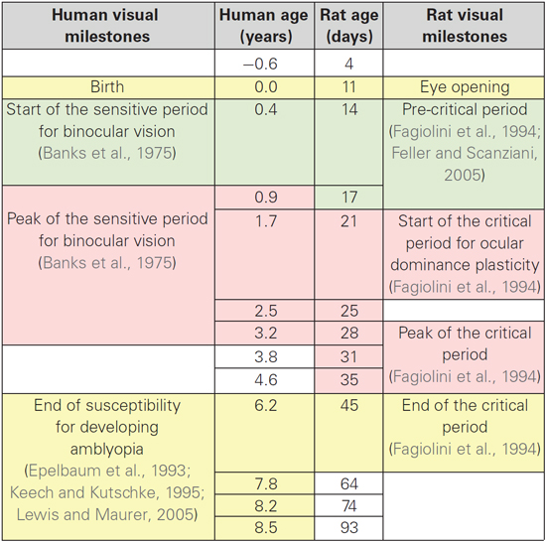
What is “normal”?
“The difference between normal and abnormal behavior is not always clear; usually it is a matter of degree or expectation.” –Dr. Solomon
Individualization
    “Understanding a child’s individual developmental progress is important in order to understand, accept, or correct his or her behavior.” –Dr. Solomon
      ***Temperament, Development, Behavior***
Reference : Solomon, M. (2015). Disciplining Someone Else’s Children. iUniverse; Bloomington, IN

Slide 10

Increase Your Knowledge
Though this list is not all inclusive, becoming familiar with these can help to prevent POWER STRUGGLES.
DEFINE
    Stages of Play | Stages of Sharing |Tantrums Autonomy | DAP

Slide 11

Warning signs of abnormal behavior…
Recognize children having...
Difficulty managing emotional outbursts
Difficulty managing impulses (such as physical aggression and verbal impulses)
Behavior that does not respond to discipline
Behavior that interferes with class routine
Behavior that interferes with social interactions
Behavior that causes self-injury

Slide 12

Age-appropriate Discipline
“The National Association for the Education of Young Children (NAEYC) DAP approach involves teachers meeting children at their age and stage of development. Accomplishing this can help each child meet challenges and achieve learning to his or her potential.” – Dr. Solomon

Slide 13
Age-appropriate Discipline
The Benefits of DAP Discipline
      How to problem solve
      Anger management
      Self-discipline
      Impulse control
      Social skills
      How to recognize and express feelings

Slide 14
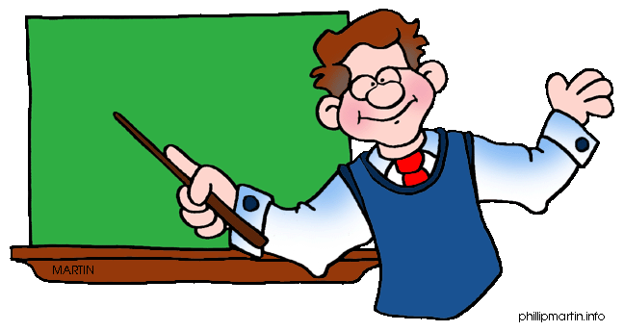

What can you as the adult do to be proactive to prevent
POWER STRUGGLES?
Use Self-Reflection
Leave home at home
Reflect on your personal values and beliefs
Be culturally, diversity, and linguistically aware
Reflect throughout the day and with your teaching teammate

Slide 15
TAKEAWAY
        What do you want to remember?
INSPIRE
        Be for the children who you would have wanted as a child.
ACTION
        How will you apply this in your classroom?

Slide 16
References
Solomon, M.L. (2015). Disciplining Someone Else’s Children, A Guide for Child Care Providers. iUniverse; Bloomington, IN
http://childwelfare.gov/preventing
http://www.sagepub.com/upm-data/53567_ch_10.pdf
https://infohub.nyced.org/.../tools-of-autonomy-pre-k.pdf?sfvrsn=7c330056_2

Slide 17
Angielena Williams, M.S. ECS
Director of Early Childhood Education
Martin University
awilliams@martin.edu
317-917-3965

Slide 18
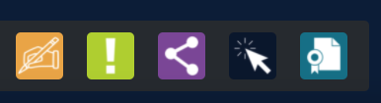
Thank you for attending!
Please complete the short feedback survey on the screen.
Don’t forget to download your PGP Certificate from the webcast toolbar.
Notes:
Make this the last slide in your presentation

