Slide 1

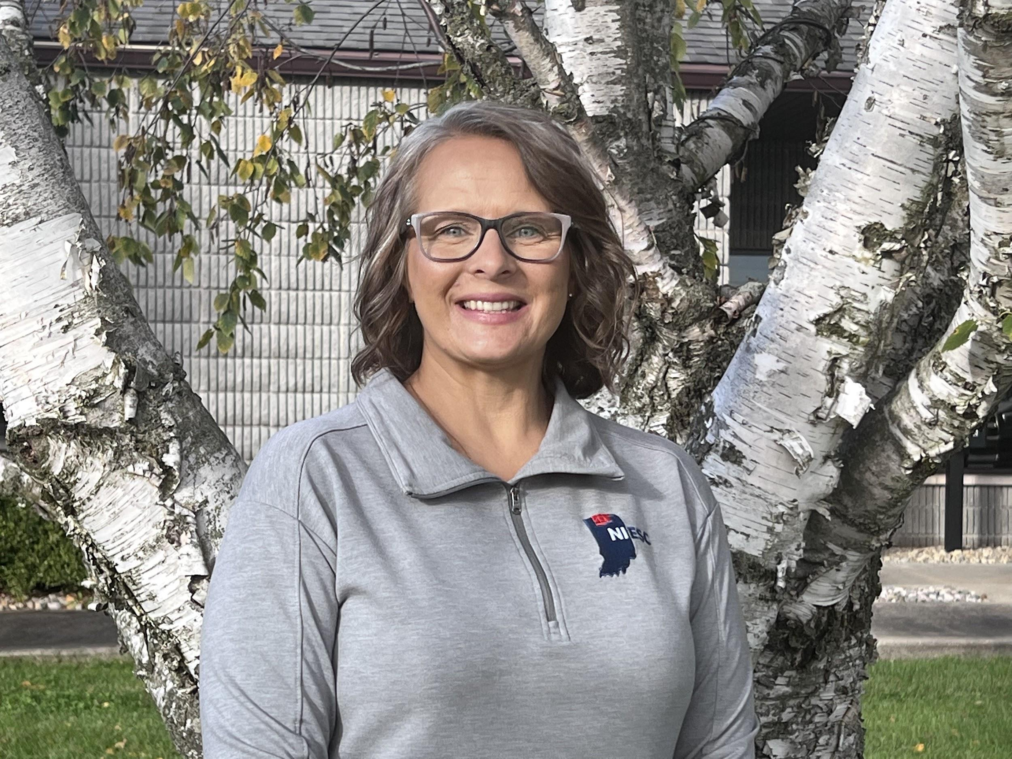


Creating Templates with Google Docs
Presentation by:
Darlene Kennedy

Slide 2


Darlene Kennedy
Director of Technology Integration
dkennedy@niesc.k12.in.us

Slide 3
Agenda
Navigate Google Templates & Custom Templates
Transfer paper forms to online fillable forms with Google Docs & Tables
Manage template submission workflow with Google Admin
Create a new workflow for your organization with online templates
Notes:
!!! Designer note: Duplicate slides or copy and paste the text boxes in the template to keep the same text formatting and position on the slide.

Slide 4
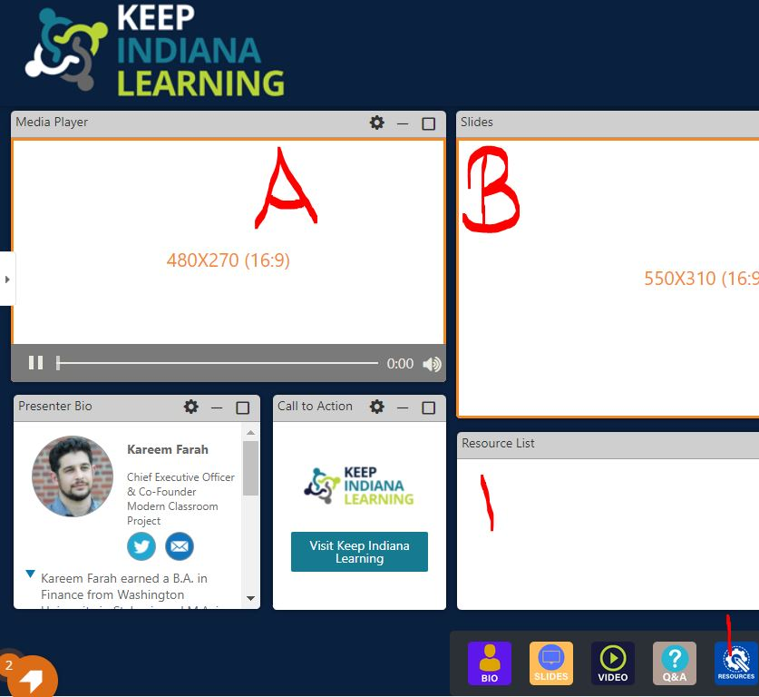


KInL ON24 Platform Tips
Follow these few tips to maximize your learning potential in today’s session:
Go Full Screen with Media Player to see my screen share
  (Window A, )
Use the Toolbar icons below
  Resources: get a copy of resource slides to follow along & take notes
  Chat: Ask a question live
    If you are watching a recorded session, this will send an email to the presenter!
  React: Let me know what you like along the way!
1
2
a
b
c

Slide 5
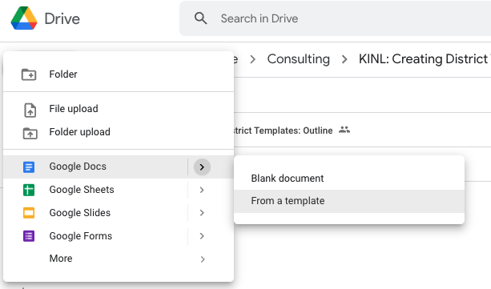
Let’s Get Started with Templates
Each Google App has Templates
Google Templates
Organization Templates
Open Google Drive
New Button (top, left corner)
Select App - use the arrow on the right
Click “From a Template”
Notes:
!!! Designer note: Duplicate slides or copy and paste the text boxes in the template to keep the same text formatting and position on the slide.

Slide 6
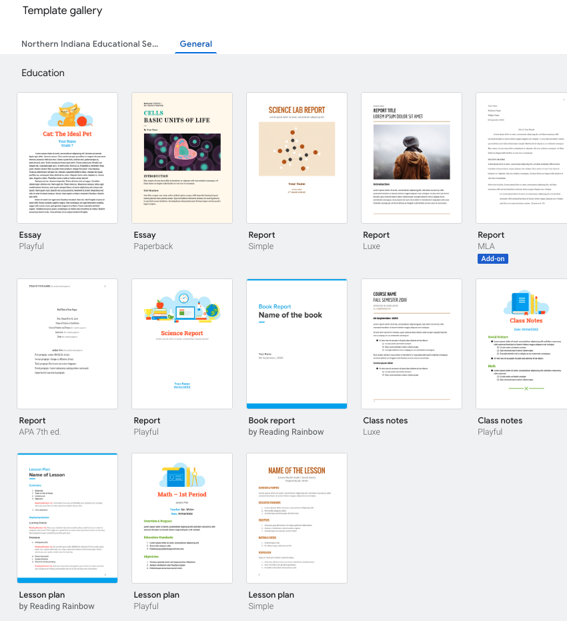
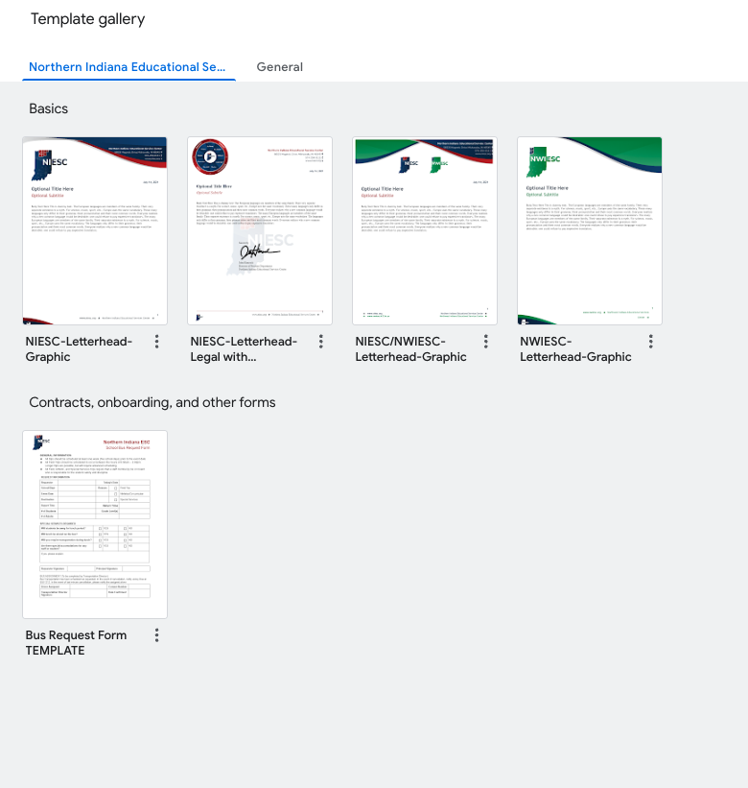
Google Templates vs. Organization Templates
Notes:
!!! Designer note: Duplicate slides or copy and paste the text boxes in the template to keep the same text formatting and position on the slide.

Slide 7
First Time with Templates?
Let’s review the basic steps of preparing your district for forms:
Collect Information
  Who needs access to templates: Available by Sub-OU in Google
  What Forms should be available: build them over time
  How do we make the decision: consult your admin team for approval
Take that to your Tech Department so the Google Admin Workflow is setup
Build your first form
Review with a team: a few pair of eyes to make final edits
Submit the Form for Approval
Communicate, Communicate, Communicate
Notes:
!!! Designer note: Duplicate slides or copy and paste the text boxes in the template to keep the same text formatting and position on the slide.

Slide 8
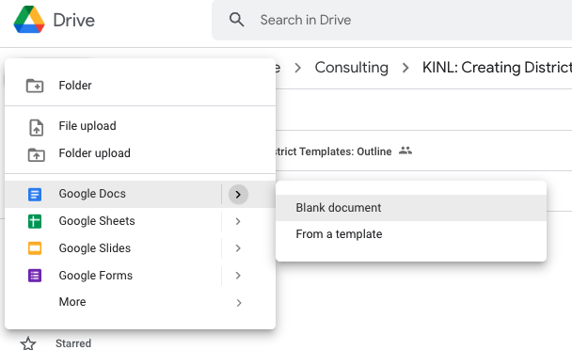
Make a Template with Google Docs
Navigate to the Google Drive Folder where you want to save the Doc
New > Doc > from a blank document
  We cannot do “from a template” because we haven’t created it yet
Notes:
!!! Designer note: Duplicate slides or copy and paste the text boxes in the template to keep the same text formatting and position on the slide.

Slide 9
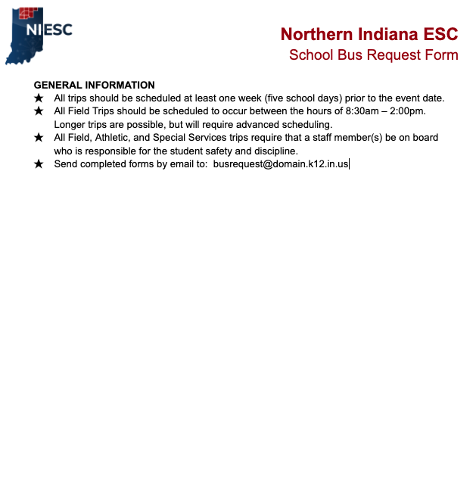
Basic Items in a Template
What should you consider for a template?
If you have a paper copy of a form, try to make it as similar as possible so it is identifiable
Create or use a pre-existing header for the district
  Don’t create a new header template if you already have it, use it and build upon it to create the form.
Instructions: be thorough in next steps
Don’t add dates, make a date field. This way your template won’t need updated
Notes:
!!! Designer note: Duplicate slides or copy and paste the text boxes in the template to keep the same text formatting and position on the slide.

Slide 10
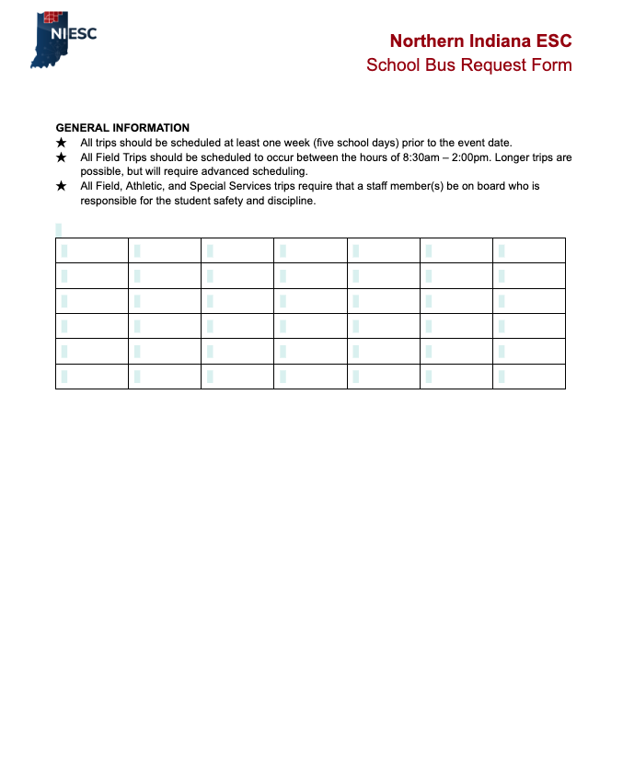
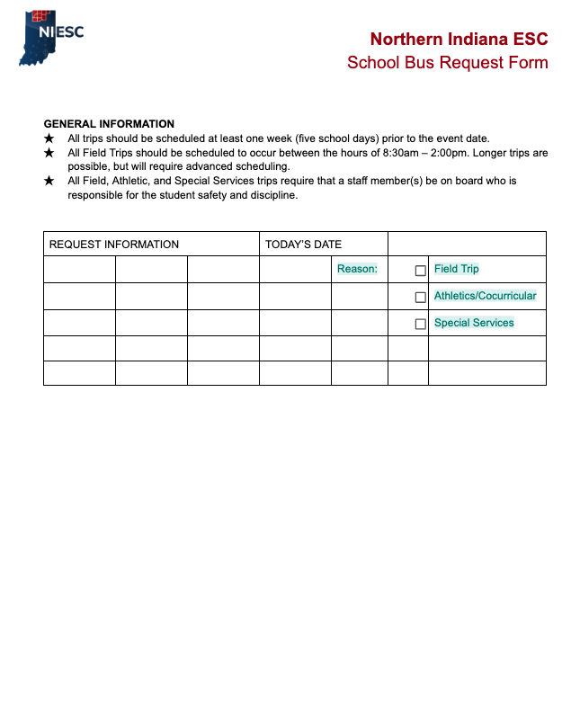
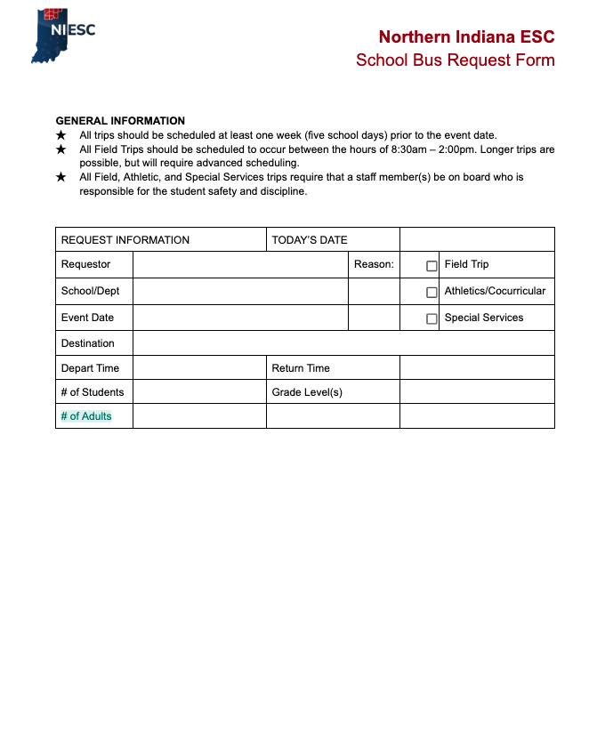
Table Modification
Notes:
!!! Designer note: Duplicate slides or copy and paste the text boxes in the template to keep the same text formatting and position on the slide.

Slide 11
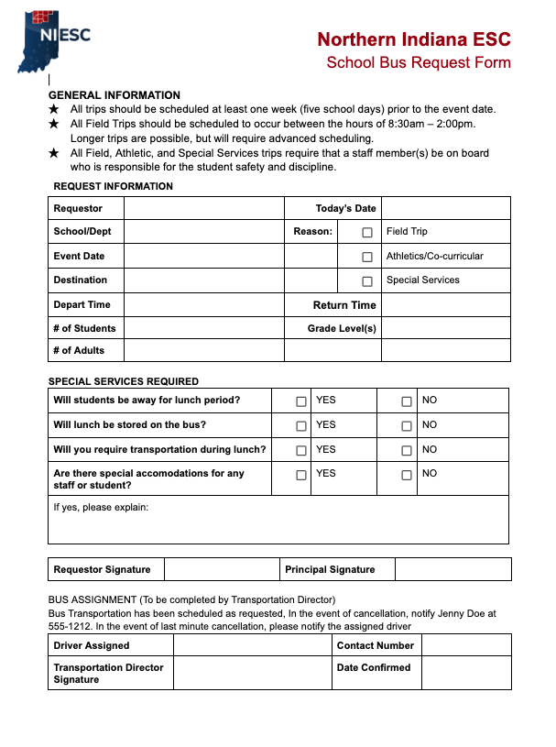
Using Tables for Fillable Forms
Always use more columns & rows than necessary
Have a visual
  Use a paper copy of a pre-existing form
  Sketch it out on a notepad
  Find a pdf online
Take advantage of checkboxes
Format cells for wrap text where needed
Fill Cells with color & bold lines to segment sections
Notes:
!!! Designer note: Duplicate slides or copy and paste the text boxes in the template to keep the same text formatting and position on the slide.

Slide 12
Deciding Access / Approval
Before making changes in Google Admin, be sure the following is decided:
Who should be able to see and use templates (admin, staff, students)
  Does this align with the Google Admin OU structure
Who can submit templates
  This can be open, by sub-ou, or a Google Admin permission
Who can approve templates
  Anyone, Sub-OU or a moderated by a Google Admin
Notes:
!!! Designer note: Duplicate slides or copy and paste the text boxes in the template to keep the same text formatting and position on the slide.

Slide 13
Setup Workflow in Google Admin
It’s time to tag in your Tech Department for access control:
Admin Console > Apps > Drive & Docs > Templates
Template Settings
Uncheck “Enable Custom templates for your organization” at the root of your domain
Turn it on ONLY for the sub-ou that need to see custom templates
This prevents student OU’s from seeing custom templates
Submission Settings
Open: anyone in the sub-OU can submit a template and it will automatically be approved and appear
Moderated: Anyone can submit but there is an approver (Google Admin Role)
Restricted: only Google Admins can submit
  A teacher or secretary would have to give the file to the Google Admin to submit
Notes:
!!! Designer note: Duplicate slides or copy and paste the text boxes in the template to keep the same text formatting and position on the slide.

Slide 14
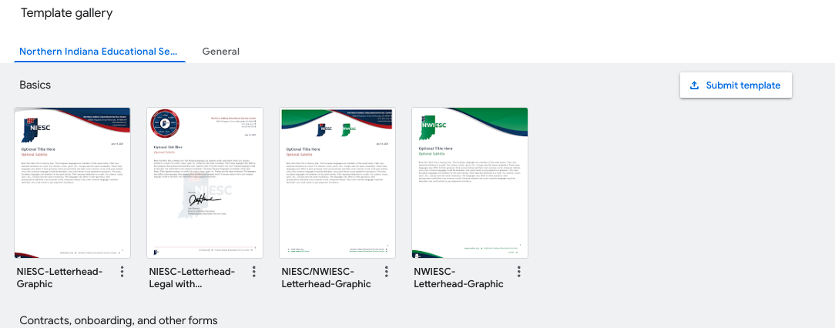
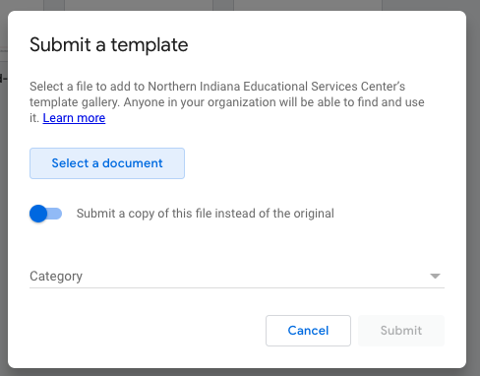
Submit the Template
Notes:
!!! Designer note: Duplicate slides or copy and paste the text boxes in the template to keep the same text formatting and position on the slide.

Slide 15
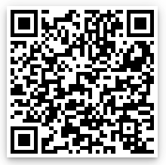
Wrap-Up
What forms would be useful to have available for your district?
How does this help your district, other than saving paper?
Use this link to add your input:
https://bit.ly/202204templates
Notes:
!!! Designer note: Duplicate slides or copy and paste the text boxes in the template to keep the same text formatting and position on the slide.

Slide 16

Want to Learn More?
Professional Development is available for your k-12 staff & instructors:
Onsite, in-person paced instruction with applicable practice time
Virtual, in-person paced instruction with applicable practice time
Materials carved to fit the needs based on a detailed survey sent to staff
Self-Paced, pre-recorded lessons paced at 1 hour of learning per week
Topics:
  Google Workspace for Office Users or Educators
  Digital Tools for Educators
  Grade Level Technology Usage Audit & Assessment
  Computer Science Standard Alignment

