Slide 1


Leading the Way for STEM An Introduction to the STEM Leadership Series
Presentation by:
Amanda McCammon
Notes:
SS is the STEM leg of KInL. SS is a STEM-centric community of practice committed to fostering the delivery of data-informed services, including high-quality professional development, resources, and support for STEM-focused districts, programs, and organizations in an endeavor to produce a combined impact greater than the sum of separate STEM efforts.
STEM Synergy is a result of numerous partnerships over the years and is the latest iteration of the Indiana STEM Ecosystem.
Today’s is the first of a series of sessions focused on leadership in STEM. Today we will be an introduction to this exciting series and we will also make sure you have all the info to register for the other 3 sessions within the series.

Slide 2

Who I Am…
17 Years in Indiana Public Education
Former Teacher, Building Administrator, CTE Director, Student Services Coordinator, and Assistant Superintendent
Former IDOE Chief of Workforce & STEM Alliance
Current KInL STEM Synergy Coordinator & Indiana STEM Ecosystem Lead
Notes:
Over 17 yrs serving at all levels in Indiana education
Technology education and PLTW teacher, building administrator, CTE Director, Student Services Director, and Assistant Superintendent.
Two years at the State level as the Chief of Workforce & STEM Alliances.
Led the charge from the General Assembly in 2017 to develop a 6 year Statewide STEM strategic plan outlining Indiana's objectives for STEM education.
Served across the nation as an educational consultant working toward equitable, high quality STEM for all. Amanda also serves as the Indiana STEM Ecosystem Lead and STEM Synergy Coordinator for CIESC/Keep Indiana Learning.

Slide 3
Today’s Learning Outcomes
By the end of the session I will….
…understand the concept of STEM literacy
…understand the similarities and differences between STEM, Integrated STEM and Integrative STEM
…be aware of the STEM Synergy Leadership Series - Leading the Way for Integrative STEM &
…be prepared to begin the on demand comprehensive series Leading the Way for Integrative STEM
Notes:
Today’s session will introduce leaders to the components of necessary collaborative strategies for facilitating an experiential and student-centered culture through leadership in integrative STEM education. From concept to considerations for implementation, this session will introduce the layout and areas of focus within the STEM Synergy Leadership Series - Leading the Way for Integrative STEM.
Learning Objectives:
Participants will:
understand the concept of STEM literacy
understand the similarities and differences between STEM, Integrated STEM and Integrative STEM
be aware of the STEM Synergy Leadership Series - Leading the Way for Integrative STEM &
be prepared to begin the on demand comprehensive series Leading the Way for Integrative STEM

Slide 4
Why a Leadership Series for STEM?
Mission and Culture
Equity, Diversity, and Inclusion
Infrastructure and Programming
Curriculum
Career and College Ready Students and STEM-Literate Citizens
Collaborative Leadership
Coherent Integrative STEM Programming
Instruction
Extended Learning
Professional Learning
Assessment
Stith, K.M., Geesa, R. L., & Egenrieder, J. (2022). Competencies of educational leadership in integrative STEM (p. 17). In R.L. Geesa, M.A. Rose, & K.M. Stith (Eds.), Leadership in Integrative STEM education: Collaborative strategies for facilitating an experiential and student-centered culture. Roman & Littlefield.
Evaluation
Notes:
First, let’s talk about WHY a series on STEM leadership.
(Figure 1.4 in the Leadership in Integrative STEM Education book used for this series.)
Often time in STEM, we focus in on just the in class components like the curriculum selection & the instructional pedagogy (PBL), and associated PD for these. All of this is very important, but we often skip the leadership component. In order to prepare STEM literate students, and develop a sustainable STEM focused level of instruction, we must not forget the leadership development and multifaceted components that play a role in this that often times, teachers have very little ability to impact. Teachers, who historically have been the focus for STEM PD, often cannot make changes needed…they can make recommendations, but not changes… on things like…School culture shifts, infrastructure changes, evaluation tool adjustments and additions, etc.
We need our educational leaders to understand the necessary components of integrative STEM and how to take those steps, in order to really make any sustainable changes and growth.

Slide 5
What is STEM Literacy?

Slide 6
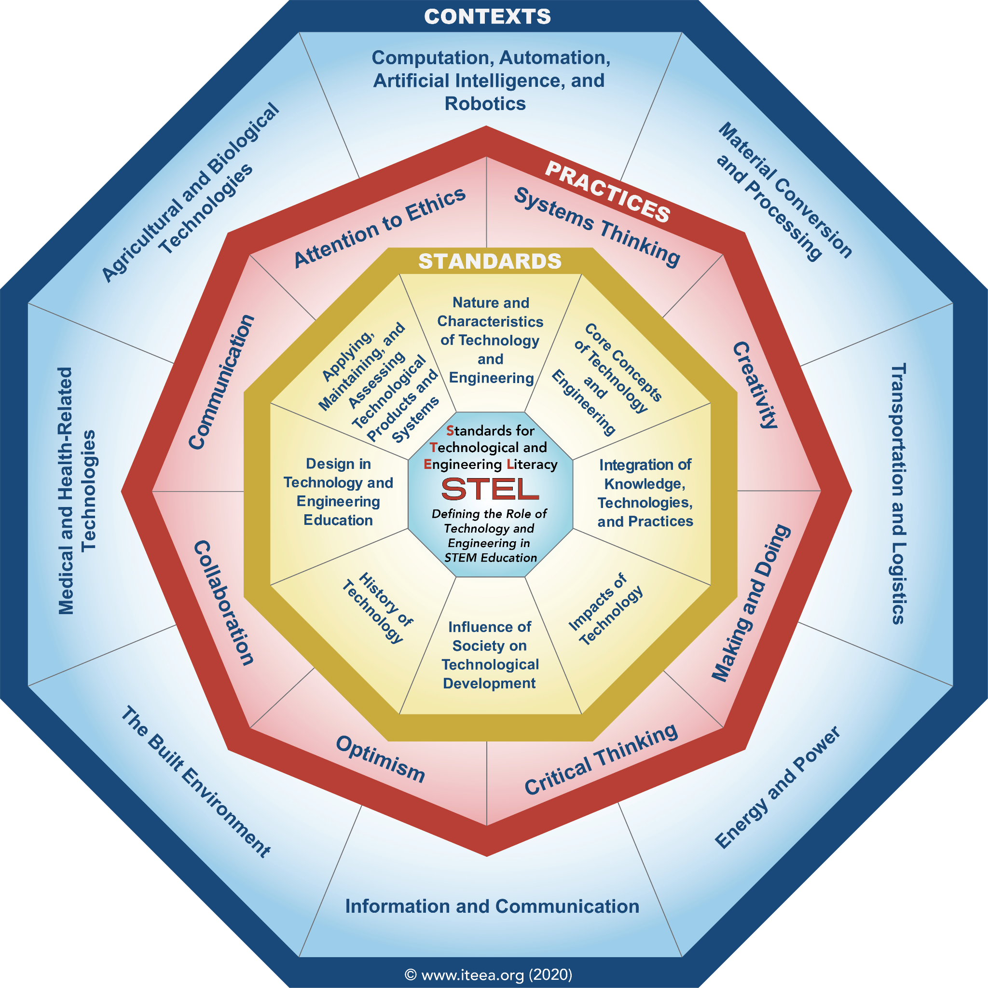
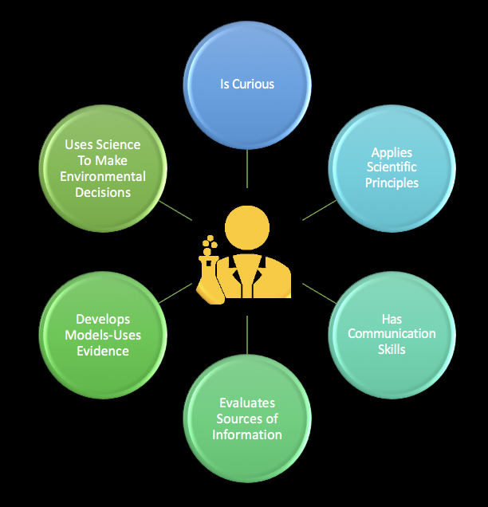
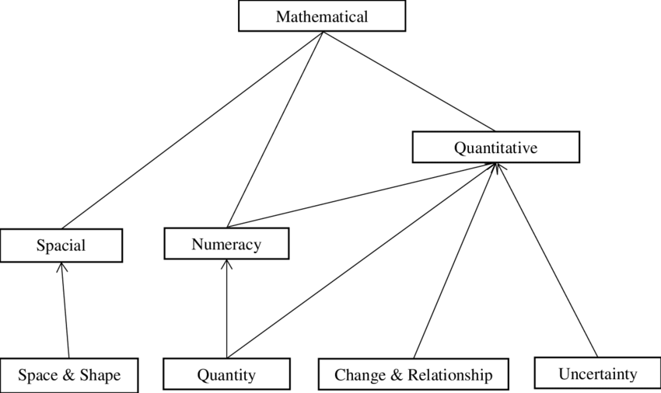
Literacy Defined
“Competence or knowledge in a specified area”
Notes:
Literacy alone is defined as the competence or knowledge in a specified area.
We often think of the ability for someone to read and write as “literacy” and in its basic definition that is true. However, literacy has stretched to other subjects outside of reading and writing and now is tied to various subject areas and content, such as science, mathematics, and technology and engineering. Each of these areas has a more specific definition of what literacy means for that particular subject area.
Let’s start of defining each component in S, T, E, and M in terms of literacy.
Science literacy refers to an individual’s: scientific
knowledge and use of that knowledge to identify questions,
acquire new knowledge, explain scientific phenomena and
draw evidence-based conclusions about science-related issues;
understanding of the characteristic features of science as a form
of human knowledge and enquiry; awareness of how science
and technology shape our material, intellectual and cultural
environments; and Willingness to engage in science-related
issues, and with the ideas of science, as a reflective citizen.
Mathematical literacy is an individual’s capacity to
formulate, employ, and interpret mathematics in a variety of
contexts. It includes reasoning mathematically and using
mathematical concepts, procedures, facts and tools to describe,
explain and predict phenomena. It assists individuals to
recognize the role that mathematics plays in the world and to
make the well-founded judgments and decisions needed by
constructive, engaged and reflective citizens [7].
Technology and Engineering Literacy (TEL) defined
capacity to use, understand, and evaluate technology as well as
to understand technological principles and strategies needed to
develop solutions and achieve goals. TEL is interrelated
domains that composed: Technology and Society; Design and
Systems; and Information and Communication Technology [8].

Slide 7
Interactions Between S, T, E, & M
Mathematical, Technology & Engineering Literacy - ability to use mathematic and engineering principles to develop and evaluate technology to develop solutions and achieve goals. Also to understand technology is created by mathematics and engineering principles to solve problems and make decisions.
Science, Technology & Engineering Literacy - ability to use science and engineering principles to develop and evaluate technology that needed to develop solution and achieving goals.
Technology & Engineering Literacy
Science,, Technology & Engineering Literacy
Mathematical, Technology & Engineering Literacy
Science Literacy
Science & Mathematical Literacy
Mathematical Literacy
Science & Mathematical Literacy - ability to use knowledge (in science and mathematics) and processes to understand, and additionally, to participate in decisions that affect science and mathematics in life, environment, and technology.
Notes:
https://www.researchgate.net/publication/332734582_What_is_Science_Technology_Engineering_Mathematics_STEM_Literacy
Equally important are the interactions between and among these
bodies of literacy…
Science & Mathematic Literacy refers to an
individual’s ability to use knowledge (in science and
mathematics) and processes to understand, and additionally, to
participate in decisions that affect science and mathematics in
life, environment, and technology.
Mathematic, Technology & Engineering Literacy
refers to an individual’s ability to use mathematic and
engineering principles to develop and evaluate technology to
developing solutions and achieving goals. This is used to
understand technology is created by mathematics and
engineering principles to solve problems and make decisions.
Science, Technology & Engineering Literacy refers
to an individual’s ability to use science and engineering
principles to develop and evaluate technology that needed to
develop solution and achieving goals.

Slide 8
What is STEM literacy?
Technology & Engineering Literacy
Knowledge, attitudes, and skills to identify questions
and problems in life situations, explain the natural and
designed world, and draw evidence-based conclusions
about STEM related-issues;
Understanding of the characteristic features of STEM
disciplines as forms of human knowledge, inquiry, and
design;
Awareness of how STEM disciplines shape our
material, intellectual, and cultural environments; and
Willingness to engage in STEM-related issues and with
the ideas of science, technology, engineering, and
mathematics as a constructive, concerned, and reflective
citizen.
Science, Technology & Engineering Literacy
Mathematical, Technology & Engineering Literacy
STEM
LITERACY
Science Literacy
Science & Mathematical Literacy
Mathematical Literacy
Notes:
https://www.researchgate.net/publication/332734582_What_is_Science_Technology_Engineering_Mathematics_STEM_Literacy
There are many definitions of STEM literacy, just as there are within the separate content areas that make up STEM, however, most of them refer to the “skills, abilities, factual knowledge, procedures, concepts, and metacognitive capabilities” for societal, economic, and personal well being through interdisciplinary areas of study.
STEM literacy is an ability to adapt and accept change
driven by the work of new technologies, in anticipation of the
multilevel impact of their actions, to effectively communicate
complex ideas for various audiences, and perhaps most
importantly, to find calculations and creativity in solving an
unimaginable problem now.
STEM literacy is also defined as
an ability to identify, apply and integrate the concepts of
science, technology, engineering, and mathematics to
understand a problem and innovate to solve the problem.

Slide 9
What is the difference between STEM, Integrated STEM & Integrative STEM?

Slide 10
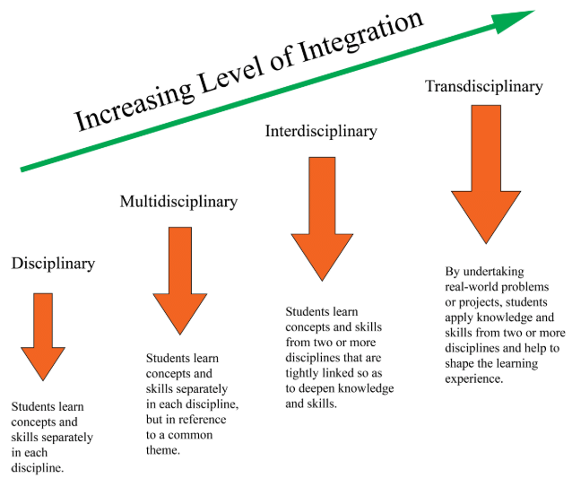
Intense
Minimal
Notes:
According to the 2022 edition of the book Leadership in Integrative STEM Education, “most definitions of STEM are addressing integration of the individual subject areas of science, technology, engineering and mathematics, but the intensity and rigor of planning for intentional integration is often understated.” (Page 5-6 & Figure 1.1)
You can look at it as a spectrum from minimal to intense integrativeness….
The design with the least intent of integrativeness is intradisciplinary or shown here as just disciplinary - this is where minimal connections are made across disciplines or not at all….just stand alone.
As these connections between disciplines are intentionally made we then have a scale moving from intradisciplinary to multi-, inter - and transdisciplinary.
Multi- is moderate integration and usually is standards being organized around a theme. The disciplines are distinctly separate, but are introduced together as part of a lesson or unit.
Inter - is moderate to intense integration with skills and concepts embedded in disciplinary standards and where the boundaries among disciplines are less distinct.
Transdisciplinary is an intense integration where all knowledge is interconnected and interdependent. Disciplines are embedded within a lesson or unit in real world contexts where students develop STEM literacy.

Slide 11
STEM Leadership Series: Facilitating a STEM-Centric Culture in PK-12 Schools

Slide 12

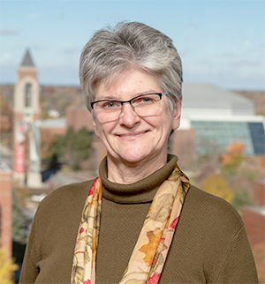

STEM Leadership Series: Facilitating a STEM-Centric Culture in PK-12 Schools
Dr. Rachel Geesa
Assistant Clinical Professor of Educational Leadership
Ball State University
Dr. Mary Annette Rose
Associate Professor of Educational Studies
Ball State University
Dr. Krista Stith
Director of the Center for Gifted Studies and Talent Development
Ball State University
Notes:
Dr. Rachel Geesa, Assistant Clinical Professor of Educational Leadership, Ball State University
Rachel Louise Geesa, EdD, is a faculty member in the department of educational leadership at Ball State University. With formal training and professional experience in art education, gifted education, and educational leadership, she guides preservice and in-service educational leaders to provide inclusive and integrative learning experiences to PK–12 learners.
Dr. Mary Annette Rose, Associate Professor of Educational Studies, Ball State University
​​Mary Annette Rose, EdD, is an associate professor of educational studies at Ball State University. She is a practitioner of integrative teaching and learning approaches, especially those that focus upon the application of science, mathematics, and social studies to enhance energy, environmental, and technological literacy.
Dr. Krista Stith, Director of the Center for Gifted Studies and Talent Development, Ball State University
Krista Marie Stith, PhD, is the Director of the Center for Gifted Studies and Talent Development at Ball State University. She holds a degree in curriculum and instruction from the Integrative STEM education Department of Virginia Tech and provides support to pre-service and in-service educators on integrative pedagogy.
Direct links:
Session 1 = https://gateway.on24.com/wcc/eh/3497555/lp/3709409/stem-leadership-series-session-1
Session 2 = https://gateway.on24.com/wcc/eh/3497555/lp/3709410/stem-leadership-series-session-2
Session 3 = https://gateway.on24.com/wcc/eh/3497555/lp/3709411/stem-leadership-series-session-3

Slide 13
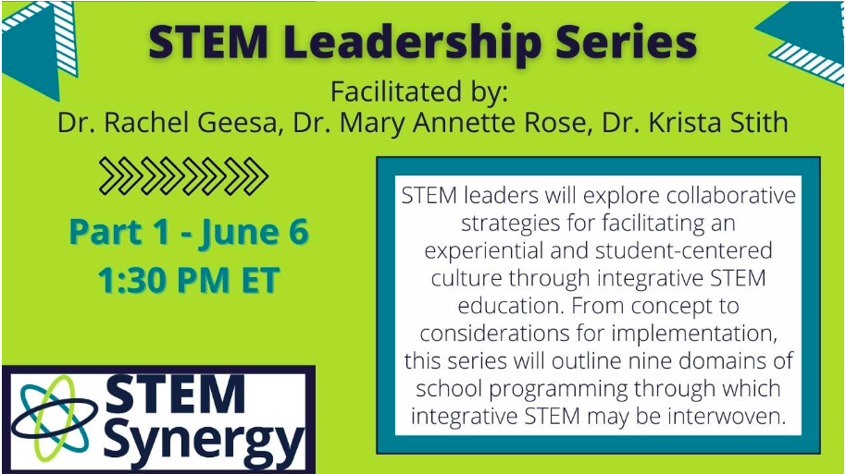
STEM Leadership Series: Facilitating a STEM-Centric Culture in PK-12 Schools
Learning Objectives:
Understand the operational definition of integrative STEM education,
explain how nine leadership competencies may foster integrative STEM culture within a school or district, and
identify schools in Indiana that have implemented integrative STEM programming.
https://gateway.on24.com/wcc/eh/3497555/lp/3709409/stem-leadership-series-session-1
Notes:
Session 1 = https://gateway.on24.com/wcc/eh/3497555/lp/3709409/stem-leadership-series-session-1
This session will introduce leaders to nine domains of school programming through which integrative STEM may be interwoven. We will define integrative STEM education in PK-12 schools, and local school case studies will be explored to better understand various STEM-focused implementation practices.
Part 1 Learning Objectives:
Participants will:
-understand the operational definition of integrative STEM education
-explain how nine leadership competencies may foster integrative STEM culture within a school or district, and
-identify schools in Indiana that have implemented integrative STEM programming,

Slide 14
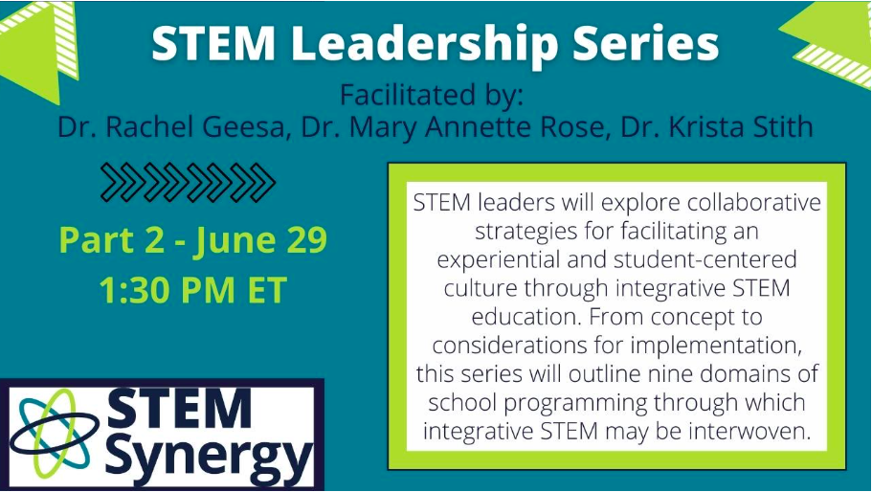
STEM Leadership Series: Facilitating a STEM-Centric Culture in PK-12 Schools
Learning Objectives:
Understand the importance of a STEM-centric mission and vision statement for a school or district,
identify strategies to build and sustain school-family-community partnerships in supporting the mission and vision,
familiarize with examples of mission and vision statements from other schools and the constructs within the statements related to program guidance, and
reflect upon session concepts to develop a STEM-centric mission and vision statement.
https://gateway.on24.com/wcc/eh/3497555/lp/3709410/stem-leadership-series-session-2
Notes:
Session 2 = https://gateway.on24.com/wcc/eh/3497555/lp/3709410/stem-leadership-series-session-2
Inclusive, integrative STEM-focused mission and vision statements are keystones in the building of a robust and equitable integrative STEM culture. In this session, we will describe critical components of developing mission and vision statements and provide examples from schools across the country.

Slide 15
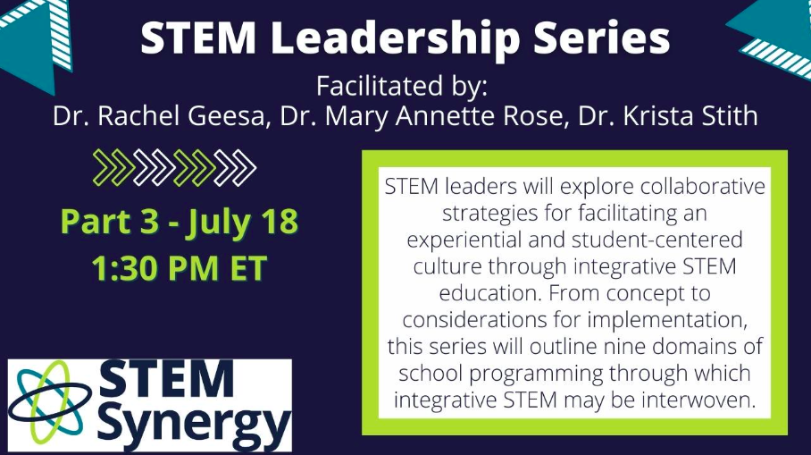
STEM Leadership Series: Facilitating a STEM-Centric Culture in PK-12 Schools
Learning Objectives:
Identify examples of locally-developed integrative STEM curriculum,
identify points of commonality—crosscutting concepts, principles, and practices—and departure of the STEM disciplines,
characterize qualities of effective multidisciplinary curriculum development team, and
reflect upon key stages and strategies for collaboratively developing integrative STEM curriculum.
https://gateway.on24.com/wcc/eh/3497555/lp/3709411/stem-leadership-series-session-3
Notes:
Session 3 = https://gateway.on24.com/wcc/eh/3497555/lp/3709411/stem-leadership-series-session-3
Maximizing relevance is a compelling reason for collaboratively developing integrative STEM curriculum. During this session, we will suggest a process for initiating collaborative curriculum development that emphasizes crosscutting concepts, principles, and practices of STEM disciplines. ‘
PUT LINK TO IDOE LEARNING LAB PD IN CHAT ALSO: If you would like to access some STEM leadership training in May, IDOE and the Learning Lab are offering sessions with our BSU prof. Friends where you can learn more about the research that contributed to the book as well as specific skills and knowledge needed within STEM.

Slide 16
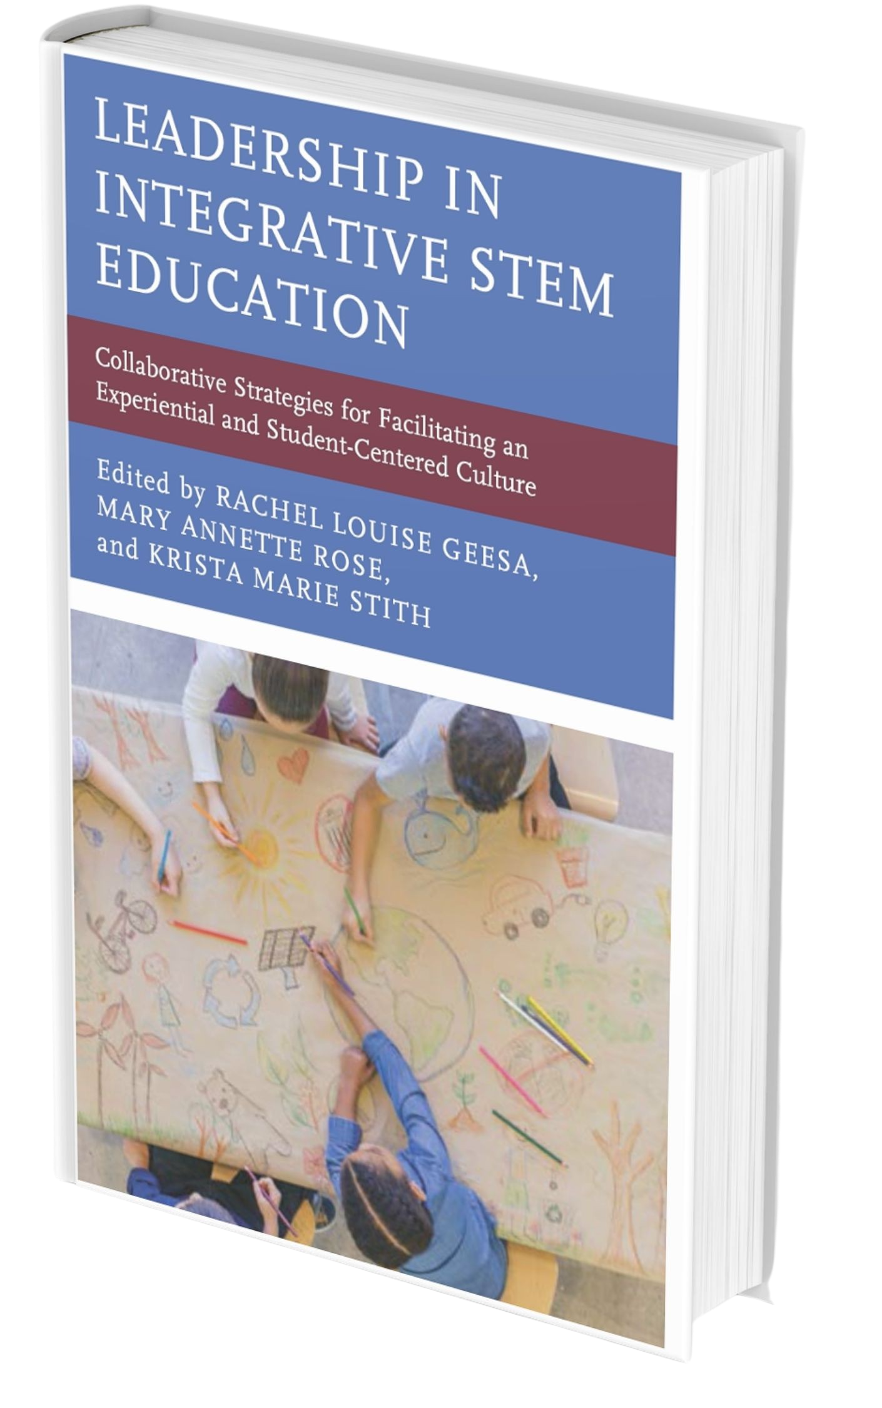
Recommended Resource:
Leadership for Integrative STEM Education: Collaborative Strategies for Facilitating an Experiential and Student-Centered Culture
Available at Rowman & Littlefield, Amazon, Barnes & Noble, etc.
Notes:
This is the book this series is based off of predominantly. *Various sections of this book will be referenced during the sessions
We do recommend that you purchase this book prior to participating in the series, but it is of course not required.
Places to Get this: (PUT IN CHAT)
https://nam12.safelinks.protection.outlook.com/?url=https%3A%2F%2Fwww.amazon.com%2FLeadership-Integrative-STEM-Education-Student-Centered%2Fdp%2F1475857365&data=04%7C01%7Crlgeesa%40bsu.edu%7C21529693ed844e353bd208d9f85e1270%7C6fff909f07dc40da9e30fd7549c0f494%7C0%7C0%7C637813906398103614%7CUnknown%7CTWFpbGZsb3d8eyJWIjoiMC4wLjAwMDAiLCJQIjoiV2luMzIiLCJBTiI6Ik1haWwiLCJXVCI6Mn0%3D%7C1000&sdata=7%2BwWogSTQDm0d8EbBOYAv1zxvwbN7rxwhr%2FI5RPGMdM%3D&reserved=0
https://nam12.safelinks.protection.outlook.com/?url=https%3A%2F%2Frowman.com%2FISBN%2F9781475857351%2FLeadership-in-Integrative-STEM-Education-Collaborative-Strategies-for-Facilitating-an-Experiential-and-Student-Centered-Culture&data=04%7C01%7Crlgeesa%40bsu.edu%7C21529693ed844e353bd208d9f85e1270%7C6fff909f07dc40da9e30fd7549c0f494%7C0%7C0%7C637813906398103614%7CUnknown%7CTWFpbGZsb3d8eyJWIjoiMC4wLjAwMDAiLCJQIjoiV2luMzIiLCJBTiI6Ik1haWwiLCJXVCI6Mn0%3D%7C1000&sdata=nasnNF0wmIrx%2F2ScNNr2AsYzGPlfIDc0NJtVTfR0w%2FM%3D&reserved=0
https://nam12.safelinks.protection.outlook.com/?url=https%3A%2F%2Fwww.barnesandnoble.com%2Fw%2Fleadership-in-integrative-stem-education-rachel-louise-geesa%2F1139609617&data=04%7C01%7Crlgeesa%40bsu.edu%7C21529693ed844e353bd208d9f85e1270%7C6fff909f07dc40da9e30fd7549c0f494%7C0%7C0%7C637813906398103614%7CUnknown%7CTWFpbGZsb3d8eyJWIjoiMC4wLjAwMDAiLCJQIjoiV2luMzIiLCJBTiI6Ik1haWwiLCJXVCI6Mn0%3D%7C1000&sdata=beBdWB2gI898z4o8KeEf%2BRk76MCbjyUeH7nqdLtn%2Fzw%3D&reserved=0

Slide 17
Resources
Leadership Series Session 1, https://gateway.on24.com/wcc/eh/3497555/lp/3709409/stem-leadership-series-session-1
Leadership Series Session 2, https://gateway.on24.com/wcc/eh/3497555/lp/3709410/stem-leadership-series-session-2
Leadership Series Session 3, https://gateway.on24.com/wcc/eh/3497555/lp/3709411/stem-leadership-series-session-3
Leadership for Integrative STEM Education: Collaborative Strategies for Facilitating an Experiential and Student-Centered Culture.
What is STEM Literacy. Retrieved from: https://www.researchgate.net/publication/332734582_What_is_Science_Technology_Engineering_Mathematics_STEM_Literacy
Technology & Engineering Literacy Image. Retrieved from: https://www.iteea.org/stel.aspx
Science Literacy Image. Retrieved from: https://thepracticalscienceteachers.com/tag/scientific-literacy/
Mathematical Literacy Image. Retrieved from: https://www.researchgate.net/figure/Tree-structure-mathematical-literacy-by-De-Lange_fig1_333140305
A Continuum of STEM Approaches Image. Retrieved from: https://www.researchgate.net/figure/A-continuum-of-STEM-approaches-to-curriculum-integration-Thananuwong-2015-Vasquez-et_fig1_333855512

Slide 18

Quarterly News from STEM Synergy
Notes:
Visit us online
Sign up for our quarterly newsletter
Make sure to whitelist keepindianalearning@ciesc.org for all future STEM Synergy newsletters!

Slide 19

Share Your Knowledge & Expertise
Notes:
Present with us….podcast, session (live/on demand), blog post, etc….stipends for contributing are available!

Slide 20

Share Your Knowledge & Expertise
Notes:
SS is looking for 45 minute conference presenters….email me if you are interested in learning more about the areas of focus!

Slide 21

THANK YOU!!
STEM Synergy Coordinator
Keep Indiana Learning
Amanda McCammon
amccammon@ciesc.org
www.KeepIndianaLearning.org
Twitter: @AMcCammon_
Notes:
As always, feel free to reach out with questions.
Need More Individualized Support? Reach out!

Slide 22

Thank you for attending!
Please complete the short feedback survey on the screen.
Don’t forget to download your PGP Certificate from the webcast toolbar.
Notes:
Make this the last slide in your presentation

