Slide 2

Mindful Moment Room
Teacher Perspective, Impact on
Discipline, and Data Collection
Photo by Lesly Juarez on Unsplash

Slide 3
Teacher Perspective
How is the Mindful Moment Room helpful to your students, to you, and to your classroom environment?

Slide 4
Teacher Perspective
When a student is in distress and is invited to the Mindful Moment Room, he/she is oftentimes not in a learning state of mind. But when you refer a student to the Mindful Moment Room for the Tier II intervention, in which he/she goes to the room per a scheduled time, is it worth the loss of instruction time?

Slide 5
Teacher Perspective
What information did you need to understand how to use the Mindful Moment Room and to know the signs of distress for students?
What continual information do you need to use this intervention?

Slide 6
Teacher Perspective
How do you invite a student to go to the Mindful Moment Room?
How do you welcome him/her back?
How successful is the student after using the Mindful Moment Room?

Slide 7
Assistant Principal Perspective
What has been the impact of the Mindful Moment Room on discipline?

Slide 8
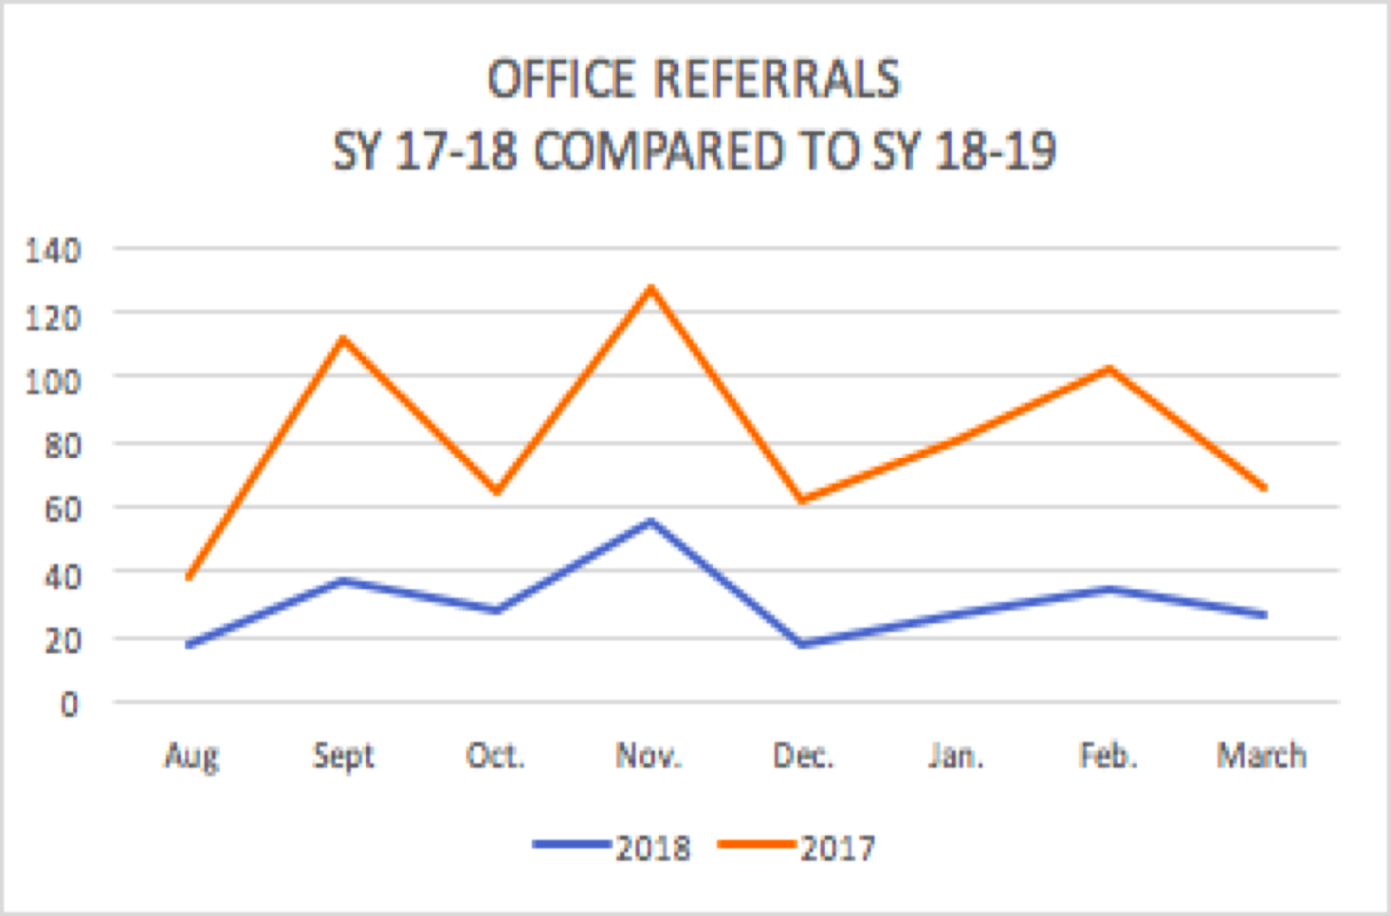
Impact on Office Referrals: 30% decrease

Slide 9
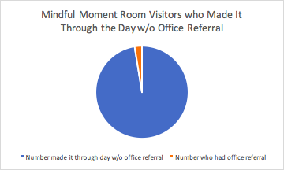
98% successful

Slide 10
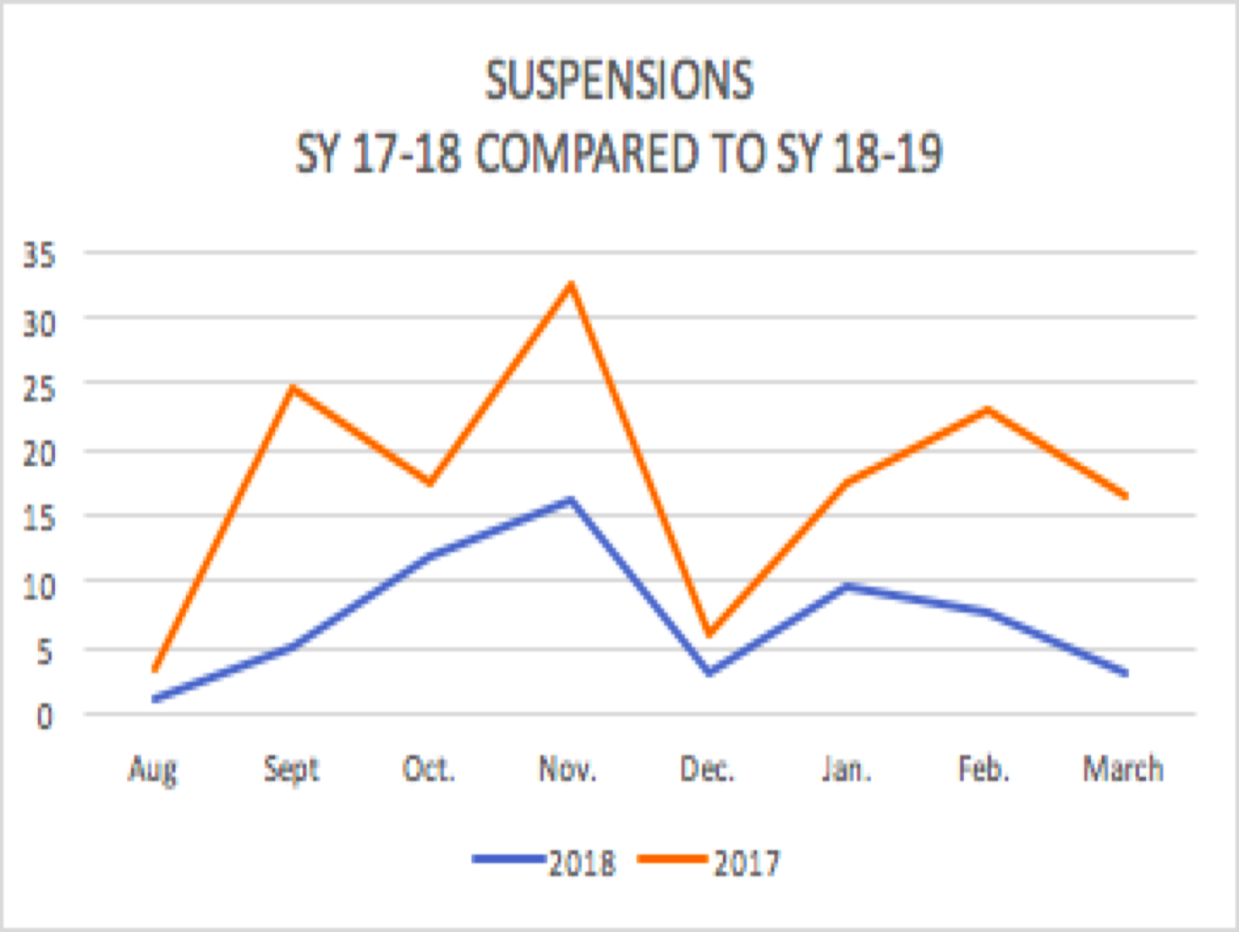
Impact on Suspensions: 51% decrease

Slide 11
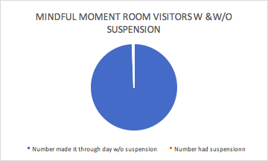
99.5% successful

Slide 12
Assistant Principal Perspective
How has the Mindful Moment Room impacted how you approach discipline with students?
How has the Mindful Moment Room impacted the follow-up discussions that you have had with parents about discipline?

Slide 13
Assistant Principal Perspective
What has been the impact of the Mindful Moment Room on school climate?

Slide 14
Data to Collect
Number of visits per month
Number of visits per day of week
Number of visits by time of day
Frequent flyers to MMR
Number of MMR referrals by teacher
Who worked with students in MMR
Number of times MMR not available

Slide 15
Data to Collect
Percent of MMR visitors who were successful rest of day (no office referrals or suspension)
Compare office referrals/suspensions year-to-year

Slide 16
Using Data
Look at heavy-hitters for discipline referrals. What supports are in place/what more do they need?
Identify teachers who need to use MMR more by those who refer for discipline more frequently.
Look for patterns in MMR usage per day of week, time of day, and teacher referral.
Then make interventions based on this data.

Slide 17

Children learn to regulate themselves through
co-regulation with a trusted adult.
Photo by Jordan Whitt on Unsplash

Slide 18
Resource Page
Desautels, L. (2016, January 07). Brains in Pain Cannot Learn! Retrieved from https://www.edutopia.org/blog/brains-in-pain-cannot-learn-lori-desautels
Desautels, L. (2019, October 15). The Role of Emotion Co-Regulation in Discipline. Retrieved November 25, 2020, from https://www.edutopia.org/article/role-emotion-co-regulation-discipline
Forbes, H. T. (2013). Help for Billy: A Beyond Consequences Approach to Helping Children in the Classroom. Cork: BookBaby

Slide 19
Resource Page
Holistic Life Foundation. https://hlfinc.org
Siegel, D. J., & Bryson, T. P. (2012). The whole-brain child. London: Constable & Robinson.
Soma, C., & Allen, D. (2018). 10 steps to create a trauma informed school. Albion, MI: The Institute for Trauma and Loss in Children, a program of Starr Global learning Network.

Slide 20




Trudi Wolfe, Jina Hackman, Chelsea Nullier, and Melissa Romo
Central Elementary, Beech Grove
twolfe@bgcs.k12.in.us
jhackman@bgcs.k12.in.us
cnullier@bgcs.k12.in.us
mromo@bgcs.k12.in.us

